Slide 2
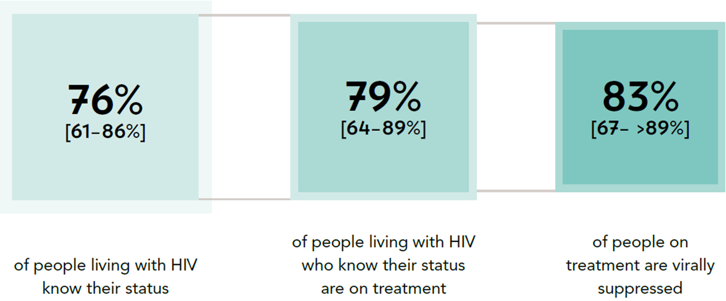
PROGRESS TOWARDS THE 90–90–90 TARGETS
Progress towards the 90–90–90 treatment target, eastern and southern Africa, 2016
Source: UNAIDS special analysis, 2017; see annex on methods for more details

Slide 3
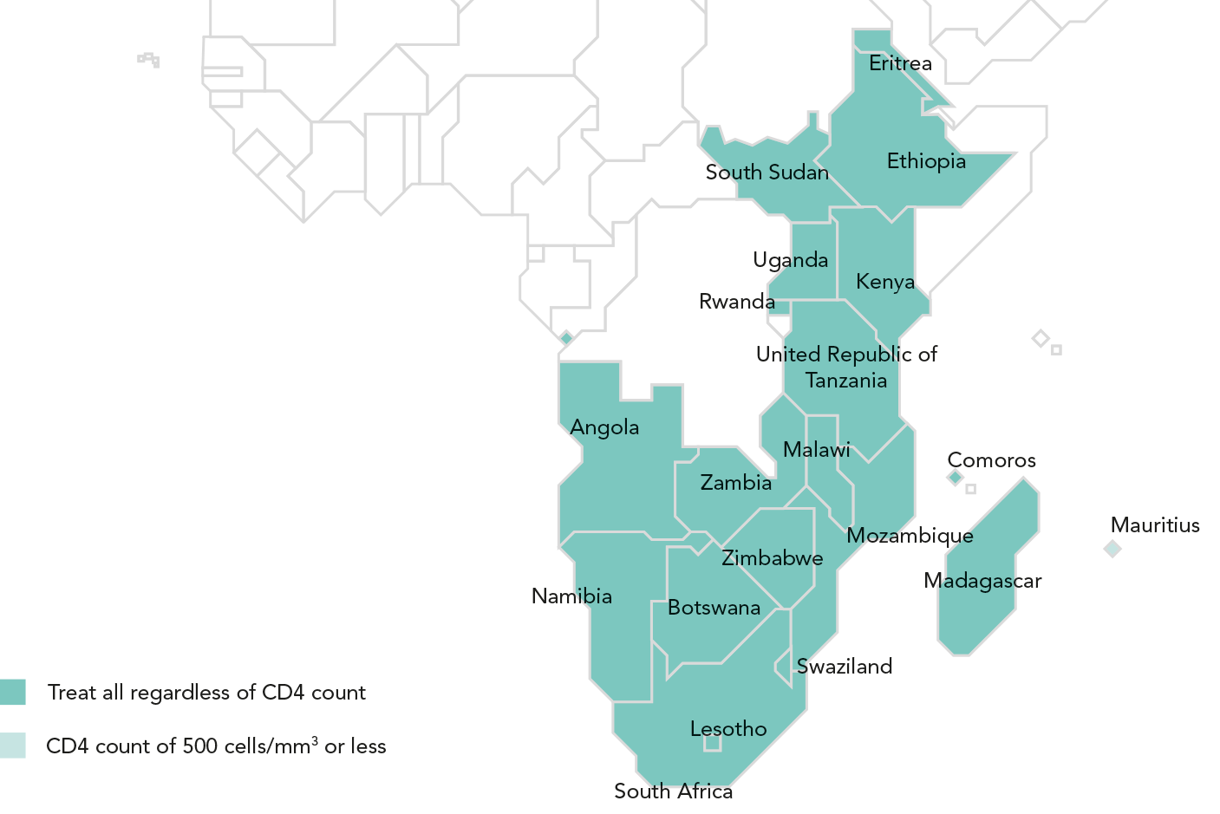
ADOPTING A TREAT ALL APPROACH
Recommended antiretroviral therapy initiation threshold among people living with HIV per Ministry of Health guidelines, by country, eastern and southern Africa, 2016
Twenty of 21 countries in eastern and southern Africa have adopted the World Health Organization recommendation that antiretroviral therapy
should be initiated in every person living with HIV at any CD4 cell count. Eleven countries are already implementing their treat all policies nationally.
Source: World Health Organization, 2017.

Slide 4
AIDS-RELATED DEATHS NEARLY CUT IN HALF IN SIX YEARS
Antiretroviral therapy coverage and number of AIDS-related deaths, eastern and southern Africa, 2000–2016
Antiretroviral therapy scale-up has been largely responsible for a steep decline in AIDS-related mortality in eastern and southern Africa: the estimated
420 000 [350 000–510 000] AIDS-related deaths in 2016 were 42% fewer than in 2010. The drop in deaths due to AIDS-related illnesses has been even
greater among children (aged 0–14 years), declining from an estimated 130 000 [99 000–150 000] in 2010 to 58 000 [41 000–80 000] in 2016.
AIDS-related illness remains a leading cause of death in the region, however, especially among young women and girls aged 15–24 years (1).
Source: 2017 Global AIDS Monitoring. UNAIDS 2017 estimates.

Slide 5
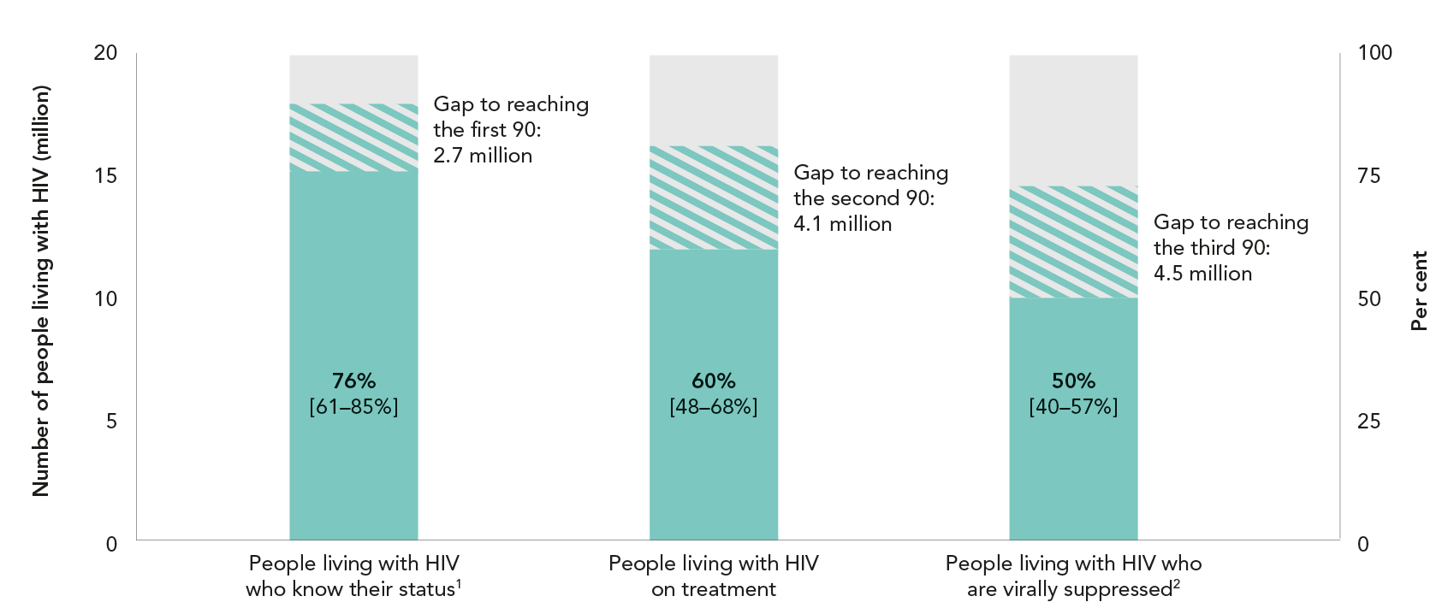
HIV TESTING AND TREATMENT CASCADE IN EASTERN
AND SOUTHERN AFRICA
Knowledge of HIV status, antiretroviral therapy coverage and viral suppression among people living with HIV, eastern and southern Africa, 2016
Source: UNAIDS special analysis, 2017; see annex on methods for more details.
¹ 2016 measure derived from data reported by 17 countries, which accounted for 99% of people living with HIV in western and central Africa.
² 2016 measure derived from data reported by 11 countries. Regionally, 37% of all people on antiretroviral therapy were reported to have received a
viral load test during the reporting period.

Slide 6
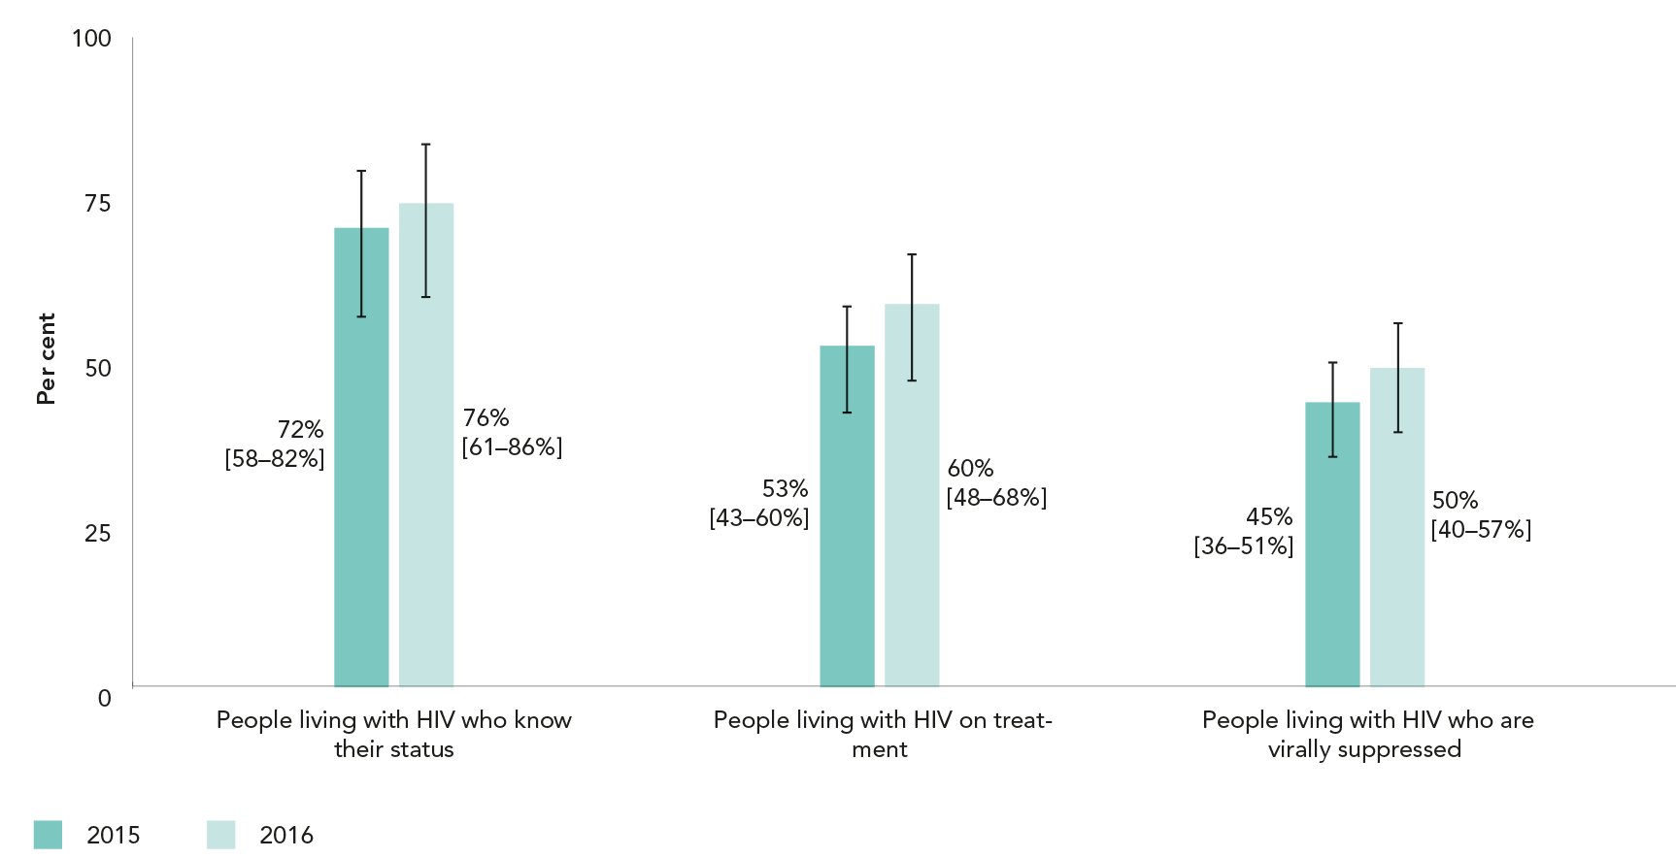
GAINS ACROSS THE TREATMENT CASCADE
Knowledge of HIV status, antiretroviral therapy coverage and viral suppression among people living with HIV, eastern and southern Africa, 2015 and 2016
Source: UNAIDS special analysis, 2017; see annex on methods for more details.

Slide 7
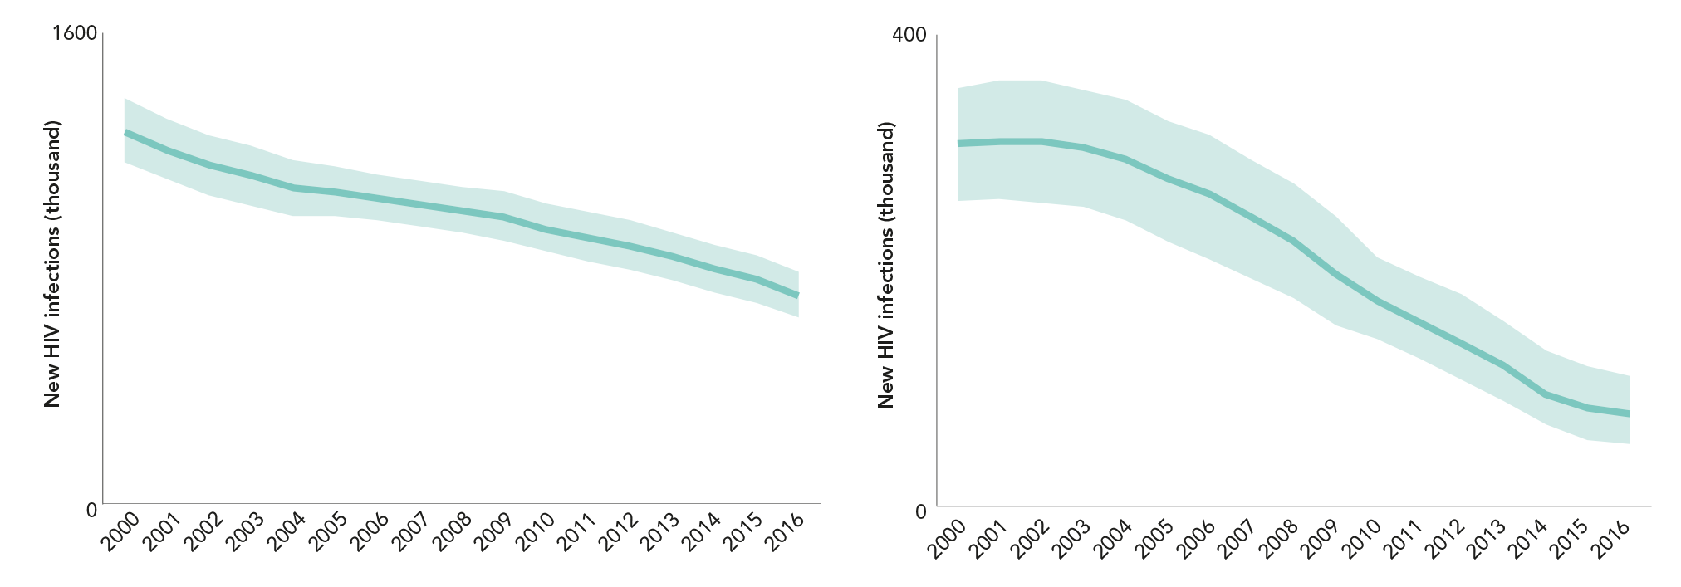
HIV INFECTIONS IN WORLD’S MOST AFFECTED REGION DECLINED BY NEARLY A THIRD (first of 2 slides)
Number of new HIV infections,
adults (aged 15 years and older),
eastern and southern Africa, 2000–2016
Number of new HIV infections,
children (aged 0–14 years),
eastern and southern Africa, 2000–2016
Source: UNAIDS 2017 estimates.
Source: UNAIDS 2017 estimates.

Slide 8
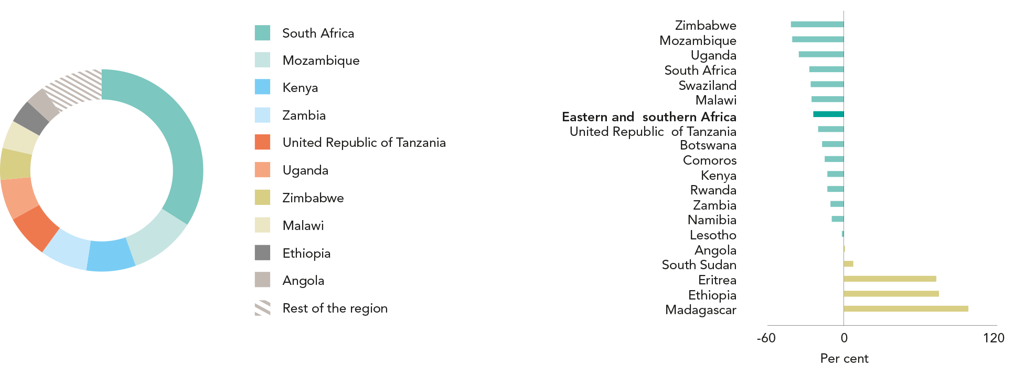
HIV INFECTIONS IN WORLD’S MOST AFFECTED REGION DECLINED BY NEARLY A THIRD (last of 2 slides)
Distribution of new HIV infections, by country, eastern and
southern Africa, 2016
Percent change in new HIV infections, by country, eastern and southern Africa, from 2010 to 20166
Source: UNAIDS 2017 estimates.
Source: UNAIDS 2017 estimates.

Slide 9
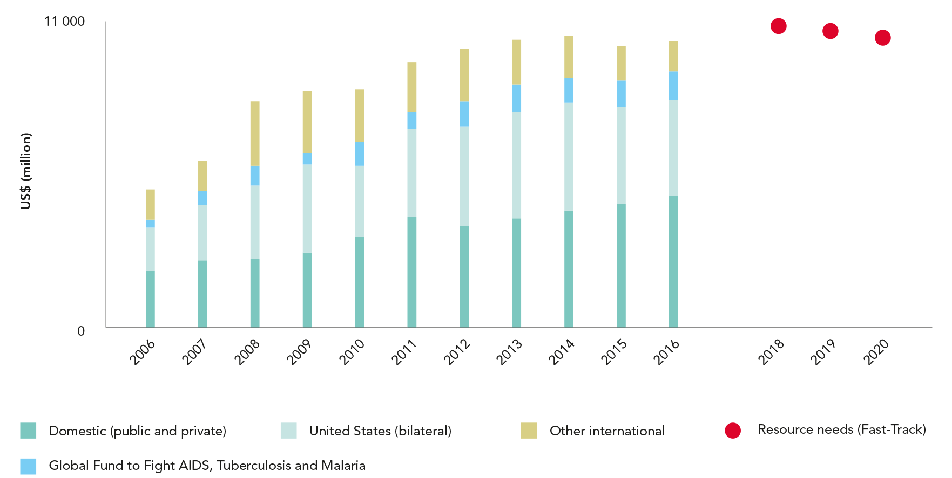
RESOURCE AVAILABILITY IS NEAR FAST-TRACK LEVELS
HIV resource availability by source, 2006–2016, and projected resource needs
by 2020, eastern and southern Africa*
Source: UNAIDS estimates on HIV resource availability, June 2017. Fast-Track update on investments needed in the AIDS response, 2016–2030. Geneva: UNAIDS; 2016. Financing the
response to low- and middle-income countries: international assistance from donor governments in 2016. The Henry J. Kaiser Family Foundation and UNAIDS (in press). GAM/GARPR
reports (2005–2017). Philanthropic support to address HIV/AIDS in 2015. Washington, DC: Funders Concerned about AIDS; 2016.
*Estimates for low- and middle-income countries per 2015 World Bank income level classification. All figures are expressed in constant 2016 US dollars.

Slide 10
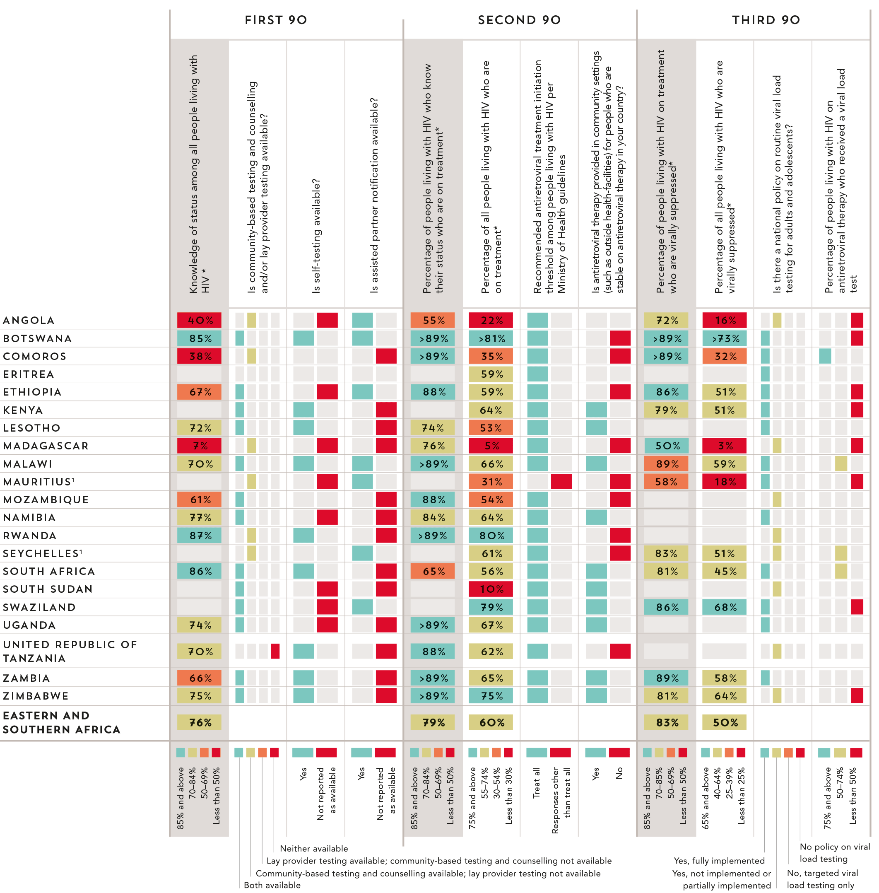
90–90–90 COUNTRY
SCORECARDS
Eastern and southern
Africa
Source: UNAIDS special analysis, 2017. 2017 Global AIDS Monitoring. UNAIDS 2017 estimates. 2017 National Commitments and Policy Instrument. European Centres for Disease Control and Prevention Continuum of HIV care 2017 progress report.
* The complete set of 90–90–90 measures and testing and treatment cascade data for countries can be found at aidsinfo.unaids.org.
¹ Estimates of people living with HIV that inform progress towards 90–90–90 are country-supplied and have not been validated by UNAIDS.

Slide 12
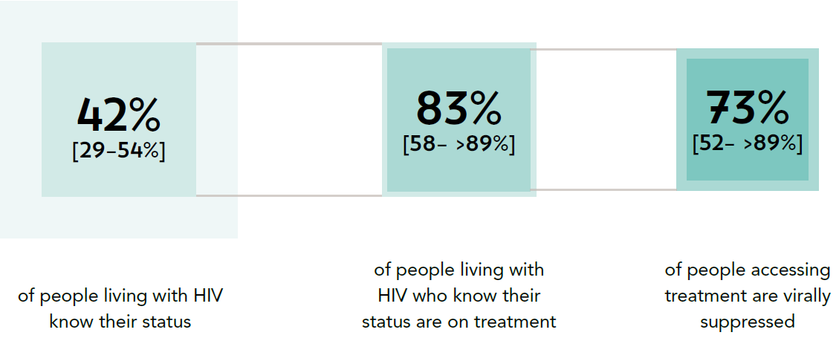
PROGRESS TOWARDS THE 90–90–90 TARGETS
Progress towards the 90–90–90 treatment target, western and central Africa, 2016
Source: UNAIDS special analysis, 2017; see annex on methods for more details

Slide 13
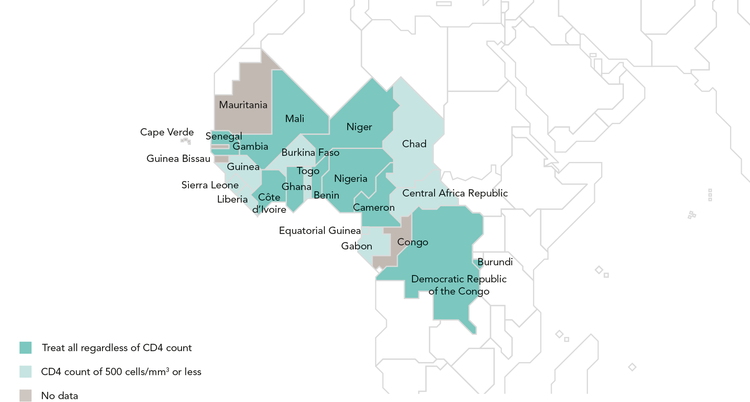
ADOPTING A TREAT ALL APPROACH
Recommended antiretroviral therapy initiation threshold among people living with HIV per Ministry of Health guidelines, by country, western and central Africa, 2016
Ten of 24 countries in western and central Africa have adopted the World Health Organization recommendation that antiretroviral therapy should
be initiated in every person living with HIV at any CD4 cell count.
Source: World Health Organization, 2017.

Slide 14
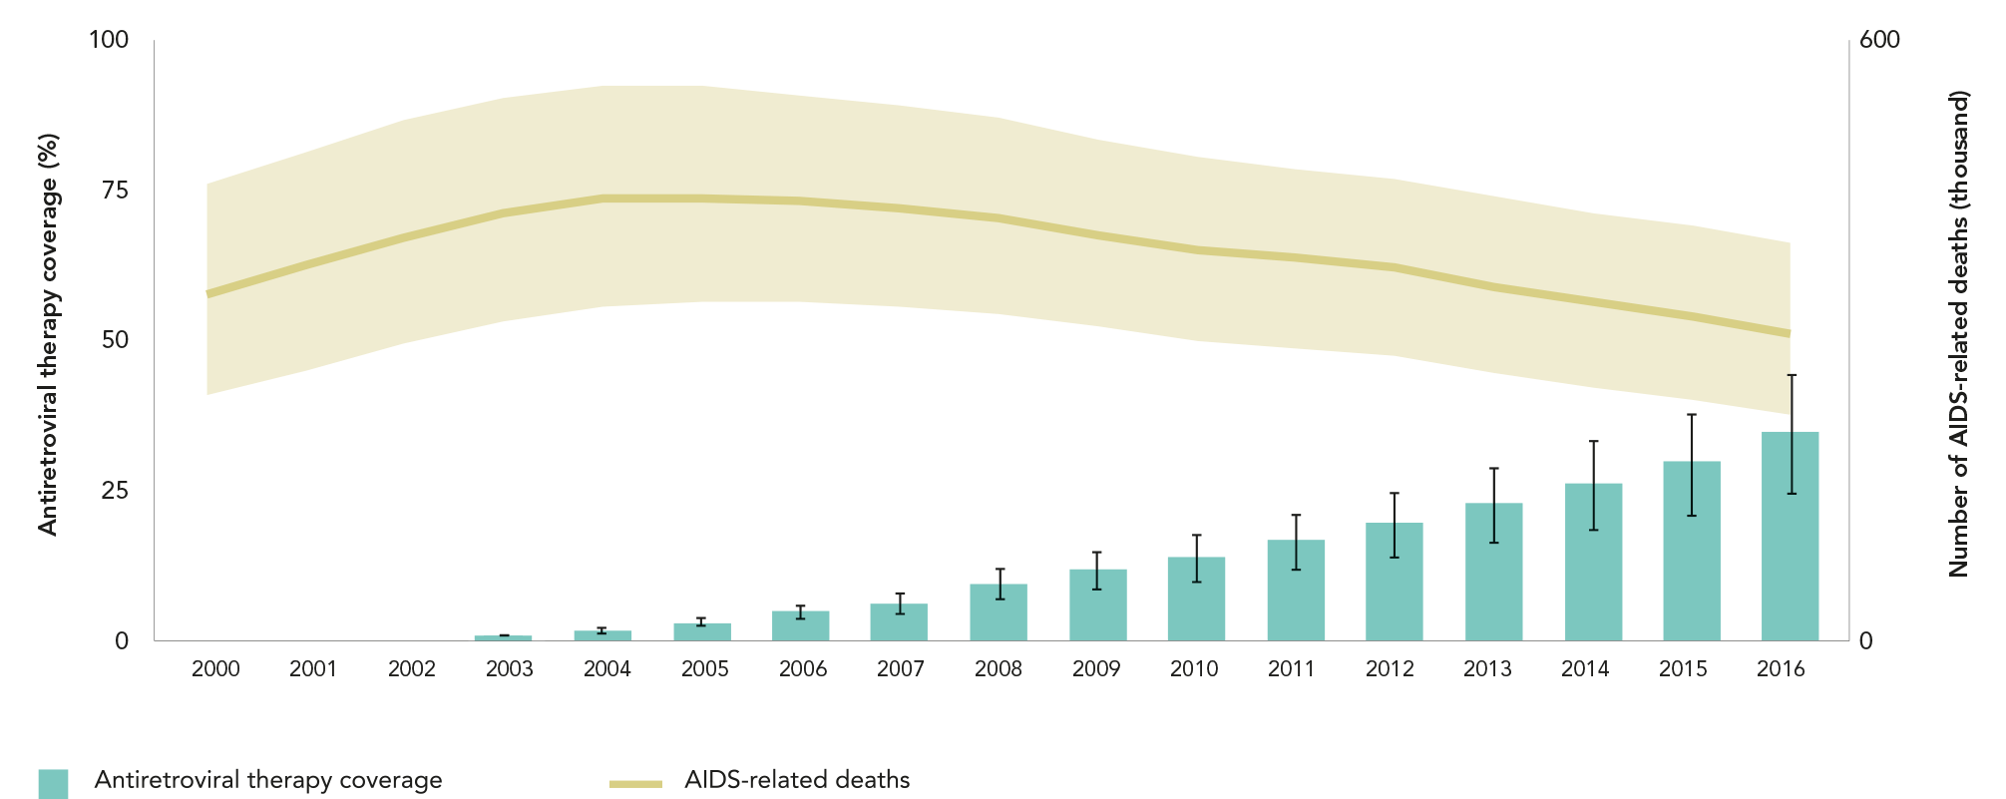
AIDS-RELATED DEATHS REMAIN HIGH IN REGION
Antiretroviral therapy coverage and number of AIDS-related deaths, western and central Africa, 2000–2016
The comparatively slow expansion of HIV treatment services has held back the reduction of AIDS-related deaths in western and central Africa.
The epidemic claimed the lives of an estimated 310 000 [220 000–400 000] adults and children in 2016, 21% fewer than the estimated
390 000 [300 000–480 000] who died due to AIDS-related causes in 2010.
Source: 2017 Global AIDS Monitoring. UNAIDS 2017 estimates.

Slide 15
HIV TESTING AND TREATMENT CASCADE IN western
and central AFRICA
Knowledge of HIV status, antiretroviral therapy coverage and viral
suppression among people living with HIV, western and central Africa, 2016
Source: UNAIDS special analysis, 2017; see annex on methods for more details.
¹ 2016 measure derived from data reported by 13 countries, which accounted for 88% of people living with HIV in the region.
² 2016 measure derived from data reported by 14 countries. Regionally, 13% of all people on antiretroviral therapy were reported to have received a
viral load test during the reporting period.

Slide 16
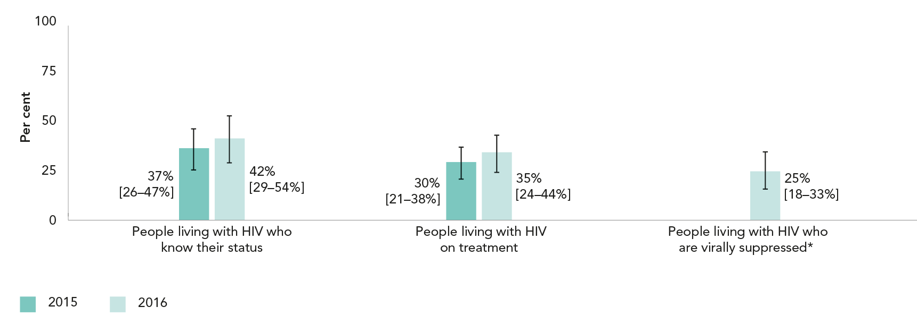
GAINS ACROSS THE TREATMENT CASCADE
Knowledge of HIV status, antiretroviral therapy coverage and viral suppression among people living with HIV, western and central Africa, 2015 and 2016
Source: UNAIDS special analysis, 2017; see annex on methods for more details.
*Insufficient data available for a 2015 estimate.

Slide 17
HIV INFECTIONS AMONG CHILDREN DECLINED BY A THIRD;
ADULTS REMAINED STABLE (first of 2 slides)
Number of new HIV infections,
adults (aged 15 years and older),
western and central Africa, 2000–2016
Number of new HIV infections,
children (aged 0–14 years),
western and central Africa, 2000–2016
Source: UNAIDS 2017 estimates.
Source: UNAIDS 2017 estimates.

Slide 18
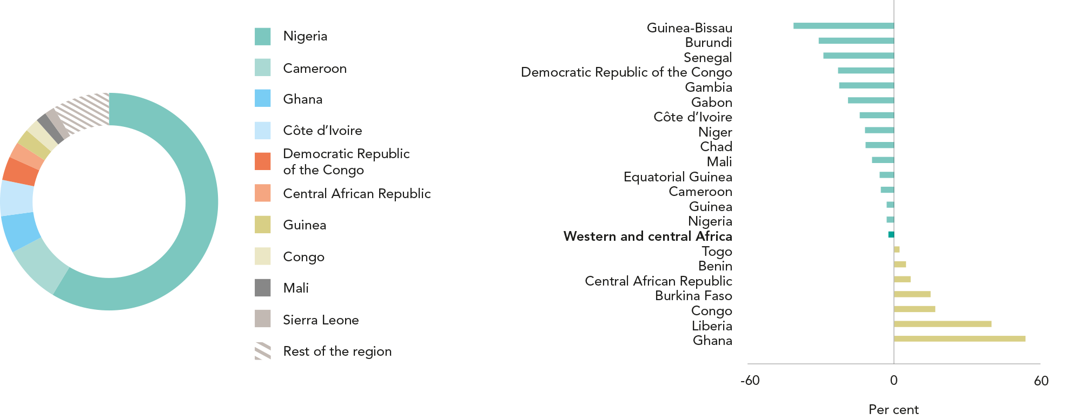
HIV INFECTIONS AMONG CHILDREN DECLINED BY A THIRD;
ADULTS REMAINED STABLE (last of 2 slides)
Distribution of new HIV infections, by country, western and
central Africa, 2016
Percent change in new HIV infections, by country, western and central Africa, from 2010 to 20166
Source: UNAIDS 2017 estimates.
Source: UNAIDS 2017 estimates.

Slide 19
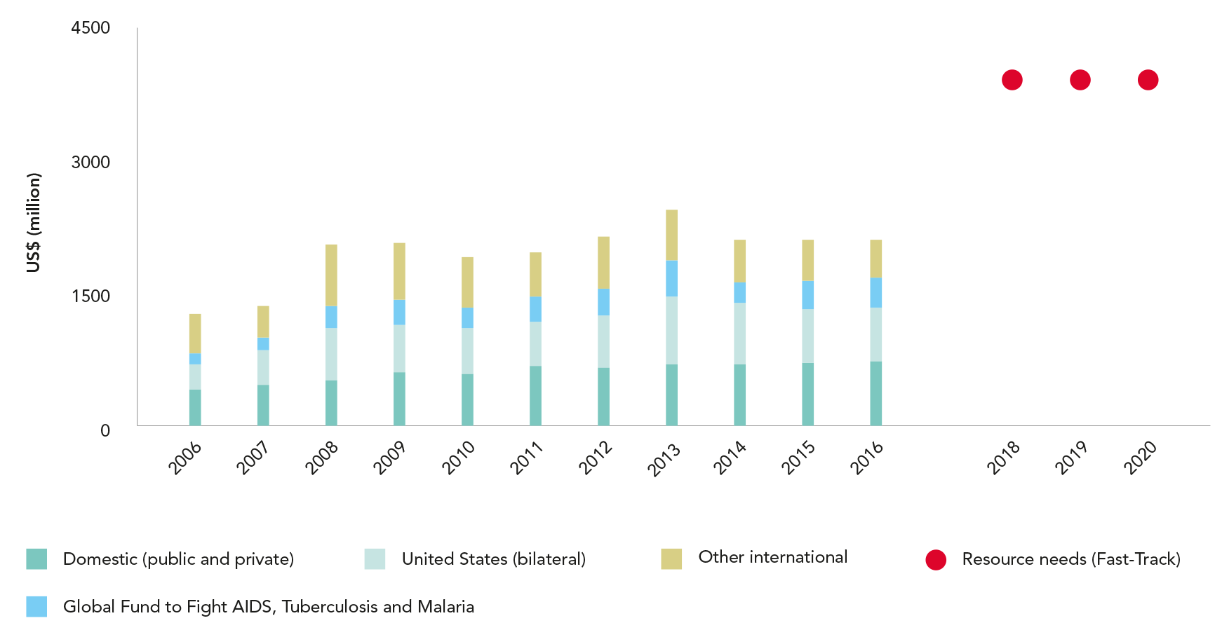
SUBSTANTIAL FINANCING GAP IN WESTERN AND CENTRAL AFRICA
HIV resource availability by source, 2006–2016, and projected resource needs
by 2020, western and central Africa*
Source: UNAIDS estimates on HIV resource availability, June 2017. Fast-Track update on investments needed in the AIDS response, 2016–2030. Geneva: UNAIDS; 2016. Financing the
response to low- and middle-income countries: international assistance from donor governments in 2016. The Henry J. Kaiser Family Foundation and UNAIDS (in press). GAM/GARPR
reports (2005–2017). Philanthropic support to address HIV/AIDS in 2015. Washington, DC: Funders Concerned about AIDS; 2016.
*Estimates for low- and middle-income countries per 2015 World Bank income level classification. All figures are expressed in constant 2016 US dollars.

Slide 20
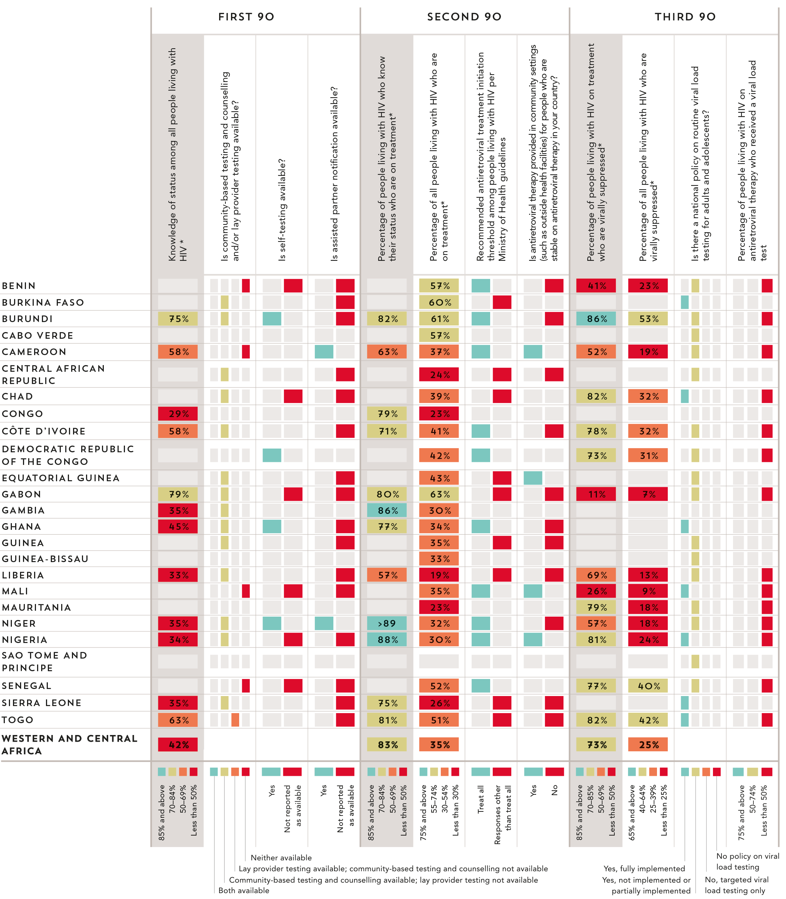
90–90–90 COUNTRY
SCORECARDS
WEstern and central
Africa
Source: UNAIDS special analysis, 2017. 2017 Global AIDS Monitoring. UNAIDS 2017 estimates. 2017 National Commitments and Policy Instrument.
* The complete set of 90–90–90 measures and testing and treatment cascade data for countries can be found at aidsinfo.unaids.org.

Slide 22
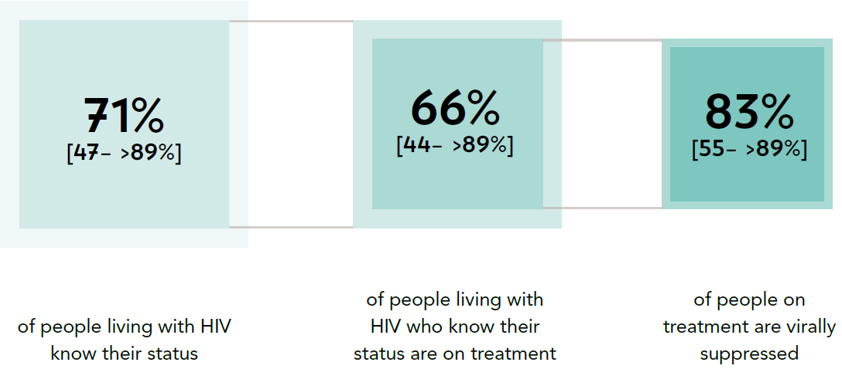
PROGRESS TOWARDS THE 90–90–90 TARGETS
Progress towards the 90–90–90 treatment target, Asia and the Pacific, 2016
Source: UNAIDS special analysis, 2017; see annex on methods for more details

Slide 23
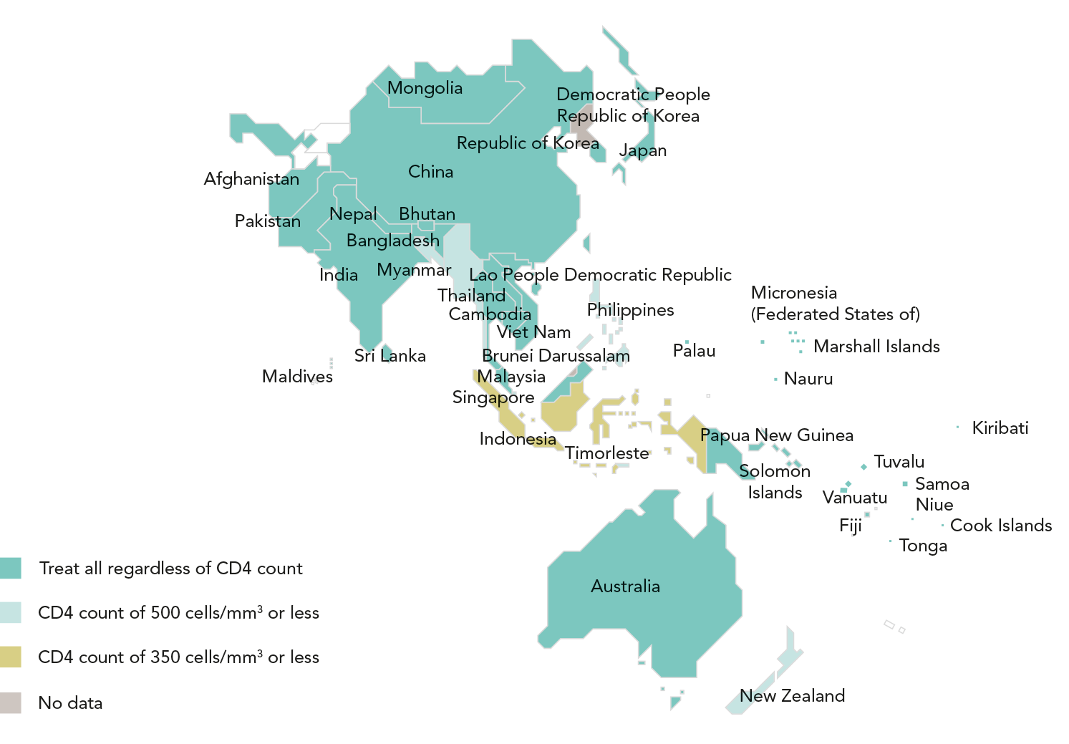
ADOPTING A TREAT ALL APPROACH
Recommended antiretroviral therapy initiation threshold among people living
with HIV per Ministry of Health guidelines, by country, Asia and the Pacific, 2016
Thirty countries in Asia and the Pacific have adopted the World Health Organization recommendation that antiretroviral therapy should be initiated
in every person living with HIV at any CD4 cell count. Treat all policies are being implemented nationally in 25 countries, including Afghanistan,
Australia, Bhutan, Cambodia, China, Cook Islands, Fiji, India, Japan, Kiribati, Lao People’s Democratic Republic, Malaysia, Mongolia, Nauru,
Nepal, Niue, Palau, Republic of Korea, Samoa, Solomon Islands, Sri Lanka, Thailand, Tonga, Viet Nam and Vanuatu.
Source: World Health Organization, 2017.

Slide 24
ONE-THIRD REDUCTION IN AIDS-RELATED DEATHS
Antiretroviral therapy coverage and number of AIDS-related deaths, Asia and the Pacific, 2000–2016
The wider availability of antiretroviral therapy has led to a nearly one-third reduction in deaths from AIDS-related illnesses in the region,
down from an estimated 240 000 [190 000–300 000] in 2010 to 170 000 [130 000–220 000] in 2016. AIDS-related deaths fell by an estimated
52% in Myanmar, while AIDS-related deaths in Indonesia increased by 68% and in Pakistan by 319%.
Source: 2017 Global AIDS Monitoring. UNAIDS 2017 estimates.

Slide 25
HIV TESTING AND TREATMENT CASCADE IN ASIA AND THE PACIFIC
Knowledge of HIV status, antiretroviral therapy coverage and viral
suppression among people living with HIV, Asia and the Pacific, 2016
Source: UNAIDS special analysis, 2017; see annex on methods for more details.

Slide 26
GAINS ACROSS THE TREATMENT CASCADE
Knowledge of HIV status, antiretroviral therapy coverage and viral suppression among people living with HIV, Asia and the Pacific, 2015 and 2016
Source: UNAIDS special analysis, 2017; see annex on methods for more details.

Slide 27
OVERALL DECLINES IN NEW HIV INFECTIONS HIDES A VARIETY
OF COUNTRY TRENDS (first of 2 slides)
Number of new HIV infections,
adults (aged 15 years and older),
Asia and the Pacific, 2000–2016
Number of new HIV infections,
children (aged 0–14 years),
Asia and the Pacific, 2000–2016
Source: UNAIDS 2017 estimates.
Source: UNAIDS 2017 estimates.

Slide 28
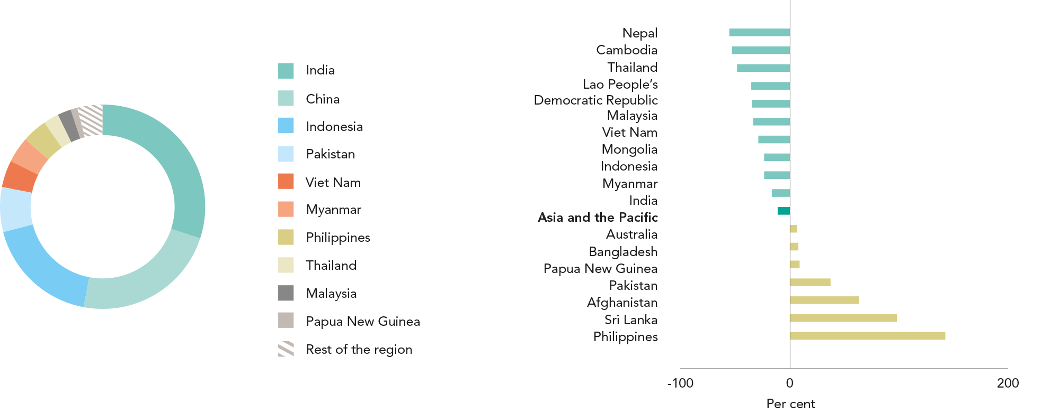
OVERALL DECLINES IN NEW HIV INFECTIONS HIDES A VARIETY
OF COUNTRY TRENDS (last of 2 slides)
Distribution of new HIV infections, by country, Asia and the Pacific, 2016
Percent change in new HIV infections, by country, Asia and the Pacific, from 2010 to 2016
Source: UNAIDS 2017 estimates.
Source: UNAIDS 2017 estimates.

Slide 29
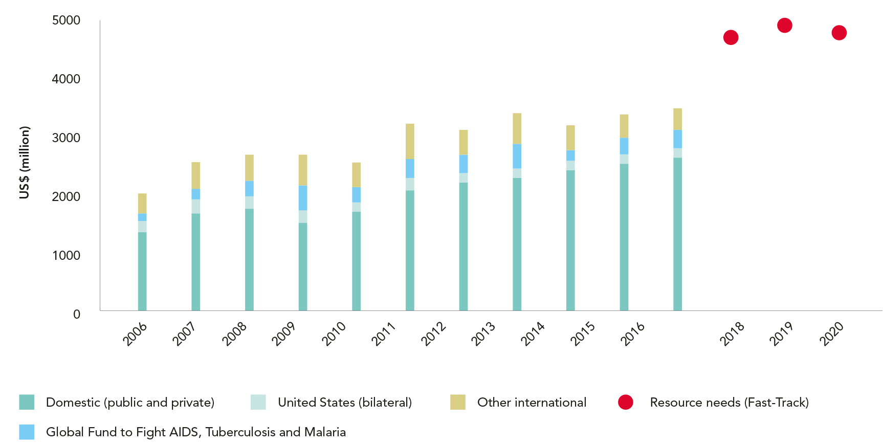
DOMESTIC RESOURCES FOR HIV HAVE DOUBLED IN A DECADE
HIV resource availability by source, 2006–2016, and projected resource needs
by 2020, Asia and the Pacific*
Source: UNAIDS estimates on HIV resource availability, June 2017. Fast-Track update on investments needed in the AIDS response, 2016–2030. Geneva: UNAIDS; 2016. Financing the
response to low- and middle-income countries: international assistance from donor governments in 2016. The Henry J. Kaiser Family Foundation and UNAIDS (in press). GAM/GARPR
reports (2005–2017). Philanthropic support to address HIV/AIDS in 2015. Washington, DC: Funders Concerned about AIDS; 2016. Shan D, Sun J, Yakusik A, et al. “Total HIV/AIDS Expenditures
in Dehong Prefecture, Yunnan Province in 2010: The First Systematic Evaluation of Both Health and Non-Health Related HIV/AIDS Expenditures in China”. PLoS ONE 8(6): e68006.
https://doi.org/10.1371/journal.pone.0068006.
*Estimates for low- and middle-income countries per 2015 World Bank income level classification. All figures are expressed in constant 2016 US dollars.

Slide 30
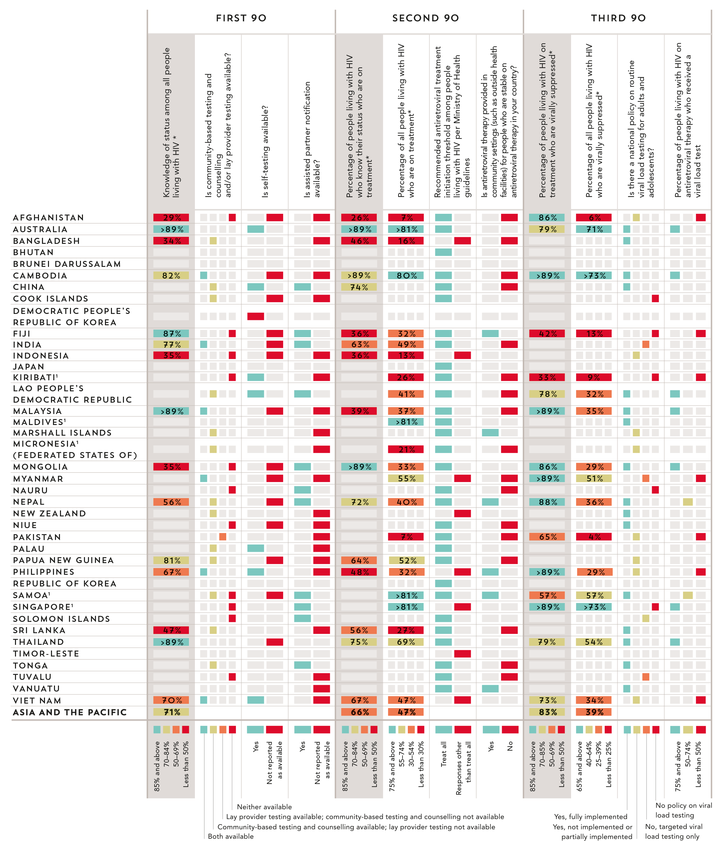
90–90–90 COUNTRY
SCORECARDS
Asia and the Pacific
Source: UNAIDS special analysis, 2017. 2017 Global AIDS Monitoring. UNAIDS 2017 estimates. 2017 National Commitments and Policy Instrument.
* The complete set of 90–90–90 measures and testing and treatment cascade data for countries can be found at aidsinfo.unaids.org.
¹ Estimates of people living with HIV that inform progress towards 90–90–90 are country-supplied and have not been validated by UNAIDS.

Slide 32
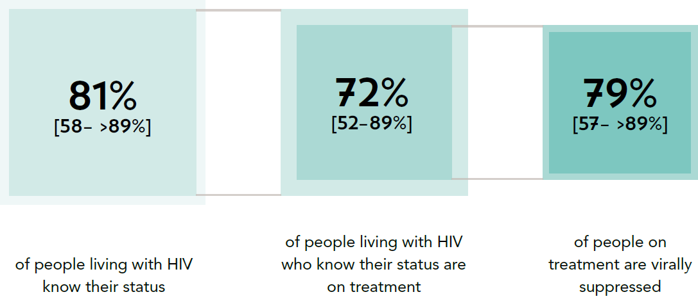
PROGRESS TOWARDS THE 90–90–90 TARGETS
Progress towards the 90–90–90 treatment target, Latin America, 2016
Source: UNAIDS special analysis, 2017; see annex on methods for more details

Slide 33
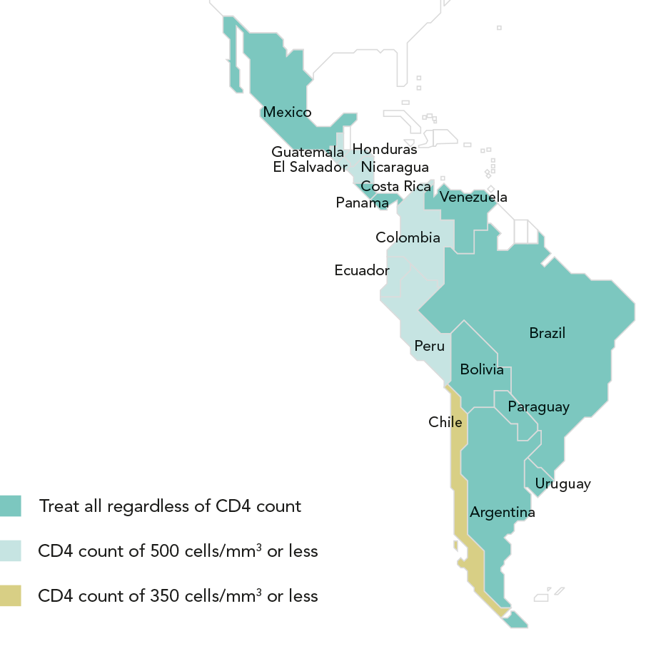
ADOPTING A TREAT ALL APPROACH
Recommended antiretroviral therapy initiation threshold among people living
with HIV per Ministry of Health guidelines, by country, Latin America, 2016
Argentina, Bolivia (Plurinational State of), Brazil, Costa Rica, Mexico, Paraguay, Uruguay and Venezuela (Bolivarian Republic of) have adopted
the World Health Organization recommendation that antiretroviral therapy should be initiated in every person living with HIV at any CD4 cell count.
Source: World Health Organization, 2017.

Slide 34
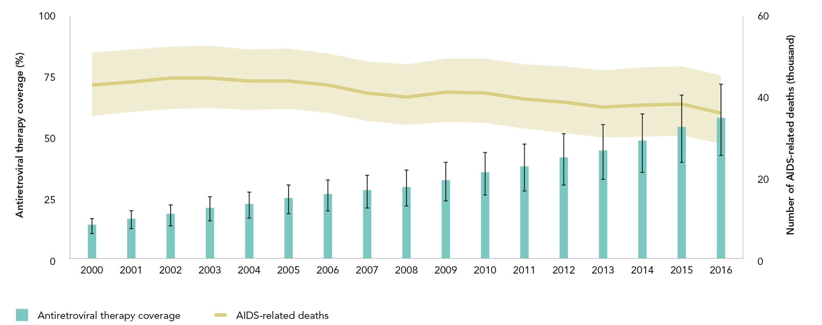
AIDS-RELATED DEATHS DECLINING IN LATIN AMERICA
DESPITE WORRYING INCREASES IN SOME COUNTRIES
Antiretroviral therapy coverage and number of AIDS-related deaths, Latin America, 2000–2016
Relatively high and rising HIV treatment coverage has played a primary role in reducing AIDS-related mortality by about 12%, from an estimated
43 000 [35 000–51 000] in 2000 to 36 000 [28 000–45 000] in 2016. The bulk of the decline was achieved in Peru, Honduras and Colombia, where
AIDS-related deaths declined by 62%, 58% and 45%, respectively. AIDS-related death rates were still rising in a number of countries, notably
Guatemala and Paraguay.
Source: 2017 Global AIDS Monitoring. UNAIDS 2017 estimates.

Slide 35
HIV TESTING AND TREATMENT CASCADE IN LATIN AMERICA
Knowledge of HIV status, antiretroviral therapy coverage and viral
suppression among people living with HIV, Latin America, 2016
Source: UNAIDS special analysis, 2017; see annex on methods for more details.
¹ 2016 measure derived from data reported by 14 countries, which accounted for 87% of people living with HIV in Latin America.
² 2016 measure derived from data reported by 14 countries. Regionally, 87% of all people on antiretroviral therapy were reported to have received a
viral load test during the reporting period.

Slide 36
GAINS ACROSS THE TREATMENT CASCADE
Knowledge of HIV status, antiretroviral therapy coverage and viral suppression among people living with HIV, Latin America, 2015 and 2016
Source: UNAIDS special analysis, 2017; see annex on methods for more details.

Slide 37
STABLE REGIONAL TREND IN NEW INFECTIONS HIDES DIFFERENCES AMONG COUNTRIES (first of 2 slides)
Number of new HIV infections,
adults (aged 15 years and older),
Latin America, 2000–2016
Number of new HIV infections,
children (aged 0–14 years),
Latin America, 2000–2016
Source: UNAIDS 2017 estimates.
Source: UNAIDS 2017 estimates.

Slide 38
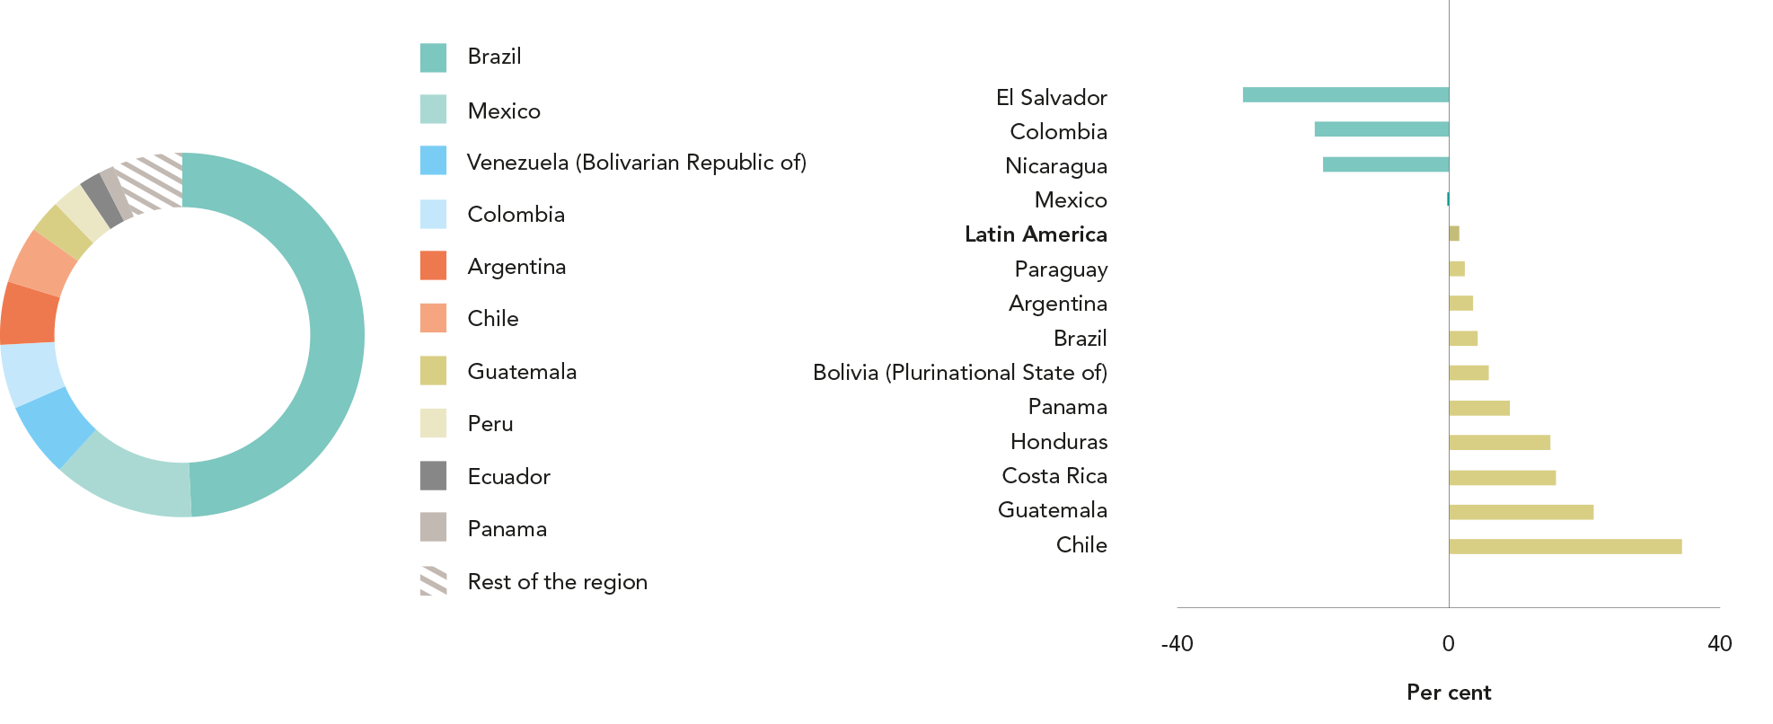
STABLE REGIONAL TREND IN NEW INFECTIONS HIDES DIFFERENCES AMONG COUNTRIES (last of 2 slides)
Distribution of new HIV infections, by country, Latin America, 2016
Percent change in new HIV infections, by country, Latin America, from 2010 to 2016
Source: UNAIDS 2017 estimates.
Source: UNAIDS 2017 estimates.

Slide 39
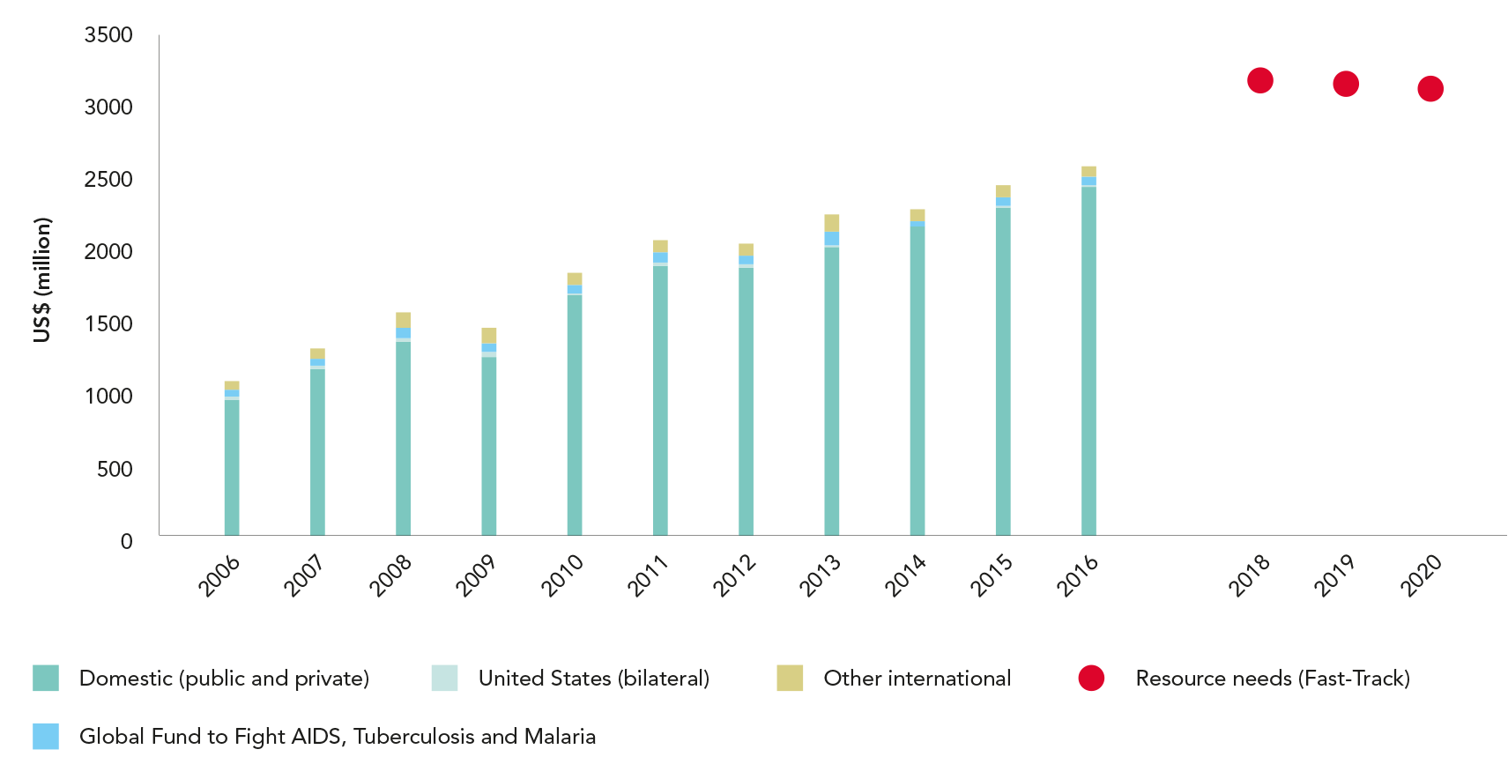
MORE RESOURCES NEEDED TO REACH FAST-TRACK TARGETS
HIV resource availability by source, 2006–2016, and projected resource needs
by 2020, Latin America*
Source: UNAIDS estimates on HIV resource availability, June 2017. Fast-Track update on investments needed in the AIDS response, 2016–2030. Geneva: UNAIDS; 2016. Financing the
response to low- and middle-income countries: international assistance from donor governments in 2016. The Henry J. Kaiser Family Foundation and UNAIDS (in press). GAM/GARPR
reports (2005–2017). Philanthropic support to address HIV/AIDS in 2015. Washington, DC: Funders Concerned about AIDS; 2016.
*Estimates for low- and middle-income countries per 2015 World Bank income level classification. All figures are expressed in constant 2016 US dollars.

Slide 40
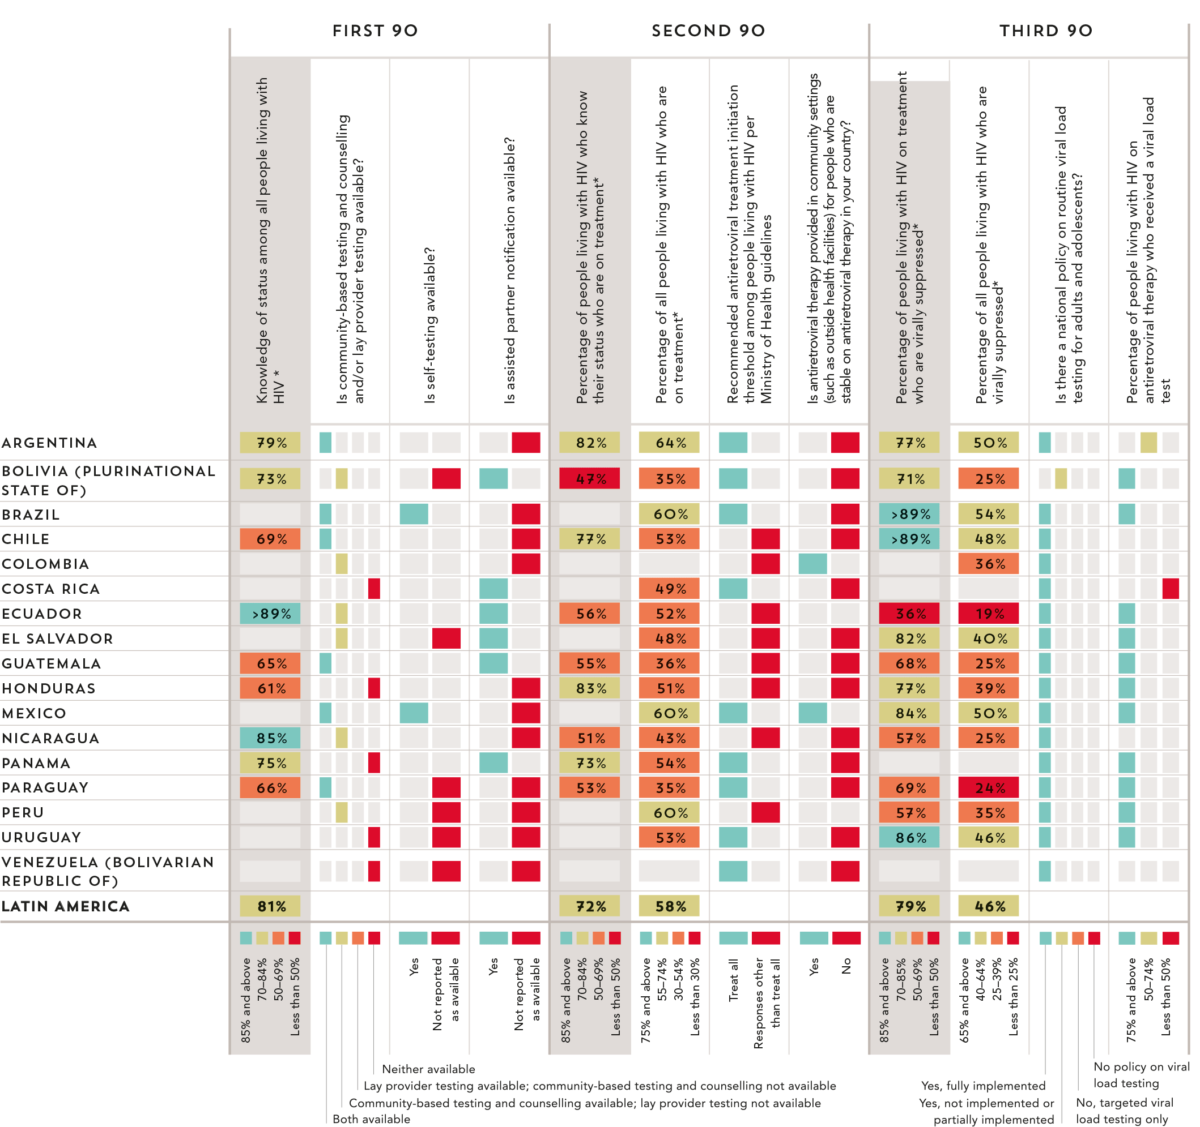
90–90–90 COUNTRY
SCORECARDS
LATIN AMERICA
Source: UNAIDS special analysis, 2017. 2017 Global AIDS Monitoring. UNAIDS 2017 estimates. 2017 National Commitments and Policy Instrument.
* The complete set of 90–90–90 measures and testing and treatment cascade data for countries can be found at aidsinfo.unaids.org.

Slide 42
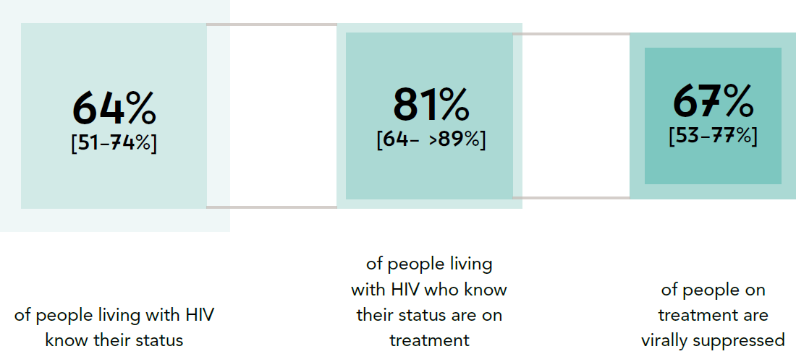
PROGRESS TOWARDS THE 90–90–90 TARGETS
Progress towards the 90–90–90 treatment target, CARIBBEAN, 2016
Source: UNAIDS special analysis, 2017; see annex on methods for more details

Slide 43
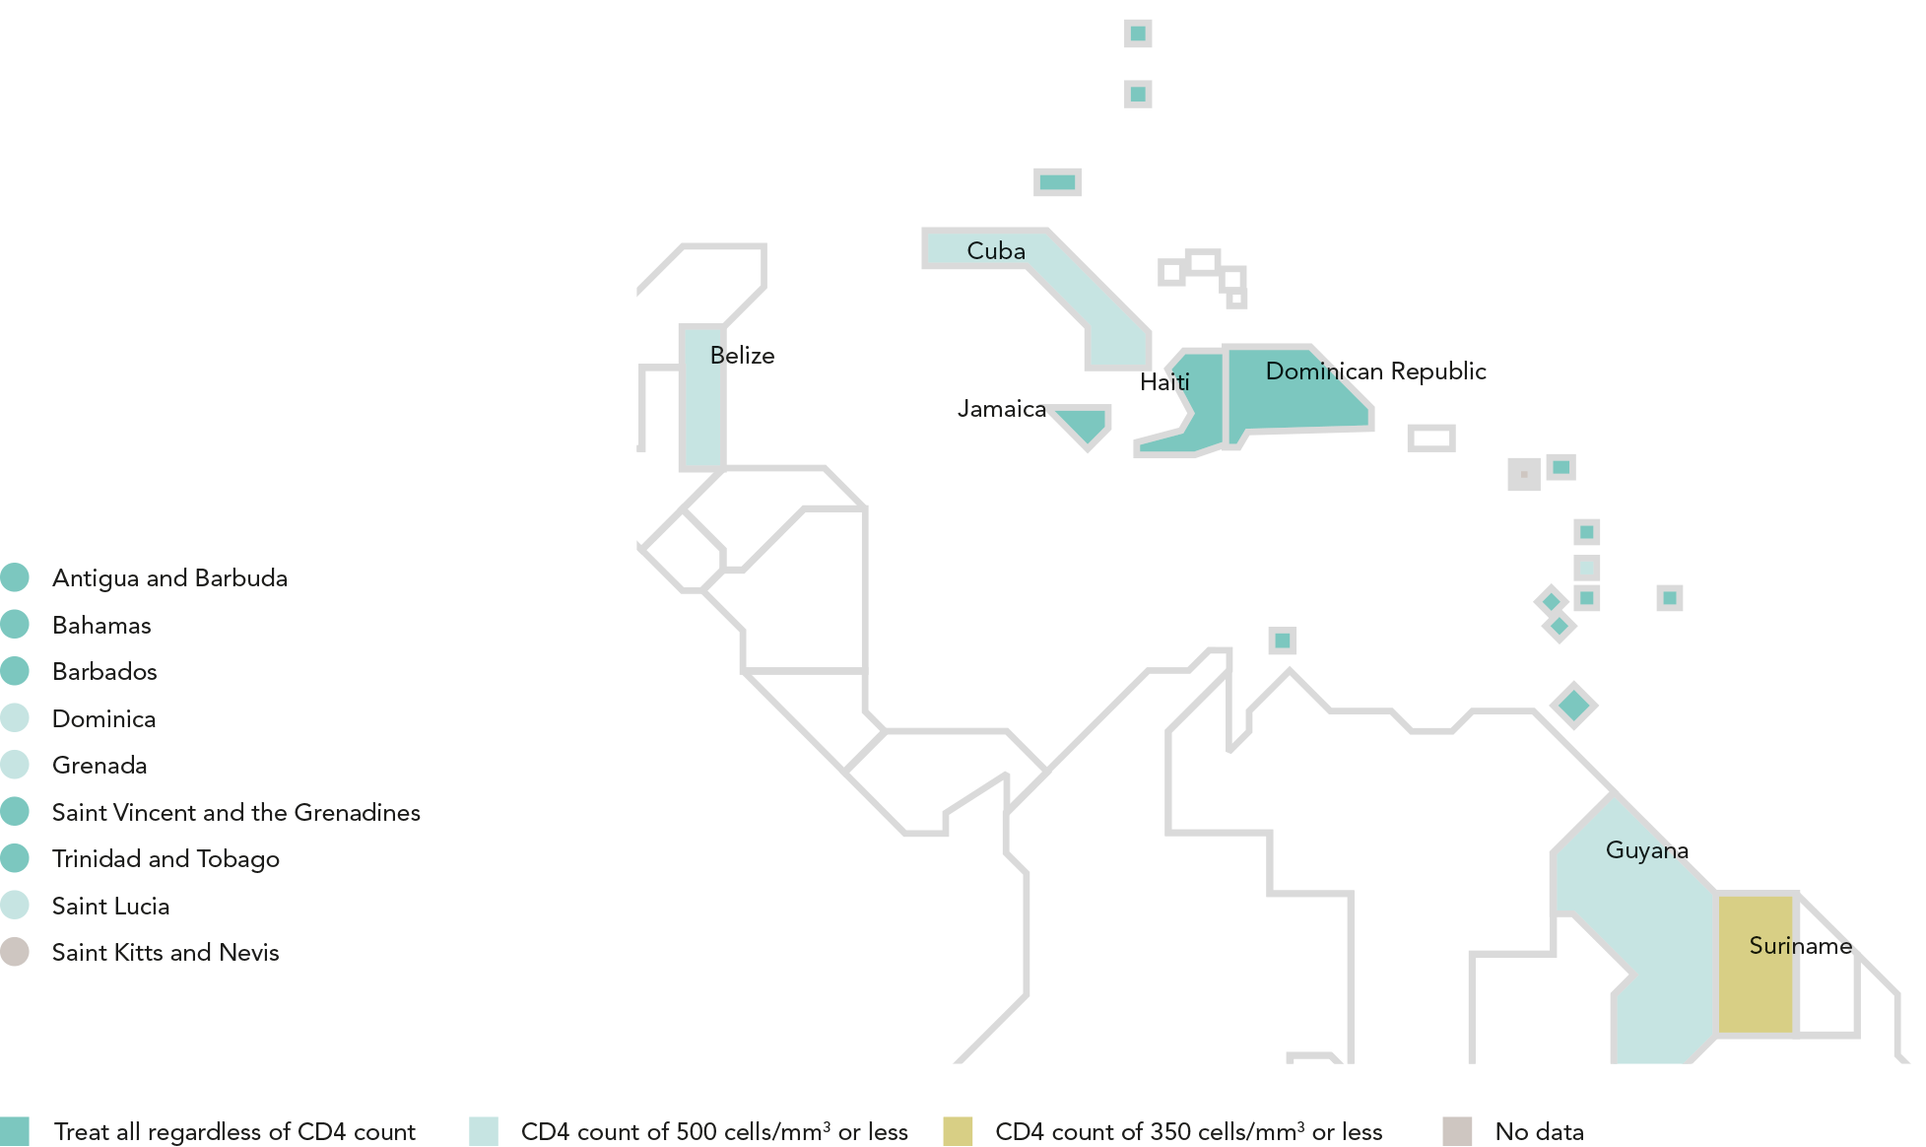
ADOPTING A TREAT ALL APPROACH
Recommended antiretroviral therapy initiation threshold among people living with HIV per Ministry of Health guidelines, by country, CARIBBEAN, 2016
Eight countries in the Caribbean have adopted the World Health Organization recommendation that antiretroviral therapy should be initiated in
every person living with HIV at any CD4 cell count. The majority of the other countries in the region start antiretroviral therapy for individuals
who have a CD4 count of under 500 cells/mm3. Countries receiving support from the Global Fund to Fight AIDS, Tuberculosis and Malaria (the
Global Fund) and the United States President’s Emergency Plan for AIDS Relief (PEPFAR) appear to be shifting more quickly to a treat all approach.
Source: World Health Organization, 2017.

Slide 44
AIDS-RELATED DEATHS DROP BELOW 10 000
Antiretroviral therapy coverage and number of AIDS-related deaths, Caribbean, 2000–2016
The number of people accessing antiretroviral therapy over the last six years has more than doubled, and this has played a primary role in the
reduction of AIDS-related deaths from an estimated 21 000 [16 000–26 000] in 2000 to an estimated 9400 [7300–12 000] in 2016.
Source: 2017 Global AIDS Monitoring. UNAIDS 2017 estimates.

Slide 45
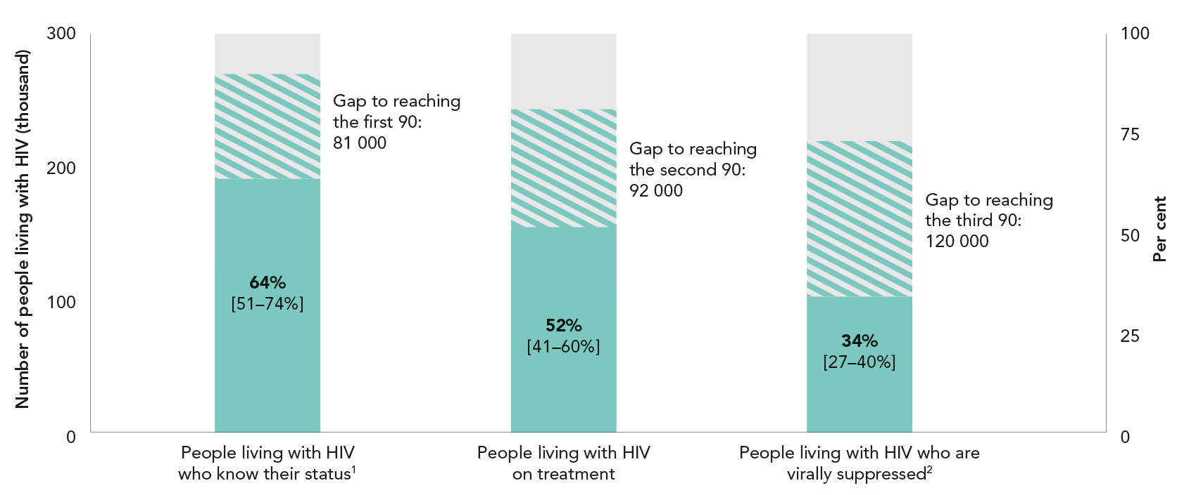
HIV TESTING AND TREATMENT CASCADE IN THE CARIBBEAN
Knowledge of HIV status, antiretroviral therapy coverage and viral
suppression among people living with HIV, CARIBBEAN, 2016
Source: UNAIDS special analysis, 2017; see annex on methods for more details.
¹ 2016 measure derived from data reported by 14 countries, which accounted for 87% of people living with HIV in Latin America.
² 2016 measure derived from data reported by 14 countries. Regionally, 87% of all people on antiretroviral therapy were reported to have received a
viral load test during the reporting period.

Slide 46
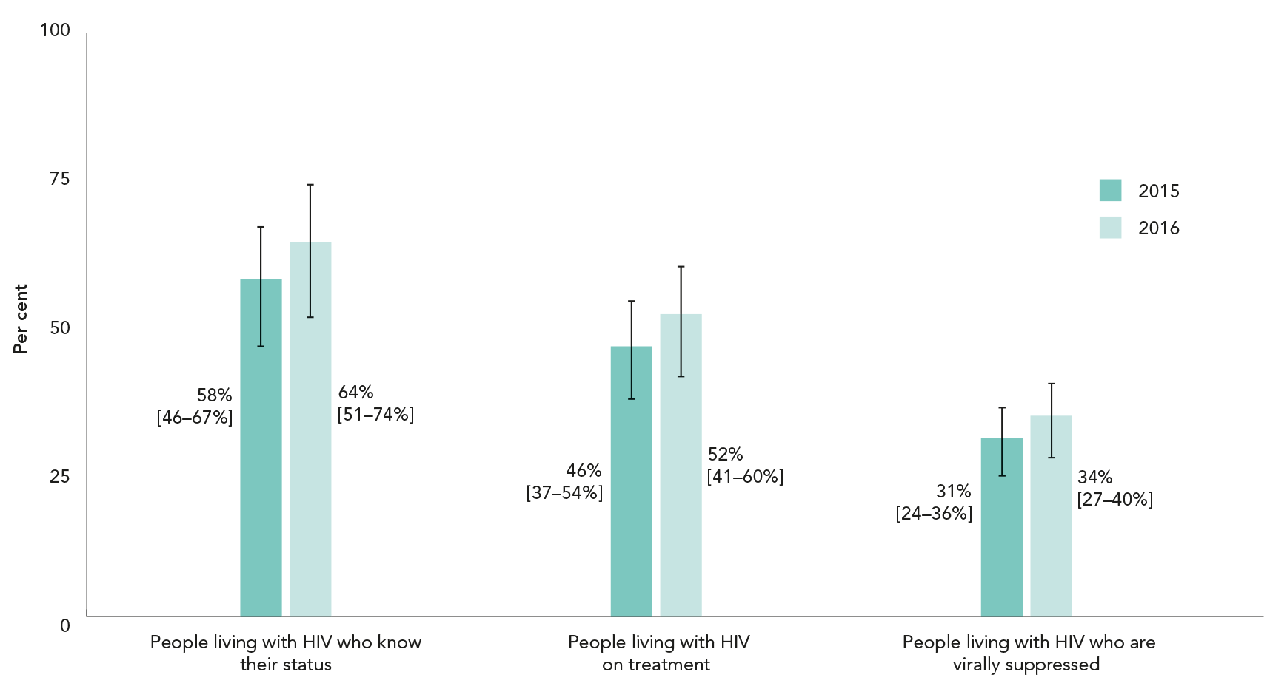
GAINS ACROSS THE TREATMENT CASCADE
Knowledge of HIV status, antiretroviral therapy coverage and viral suppression among people living with HIV, Caribbean, 2015 and 2016
Source: UNAIDS special analysis, 2017; see annex on methods for more details.

Slide 47
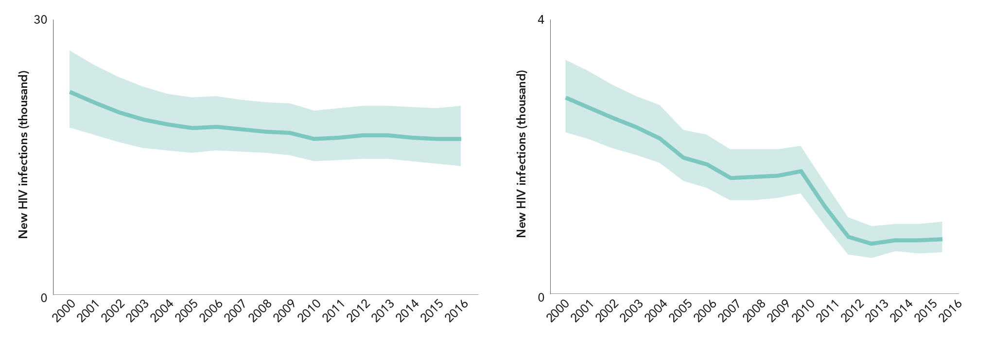
NEW HIV INFECTIONS RISING IN CUBA, FALLING IN HAITI (first of 2 slides)
Number of new HIV infections,
adults (aged 15 years and older),
Caribbean, 2000–2016
Number of new HIV infections,
children (aged 0–14 years),
Caribbean, 2000–2016
Source: UNAIDS 2017 estimates.
Source: UNAIDS 2017 estimates.

Slide 48
NEW HIV INFECTIONS RISING IN CUBA, FALLING IN HAITI (last of 2 slides)
Distribution of new HIV infections, by country, Caribbean, 2016
Percent change in new HIV infections, by country, Caribbean, from 2010 to 2016
Source: UNAIDS 2017 estimates.
Source: UNAIDS 2017 estimates.

Slide 49
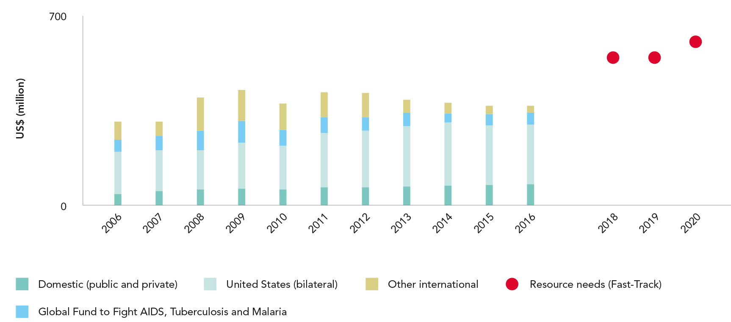
DIMINISHING EXTERNAL FUNDING IN THE CARIBBEAN
HIV resource availability by source, 2006–2016, and projected resource needs
by 2020, Caribbean*
Source: UNAIDS estimates on HIV resource availability, June 2017. Fast-Track update on investments needed in the AIDS response, 2016–2030. Geneva: UNAIDS; 2016. Financing the
response to low- and middle-income countries: international assistance from donor governments in 2016. The Henry J. Kaiser Family Foundation and UNAIDS (in press). GAM/GARPR
reports (2005–2017). Philanthropic support to address HIV/AIDS in 2015. Washington, DC: Funders Concerned about AIDS; 2016.
*Estimates for low- and middle-income countries per 2015 World Bank income level classification. All figures are expressed in constant 2016 US dollars.

Slide 50
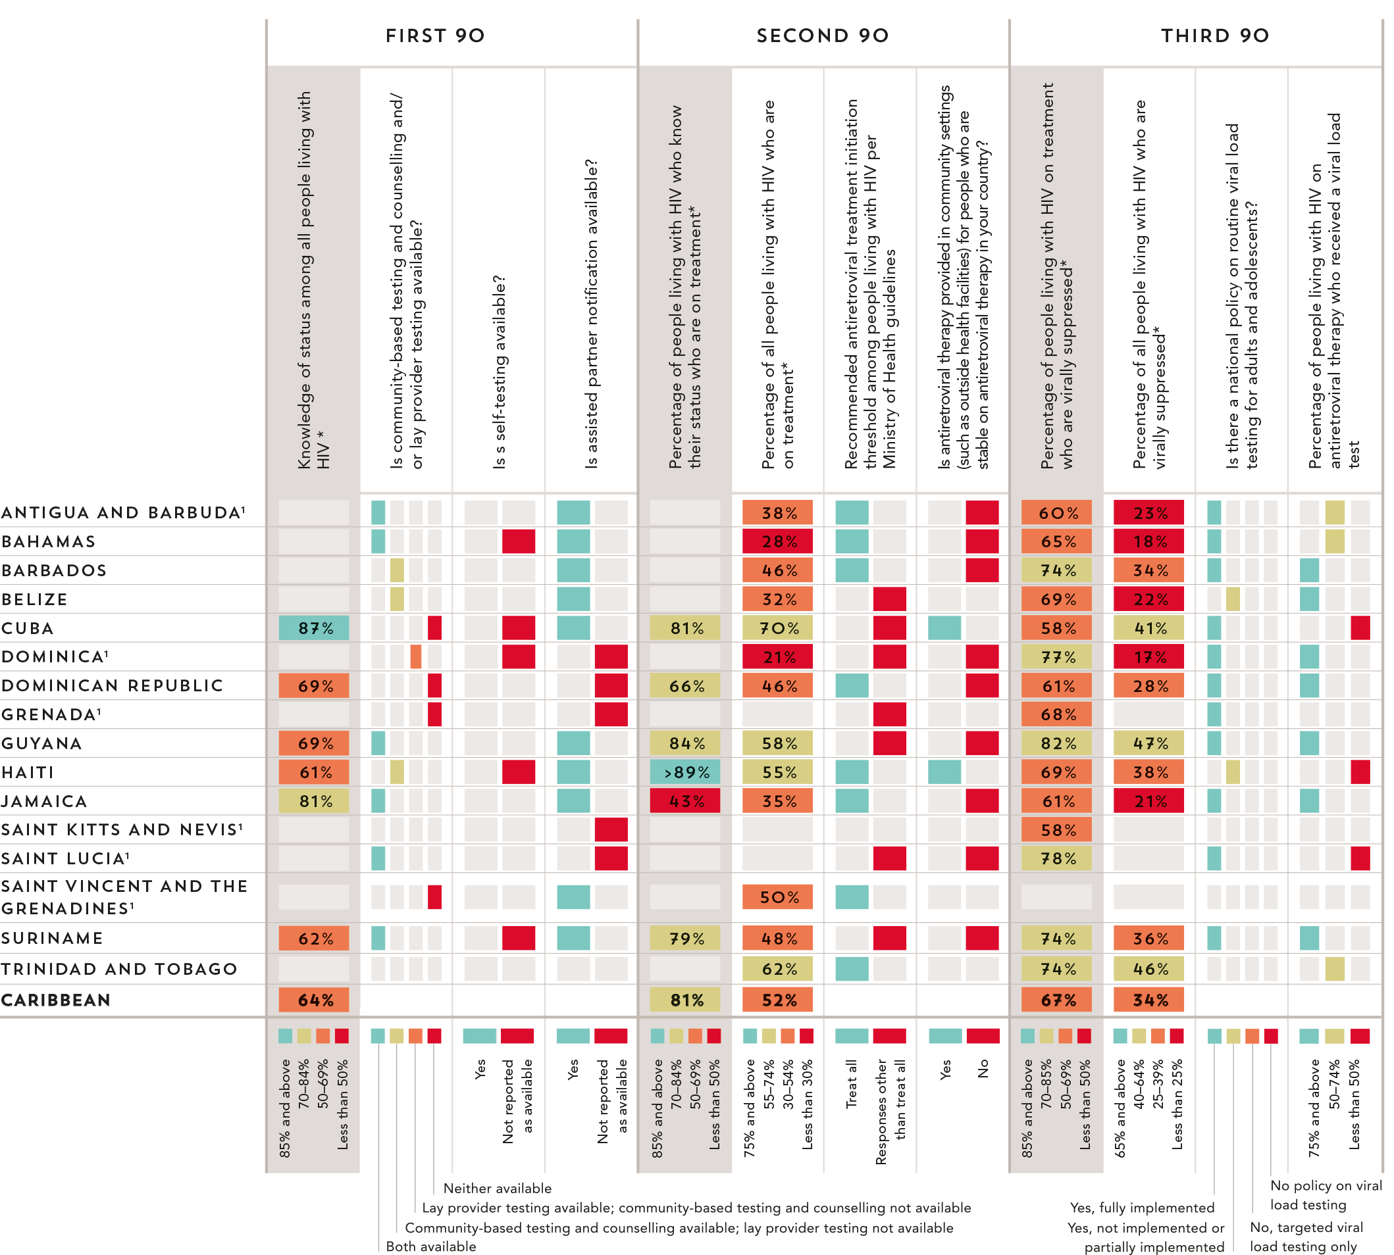
90–90–90 COUNTRY
SCORECARDS
CARIBBEAN
* The complete set of 90–90–90 measures and testing and treatment cascade data for countries can be found at aidsinfo.unaids.org.
Source: UNAIDS special analysis, 2017. 2017 Global AIDS Monitoring. UNAIDS 2017 estimates. 2017 National Commitments and Policy Instrument.
¹ Estimates of people living with HIV that inform progress towards 90–90–90 are country-supplied and have not been validated by UNAIDS.

Slide 52
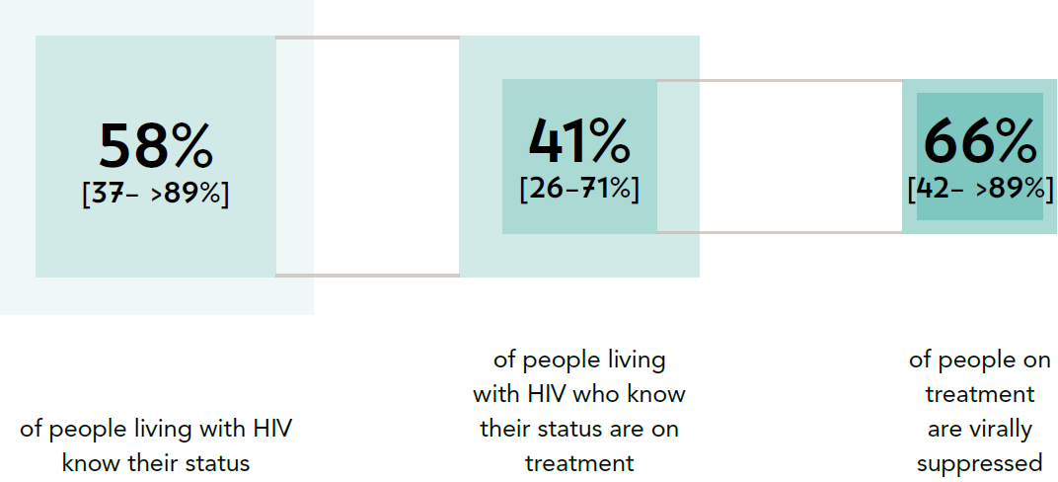
PROGRESS TOWARDS THE 90–90–90 TARGETS
Progress towards the 90–90–90 treatment target, Middle East and North Africa, 2016
Source: UNAIDS special analysis, 2017; see annex on methods for more details

Slide 53
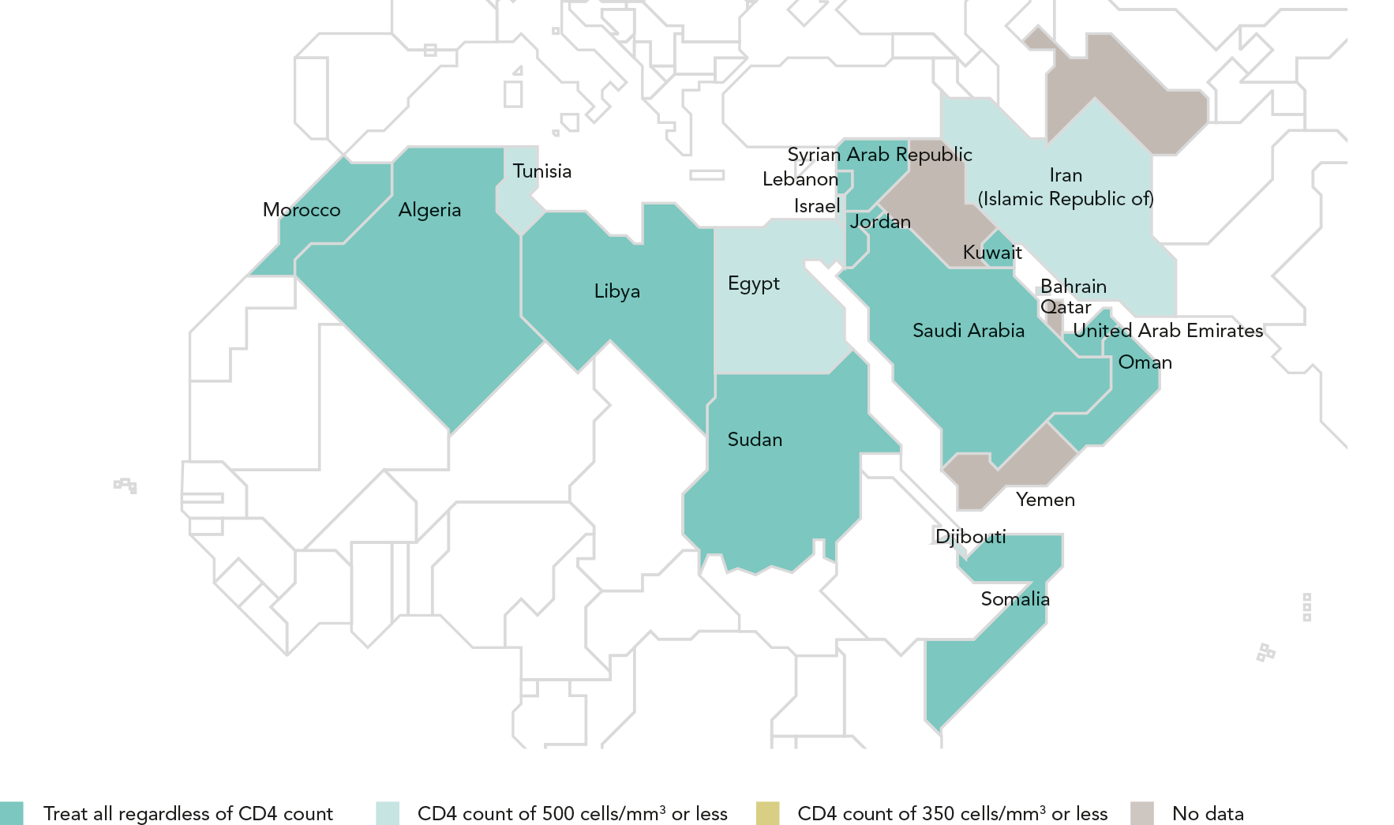
ADOPTING A TREAT ALL APPROACH
Recommended antiretroviral therapy initiation threshold among people living
with HIV per Ministry of Health guidelines, by country, Middle East and North Africa, 2016
Source: World Health Organization, 2017.

Slide 54
AIDS-RELATED DEATHS CONTINUE TO RISE
Antiretroviral therapy coverage and number of AIDS-related deaths, Middle East and North Africa, 2000–2016*
The Middle East and North Africa is one of two regions in the world where AIDS-related deaths continue to rise. The annual number of adults and children dying due to
AIDS-related illnesses increased from an estimated 3600 [2200–6400] in 2000 to more than 11 000 [7700–19 000] in 2016. AIDS-related deaths more than doubled between
2000 and 2010 in Egypt, the Islamic Republic of Iran, Kuwait, Morocco, Sudan, Tunisia and Yemen, which can be explained by increasing incidence in some countries
and limited access to treatment in others. In countries where treatment coverage has expanded, AIDS-related deaths have decreased significantly since 2010 (e.g. by 37%
in Algeria and 28% in Djibouti).
Source: 2017 Global AIDS Monitoring; UNAIDS 2017 estimates.
* Estimates for Kuwait are for citizens of the country only.

Slide 55
HIV TESTING AND TREATMENT CASCADE IN THE MIDDLE EAST
AND NORTH AFRICA
Knowledge of HIV status, antiretroviral therapy coverage and viral suppression among people living with HIV, Middle East and North Africa, 2016
Source: UNAIDS special analysis, 2017; see annex on methods for more details.
¹ 2016 measure derived from data reported by six countries, which accounted for 80% of people living with HIV in the region.
² 2016 measure derived from data reported by six countries. Worldwide, 34% of all people on antiretroviral therapy were reported to have received a
viral load test during the reporting period.

Slide 56
GAINS ACROSS THE TREATMENT CASCADE
Knowledge of HIV status, antiretroviral therapy coverage and viral suppression among people living with HIV, Middle East and North Africa, 2015 and 2016
Source: UNAIDS special analysis, 2017; see annex on methods for more details.

Slide 57
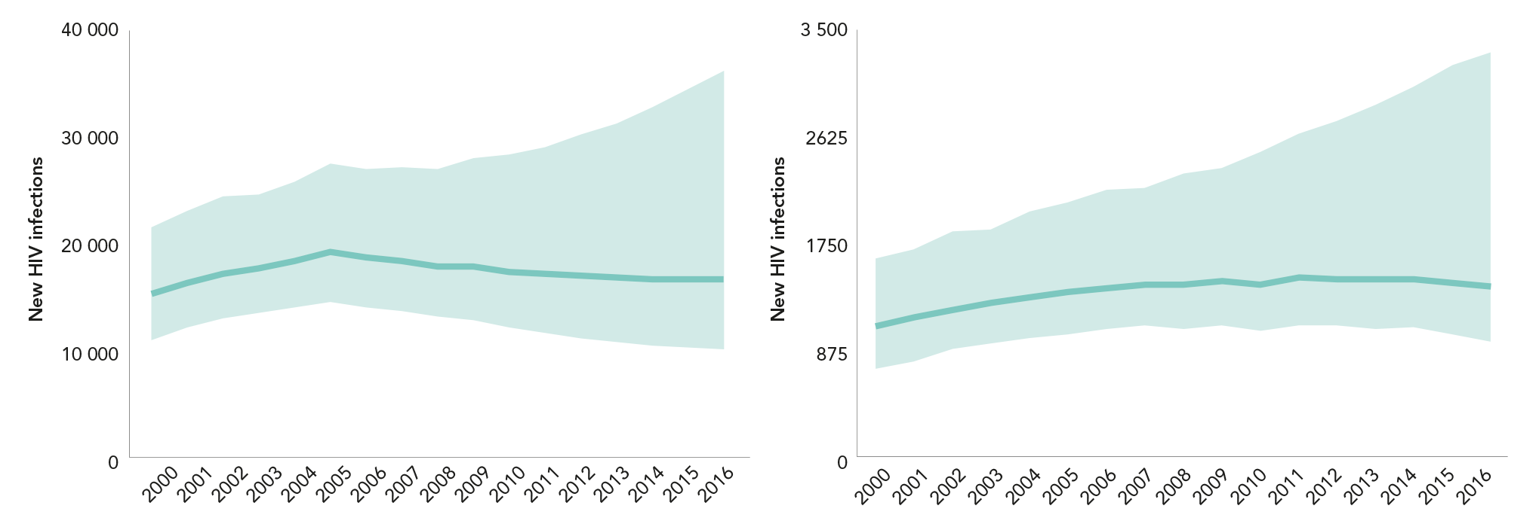
NEW INFECTION TRENDS VARY WIDELY IN THE MIDDLE EAST
AND NORTH AFRICA (first of 2 slides)
Number of new HIV infections,
adults (aged 15 years and older),
Middle East and North Africa, 2000–2016
Number of new HIV infections,
children (aged 0–14 years),
Middle East and North Africa, 2000–2016
Source: UNAIDS 2017 estimates.
Source: UNAIDS 2017 estimates.

Slide 58
NEW INFECTION TRENDS VARY WIDELY IN THE MIDDLE EAST
AND NORTH AFRICA (last of 2 slides)
Distribution of new HIV infections, by country, Middle East and
North Africa, 2016
Percent change in new HIV infections, by country, Middle East and
North Africa, from 2010 to 20166
Source: UNAIDS 2017 estimates.
Source: UNAIDS 2017 estimates.
*Estimates for Bahrain, Kuwait, Jordan and Qatar are for citizens of the country only.

Slide 59
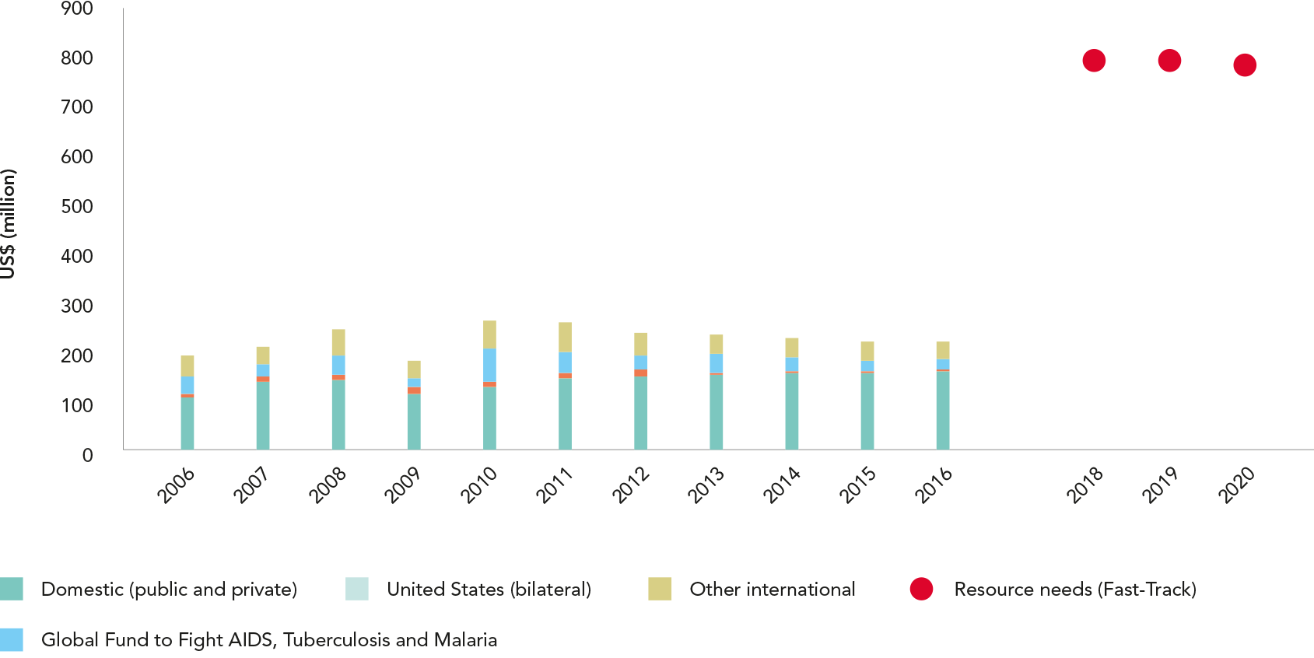
RESOURCE AVAILABILITY IS SHORT OF FAST-TRACK NEEDS
HIV resource availability by source, 2006–2016, and projected resource needs by 2020, Middle East and North Africa*
Source: UNAIDS estimates on HIV resource availability, June 2017. Fast-Track update on investments needed in the AIDS response, 2016–2030. Geneva: UNAIDS; 2016. Financing the
response to low- and middle-income countries: international assistance from donor governments in 2016. The Henry J. Kaiser Family Foundation and UNAIDS (in press). GAM/GARPR
reports (2005–2017). Philanthropic support to address HIV/AIDS in 2015. Washington, DC: Funders Concerned about AIDS; 2016.
*Estimates for low- and middle-income countries per 2015 World Bank income level classification. All figures are expressed in constant 2016 US dollars.

Slide 60
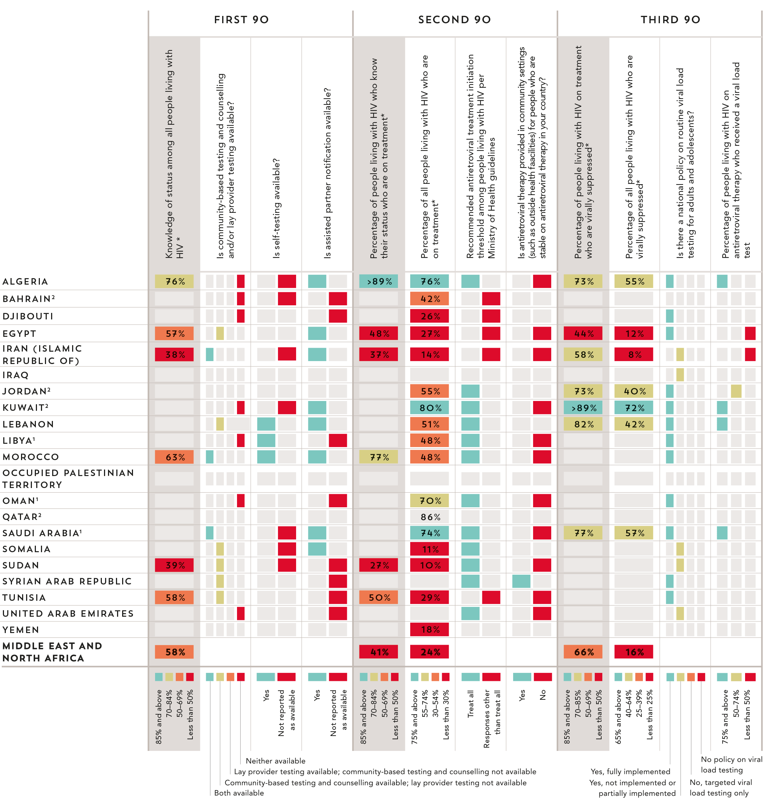
90–90–90 COUNTRY
SCORECARDS
Middle East
and North Africa
Source: UNAIDS special analysis, 2017. 2017 Global AIDS Monitoring. UNAIDS 2017 estimates. 2017 National Commitments and Policy Instrument.
* The complete set of 90–90–90 measures and testing and treatment cascade data for countries can be found at aidsinfo.unaids.org.
¹ Estimates of people living with HIV that inform progress towards 90–90–90 are country-supplied and have not been validated by UNAIDS.
² Estimates of people living with HIV are only for citizens of the country.

Slide 62
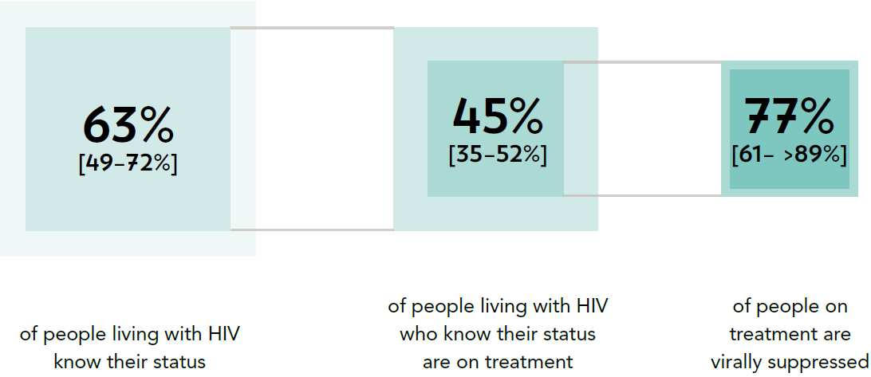
PROGRESS TOWARDS THE 90–90–90 TARGETS
Progress towards the 90–90–90 treatment target, eastern Europe
and central Asia, 2016
Source: UNAIDS special analysis, 2017; see annex on methods for more details

Slide 63
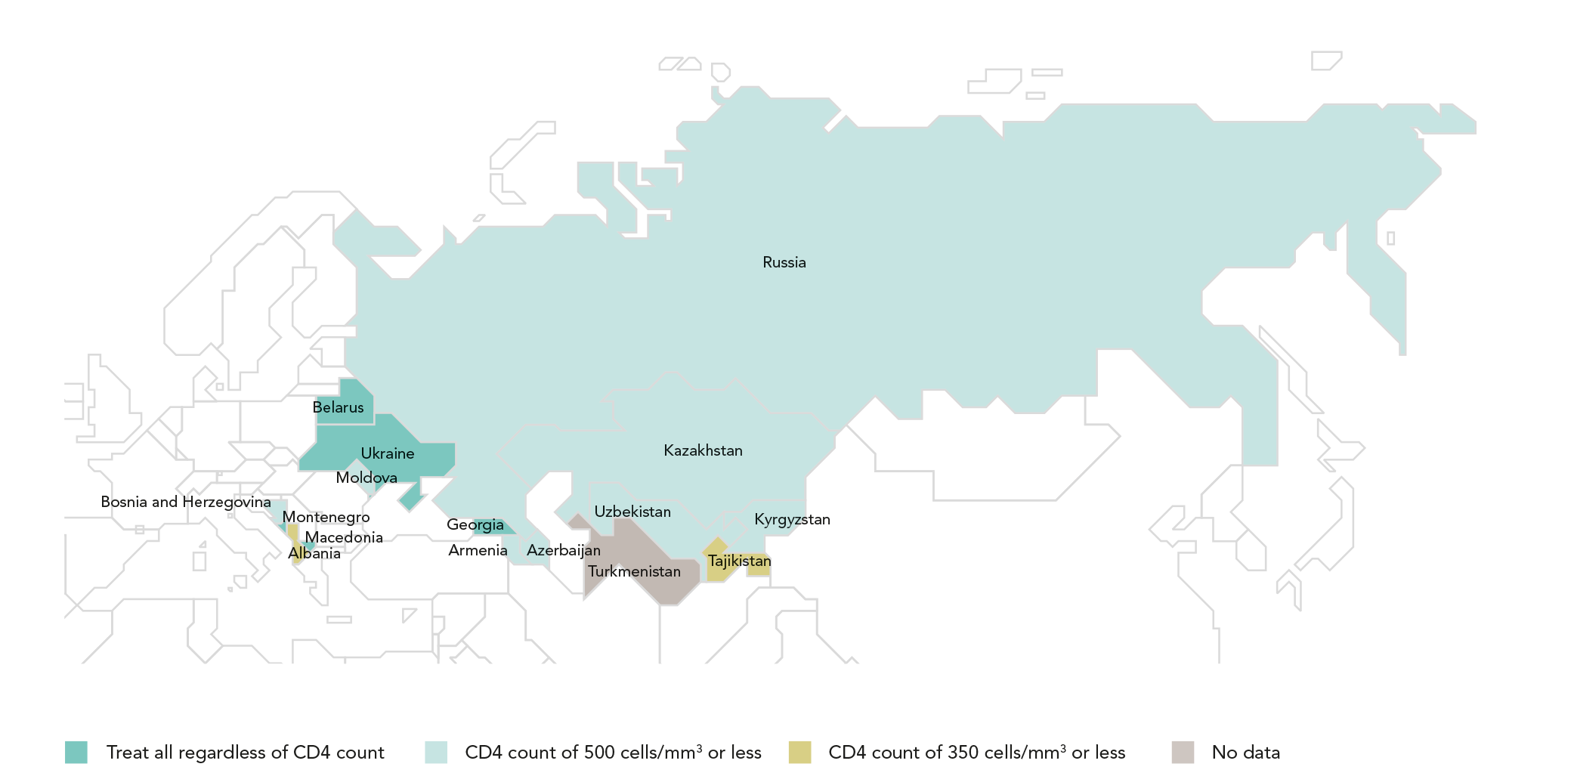
ADOPTING A TREAT ALL APPROACH
Recommended antiretroviral therapy initiation threshold among people living with HIV per Ministry of Health guidelines, by country, eastern Europe and central Asia, 2016
Four countries—Belarus, Georgia, Montenegro and Ukraine—have adopted the World Health Organization recommendation that antiretroviral
therapy should be initiated in every person living with HIV at any CD4 cell count.
Source: World Health Organization, 2017.

Slide 64
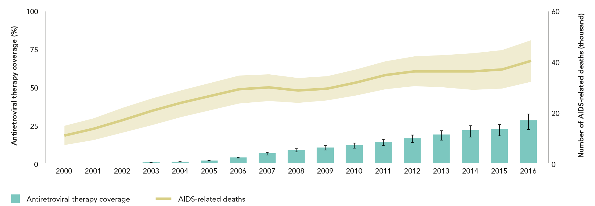
AIDS-RELATED DEATHS CONTINUE TO INCREASE
Antiretroviral therapy coverage and number of AIDS-related deaths, eastern Europe and central Asia, 2000–2016
Low coverage of HIV testing and treatment programmes and rising numbers of new infections are contributing to an increasing trend in AIDS-related
mortality. The annual number of deaths due to AIDS-related causes rose from an estimated 32 000 [27 000–37 000] in 2010 to 40 000 [32 000–49 000]
in 2016, a 25% increase. The bulk of this increase occurred in the Russian Federation, where the epidemic claimed a reported 30 550 lives in 2016 (1).
Source: 2017 Global AIDS Monitoring. UNAIDS 2017 estimates.

Slide 65
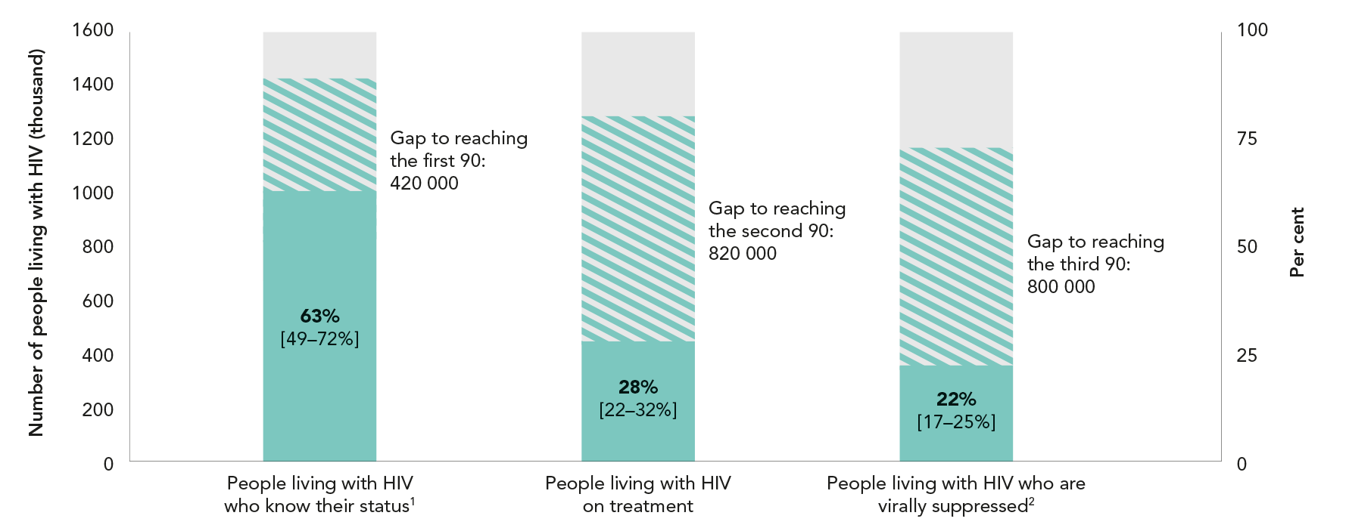
HIV TESTING AND TREATMENT CASCADE IN eastern Europe
And central Asia
Knowledge of HIV status, antiretroviral therapy coverage and viral suppression among people living with HIV, eastern Europe And central Asia, 2016
Source: UNAIDS special analysis, 2017; see annex on methods for more details.
¹ 2016 measure derived from data reported by 12 countries, which accounted for 99% of people living with HIV in the region.
² 2016 measure derived from data reported by 13 countries. In the region, 93% of all people on antiretroviral therapy were reported to have received
a viral load test during the reporting period.

Slide 66
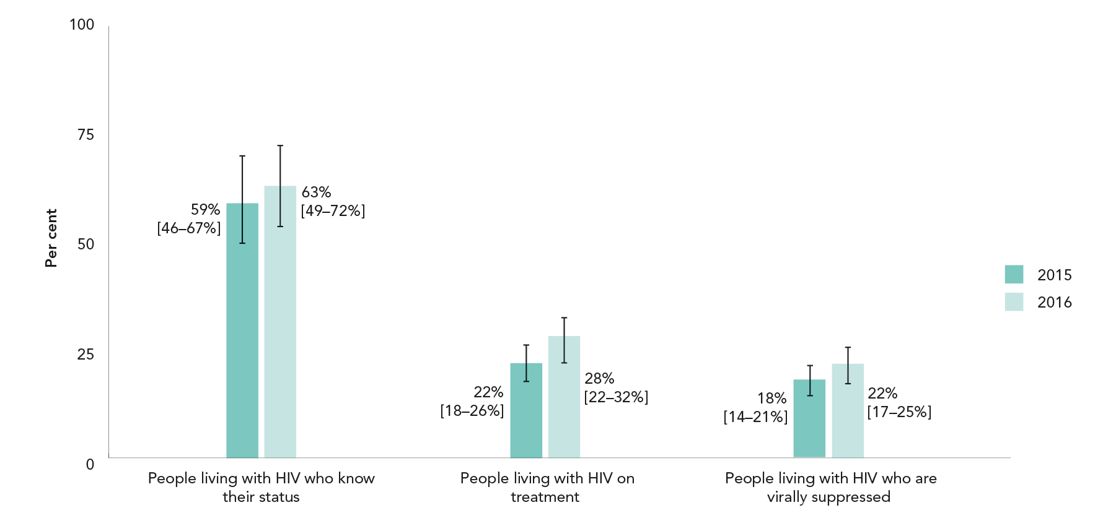
GAINS ACROSS THE TREATMENT CASCADE
Knowledge of HIV status, antiretroviral therapy coverage and viral suppression among people living with HIV, Middle East and North Africa, 2015 and 2016
Source: UNAIDS special analysis, 2017; see annex on methods for more details.

Slide 67
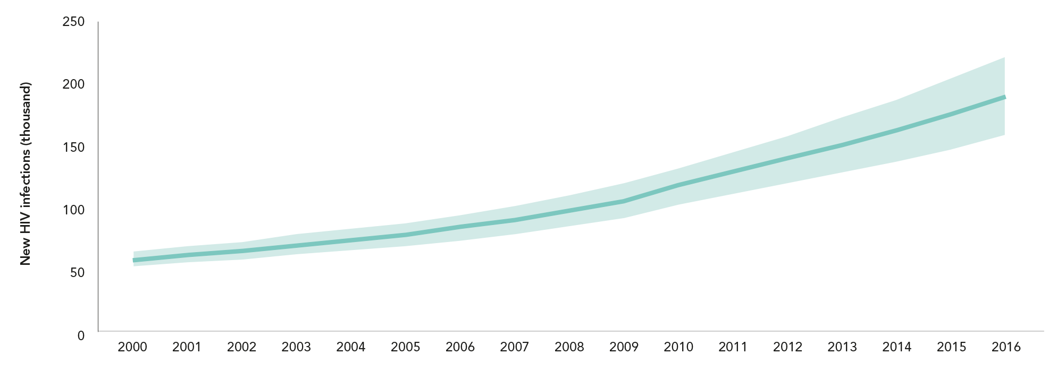
HIV INFECTIONS CONTINUE TO CLIMB IN EASTERN EUROPE
AND CENTRAL ASIA (first of 2 slides)
Number of new HIV infections, adults (aged 15 years and older),
eastern Europe and central Asia, 2000–2016
Source: UNAIDS 2017 estimates

Slide 68
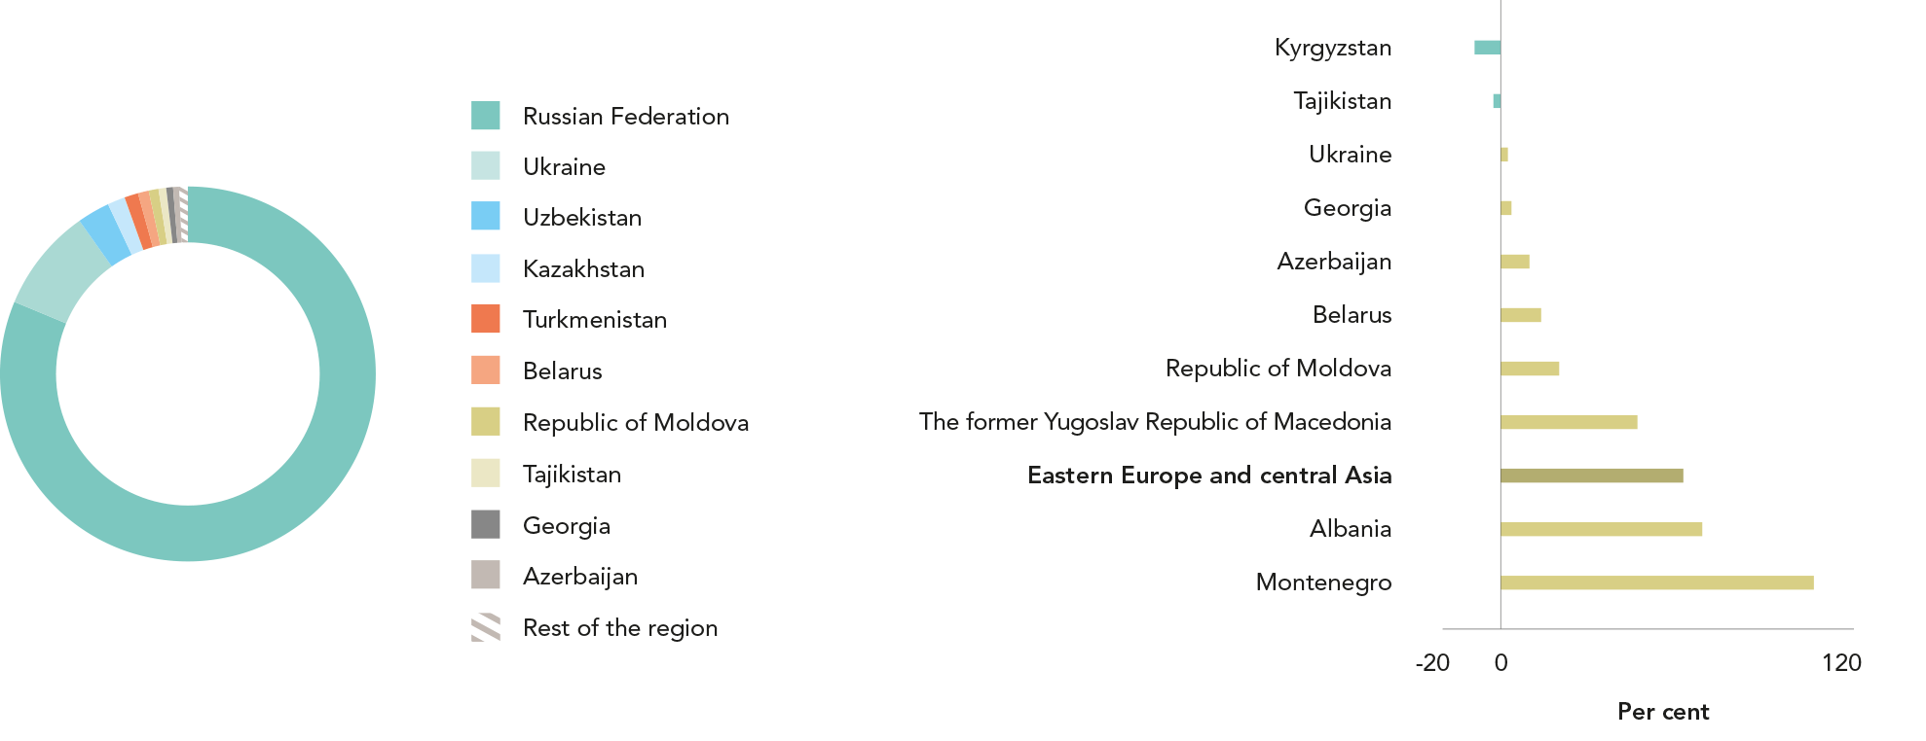
HIV INFECTIONS CONTINUE TO CLIMB IN EASTERN EUROPE
AND CENTRAL ASIA (last of 2 slides)
Distribution of new HIV infections, by country, eastern Europe and central Asia, 2016
Percent change in new HIV infections, by country, eastern Europe and central Asia, from 2010 to 2016
Source: UNAIDS 2017 estimates
Source: UNAIDS 2017 estimates

Slide 69
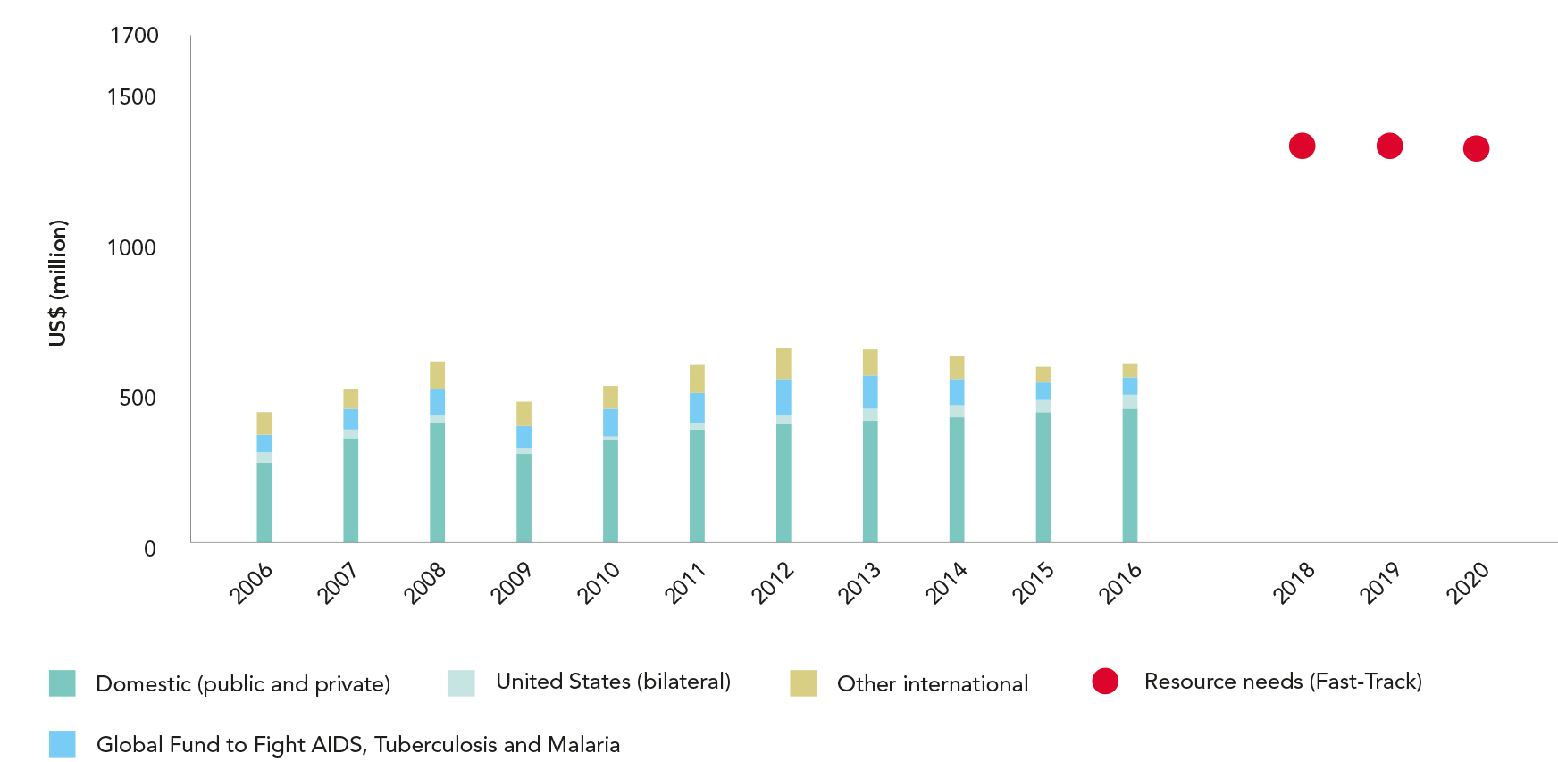
DOMESTIC FUNDING INCREASING, BUT A LARGE RESOURCE GAP REMAINS
HIV resource availability by source, 2006–2016, and projected resource needs by 2020, eastern Europe and central AsiA*
Source: UNAIDS estimates on HIV resource availability, June 2017. Fast-Track update on investments needed in the AIDS response, 2016–2030. Geneva: UNAIDS; 2016. Financing the
response to low- and middle-income countries: international assistance from donor governments in 2016. The Henry J. Kaiser Family Foundation and UNAIDS (in press). GAM/GARPR
reports (2005–2017). Philanthropic support to address HIV/AIDS in 2015. Washington, DC: Funders Concerned about AIDS; 2016.
*Estimates for low- and middle-income countries per 2015 World Bank income level classification. All figures are expressed in constant 2016 US dollars.

Slide 70
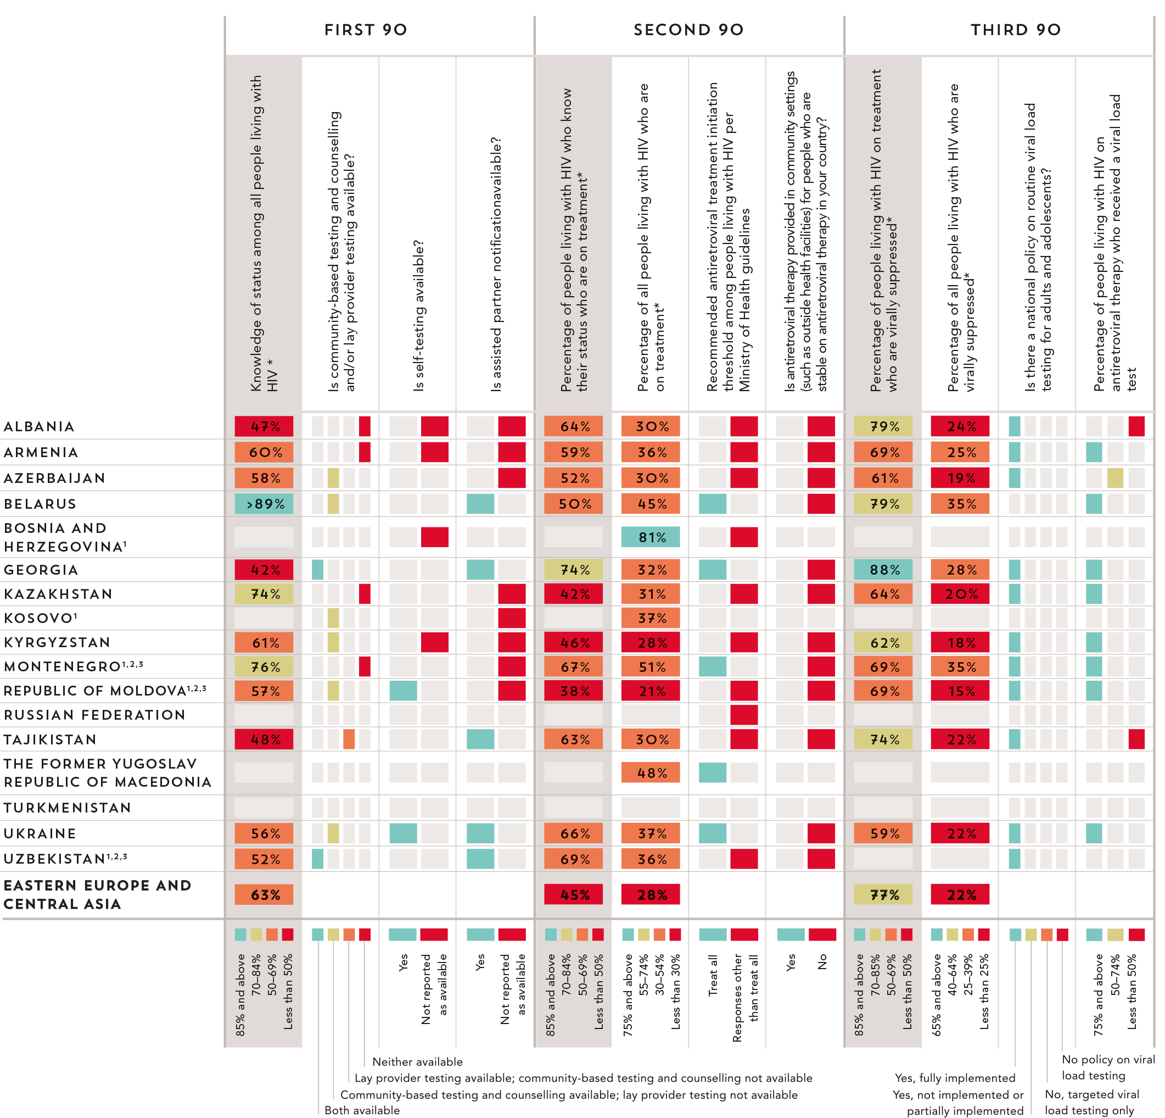
90–90–90 COUNTRY
SCORECARDS
Eastern Europe
and central Asia
Source: UNAIDS special analysis, 2017. 2017 Global AIDS Monitoring. UNAIDS 2017 estimates. 2017 National Commitments and Policy Instrument.
* The complete set of 90–90–90 measures and testing and treatment cascade data for countries can be found at aidsinfo.unaids.org.
¹ Estimates of people living with HIV that inform progress towards 90–90–90 are country-supplied and have not been validated by UNAIDS.
² Estimates of people living with HIV are only for citizens of the country.

Slide 72
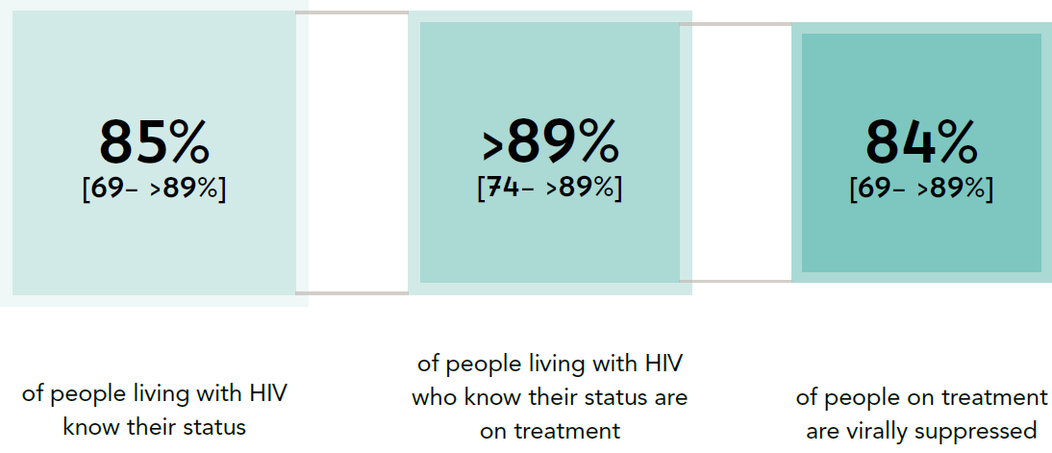
PROGRESS TOWARDS THE 90–90–90 TARGETS
Progress towards the 90–90–90 treatment target, western and central Europe
and North America, 2016
Source: UNAIDS special analysis, 2017; see annex on methods for more details

Slide 73
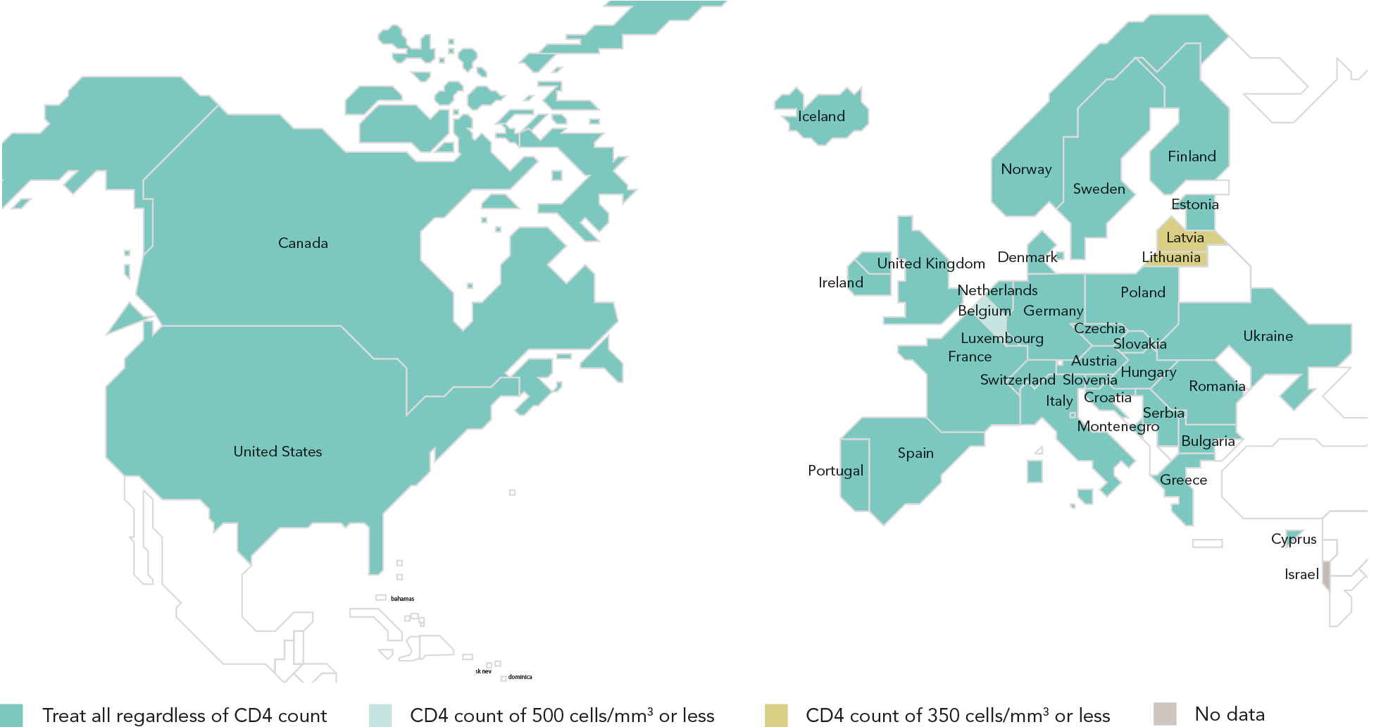
ADOPTING A TREAT ALL APPROACH
Recommended antiretroviral therapy initiation threshold among people living with HIV per Ministry of Health guidelines, by country, western and central Europe and
North America, 2016
Most countries in the region have adopted the World Health Organization recommendation that antiretroviral therapy should be initiated in every
person living with HIV regardless of CD4 cell count. In Latvia and Lithuania, the threshold for antiretroviral therapy initiation is CD4 T-cell counts
of under 350 cells/mm³, and in Belgium it is under 500 cells/mm³.
Source: World Health Organization, 2017.

Slide 74
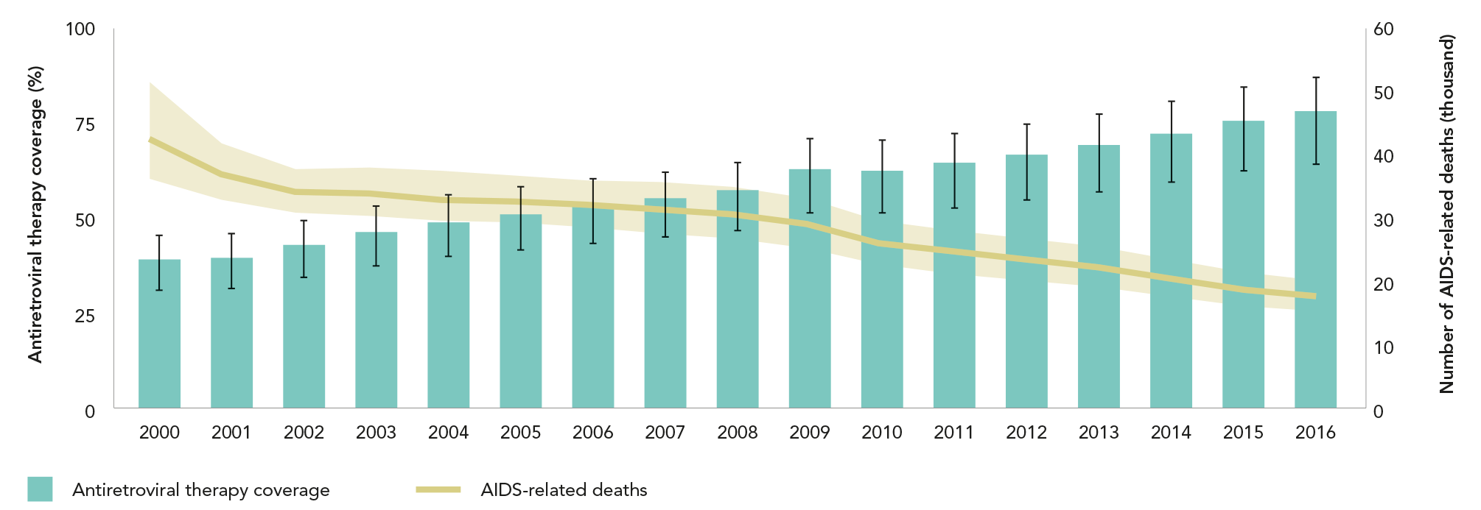
HIGH COVERAGE OF TREATMENT BRINGS AIDS-RELATED MORTALITY UNDER 20 000 A YEAR
Antiretroviral therapy coverage and number of AIDS-related deaths, western and central Europe and North America, 2000–2016
High and rising coverage of antiretroviral therapy has played a primary role in the reduction of AIDS-related deaths from an estimated 43 000 [36 000–52 000] in 2000 to an estimated 18 000 [15 000–20 000] in 2016.
Source: 2017 Global AIDS Monitoring. UNAIDS 2017 estimates.

Slide 75
HIV TESTING AND TREATMENT CASCADE IN WESTERN
AND CENTRAL EUROPE AND NORTH AMERICA
Knowledge of HIV status, antiretroviral therapy coverage and viral suppression among people living with HIV, WESTERN AND CENTRAL EUROPE AND NORTH AMERICA, 2016
Source: UNAIDS special analysis, 2017; see annex on methods for more details.
¹ 2016 measure derived from data reported by 25 countries, which accounted for 99% of people living with HIV in western and central Europe and North America.
² 22016 measure derived from data reported by 14 countries. Regionally, 100% of all people on antiretroviral therapy were reported to have received a
viral load test during the reporting period.

Slide 76
HIV TESTING AND TREATMENT CASCADE IN THE EUROPEAN UNION
Knowledge of HIV status, antiretroviral therapy coverage and viral
suppression among people living with HIV, European Union, 2016
Source: UNAIDS special analysis, 2017; see annex on methods for more details.

Slide 77
DECLINES IN NEW INFECTIONS IN THE REGION TEMPERED BY INCREASES IN CZECHIA, SERBIA AND SLOVAKIA (first of 3 slides)
Number of new HIV infections, adults (aged 15 years and older), western
and central Europe and North America, 2000–2016
Source: UNAIDS 2017 estimates

Slide 78
DECLINES IN NEW INFECTIONS IN THE REGION TEMPERED BY INCREASES IN CZECHIA, SERBIA AND SLOVAKIA (second of 3 slides)
Distribution of new HIV infections, by country, western and central Europe
and North America, 2016
Source: UNAIDS 2017 estimates

Slide 79
DECLINES IN NEW INFECTIONS IN THE REGION TEMPERED BY INCREASES IN CZECHIA, SERBIA AND SLOVAKIA (last of 3 slides)
Percent change in new HIV infections, by country, western and central
Europe and North America, from 2010 to 2016
Source: UNAIDS 2017 estimates

Slide 80
90–90–90 COUNTRY
SCORECARDS
Eastern Europe
and central Asia
* The complete set of 90–90–90 measures and testing and treatment cascade data for countries can be found at aidsinfo.unaids.org.
¹ All measures of progress toward 90–90–90 and the testing and treatment cascade are for 2016 except as follows: 2015: Bulgaria, Germany, Hungary, Israel, Netherlands, Sweden, Switzerland, United Kingdom. 2014: Belgium, Canada, Serbia, Spain. 2013: Austria, France, Greece. 2012: Italy. Policy measures are as of 2016.
² Estimates of people living with HIV that inform progress towards 90–90–90 are country-supplied and have not been validated by UNAIDS.
³ Data from European Centres for Disease Control and Prevention Continuum of HIV care 2017 progress report.
Source: UNAIDS special analysis, 2017. 2017 Global AIDS Monitoring. UNAIDS 2017 estimates. 2017 National Commitments and Policy Instrument. European Centres for Disease Prevention and Control. Continuum of HIV care 2017 progress report. Stockholm: European Centres for Disease Prevention and Control; 2017.

