Slide 1
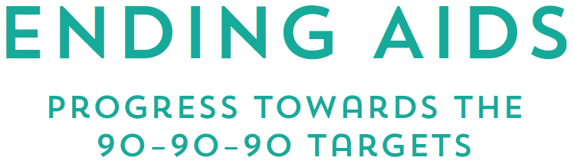

Slide 2


Slide 3
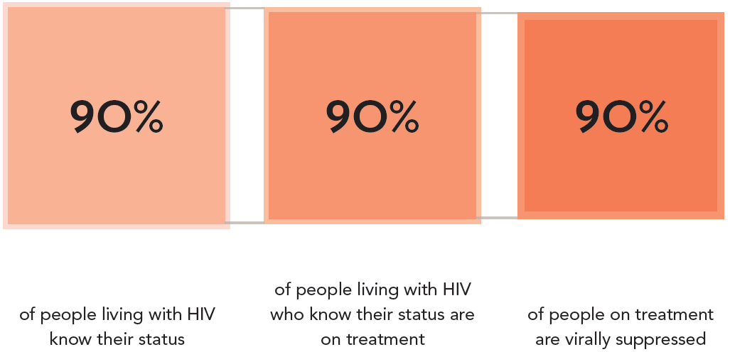
EMPHASIZING VIRAL SUPPRESSION AMONG PEOPLE
LIVING WITH HIV
The 90–90–90 targets FOR 2020

Slide 4
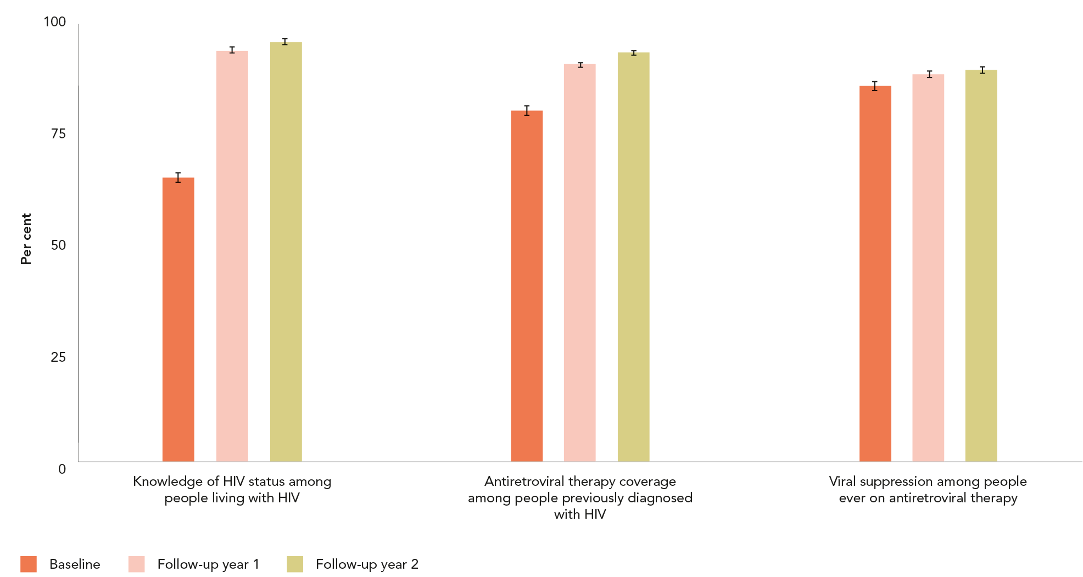
90–90–90 ACHIEVED IN RURAL EAST AFRICA
Progress towards the 90–90–90 targets, all ages, 16 communities
in rural Kenya and Uganda
Source: Petersen M, Balzer L, Kwarsiima D, Sang N, Chamie G, Ayieko J et al. Association of implementation of a universal testing and treatment intervention with HIV diagnosis,
receipt of antiretroviral therapy, and viral suppression in East Africa. JAMA. 2017;317(21):2196–2206.

Slide 5
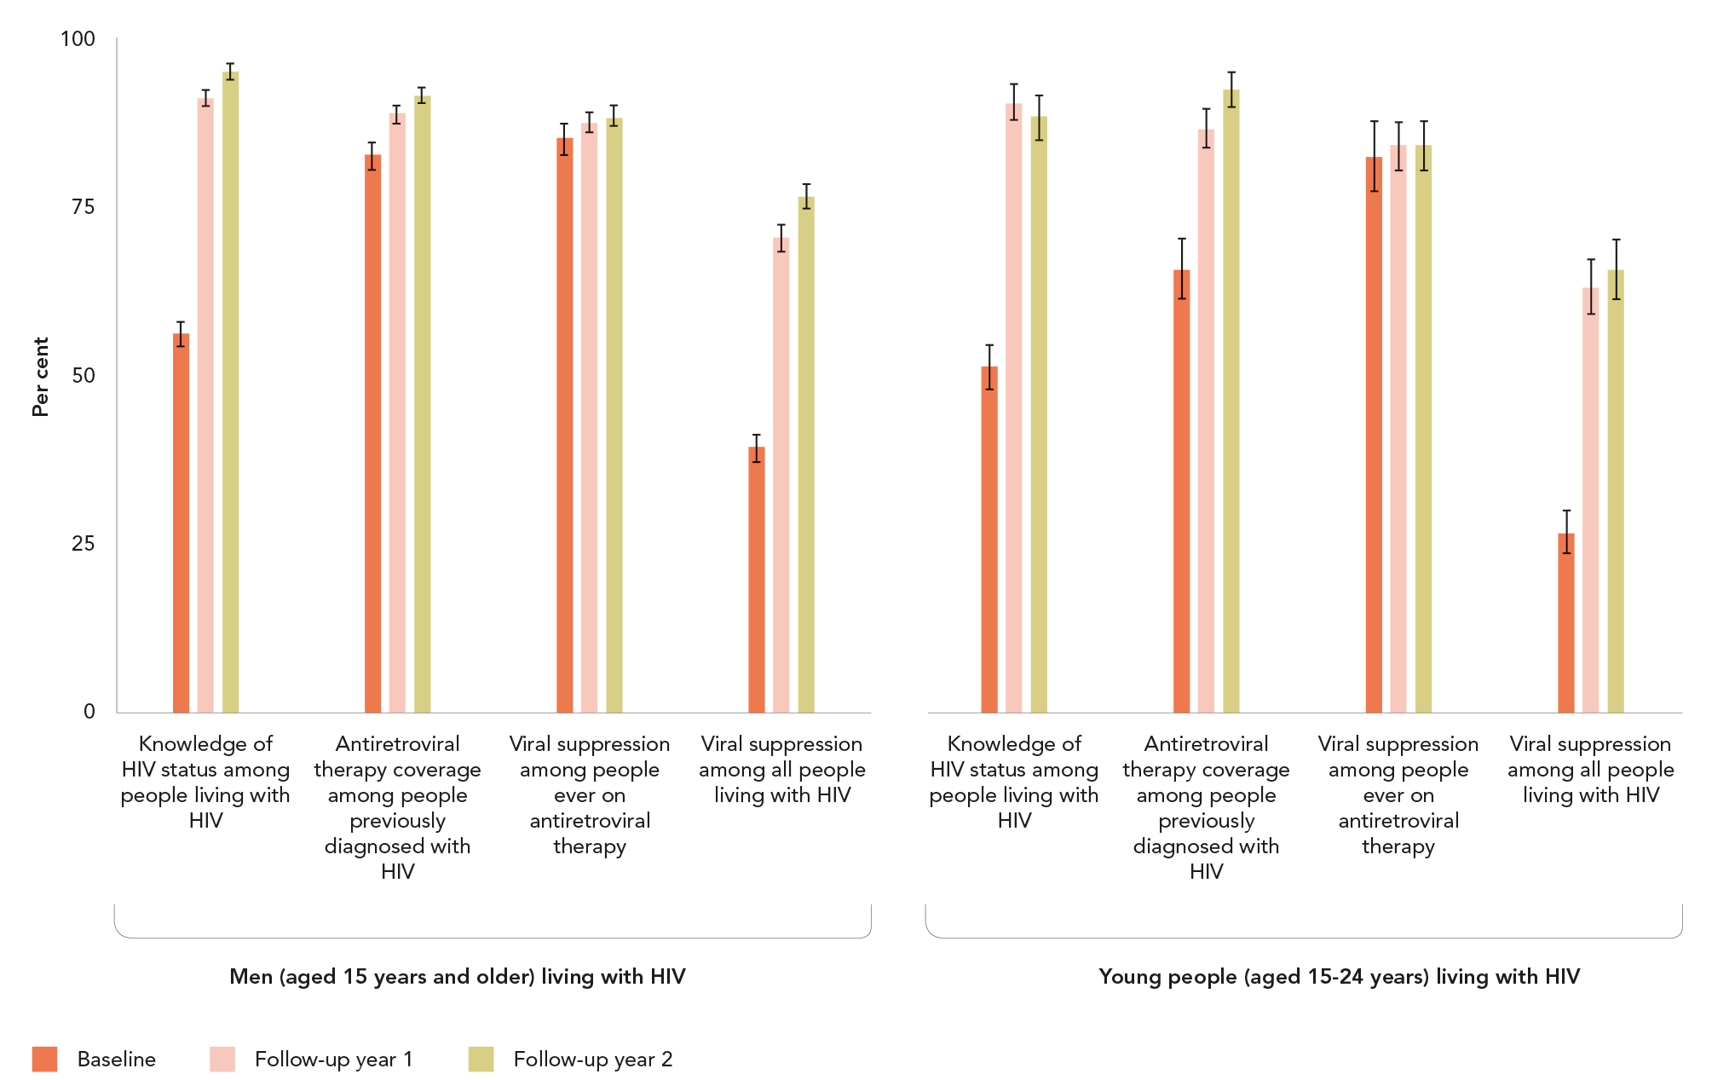
REACHING MEN AND YOUNG PEOPLE
Progress towards the 90–90–90 targets, men (aged 15 years and older) and
young people (aged 15–24 years), 16 communities in rural Uganda and Kenya
Source: Petersen M, Balzer L, Kwarsiima D, Sang N, Chamie G, Ayieko J et al. Association of implementation of a universal testing and treatment intervention with HIV diagnosis,
receipt of antiretroviral therapy, and viral suppression in East Africa. JAMA. 2017;317(21):2196–2206.

Slide 6
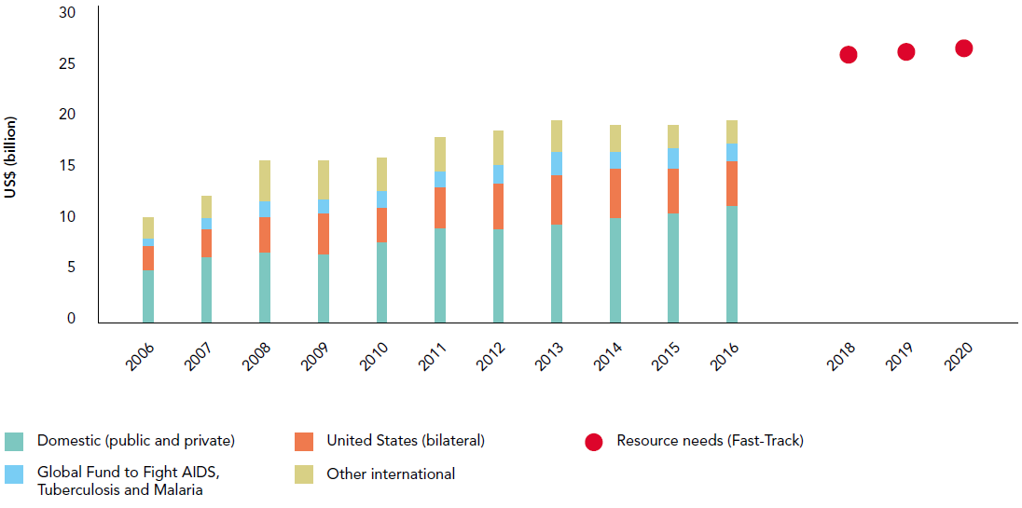
RESOURCE AVAILABILITY IN DANGER OF FALLING SHORT
OF GLOBAL COMMITMENTS
HIV resource availability by source, 2006–2016, and projected resource needs by 2020, low- and middle-income countries*
Source: UNAIDS estimates June 2017 on HIV resource availability. Fast-Track update on investments needed in the AIDS response, 2016–2030. Geneva: UNAIDS; 2016.
Financing the response to low- and middle-income countries: international assistance from Donor Governments in 2016. The Henry J. Kaiser Family Foundation and UNAIDS (in press).
GAM/GARPR reports (2005–2017). Philanthropic support to address HIV/AIDS in 2015. Washington, DC: Funders Concerned about AIDS; 2016.
*Estimates for low- and middle-income countries per 2015 World Bank income level classification. All figures are expressed in constant 2016 US dollars.

Slide 7
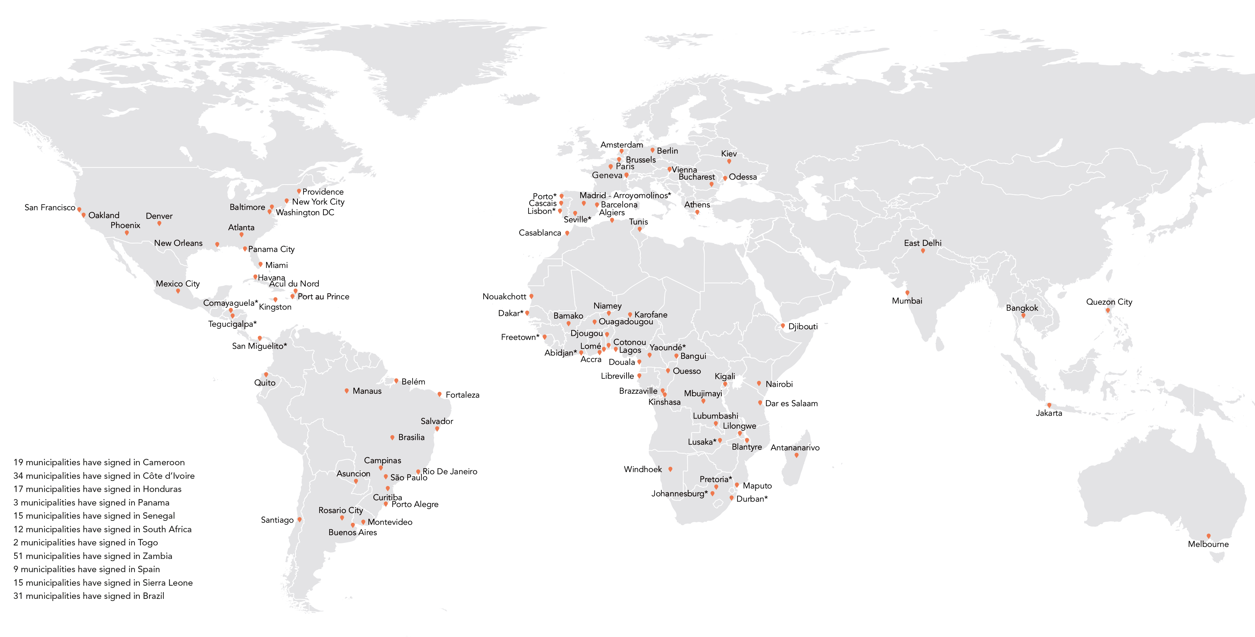
Fast-Track cities
See the Fast-Track Cities Global Web Portal (available at http://www.fast-trackcities.org/).
Cities and municipalities THAT have signed on to the 2014 Paris Declaration on ending the AIDS epidemic, 2017
Source: UNAIDS 2017.

Slide 8


Slide 9
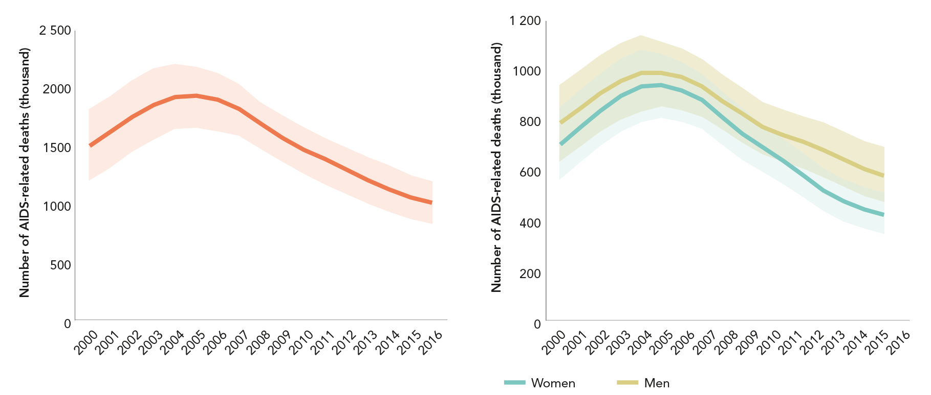
DECLINE IN DEATHS MORE RAPID AMONG WOMEN
AIDS-related deaths,
All ages, global, 2000–2016
AIDS-related deaths By sex, all ages, global, 2000–2016
Source: UNAIDS 2017 estimates
Source: UNAIDS 2017 estimates

Slide 10
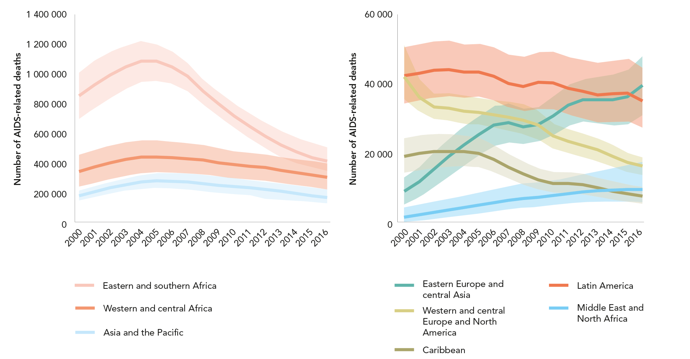
Decline in deaths sharpest in eastern and southern Africa
AIDS-related deaths, by region, 2000–2016
Source: UNAIDS 2017 estimates

Slide 11
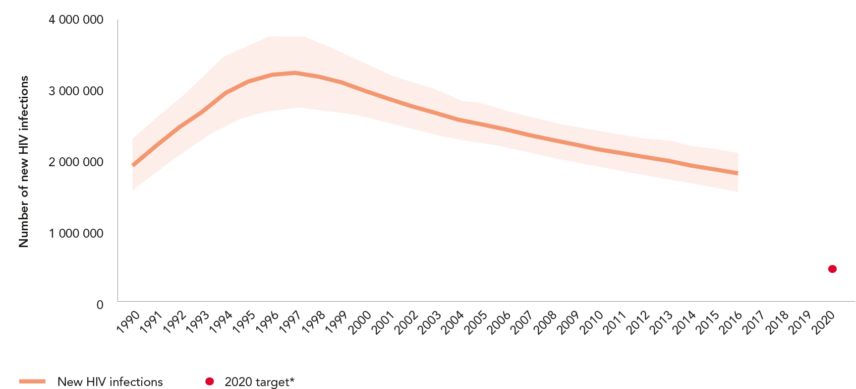
REDUCTIONS IN NEW INFECTIONS ARE OFF TARGET
New HIV infections, all ages, global, 1990–2016 and 2020 target
Source: UNAIDS 2017 estimates.
*The 2020 target is fewer than 500 000 new HIV infections, equivalent to a 75% reduction since 2010.

Slide 12
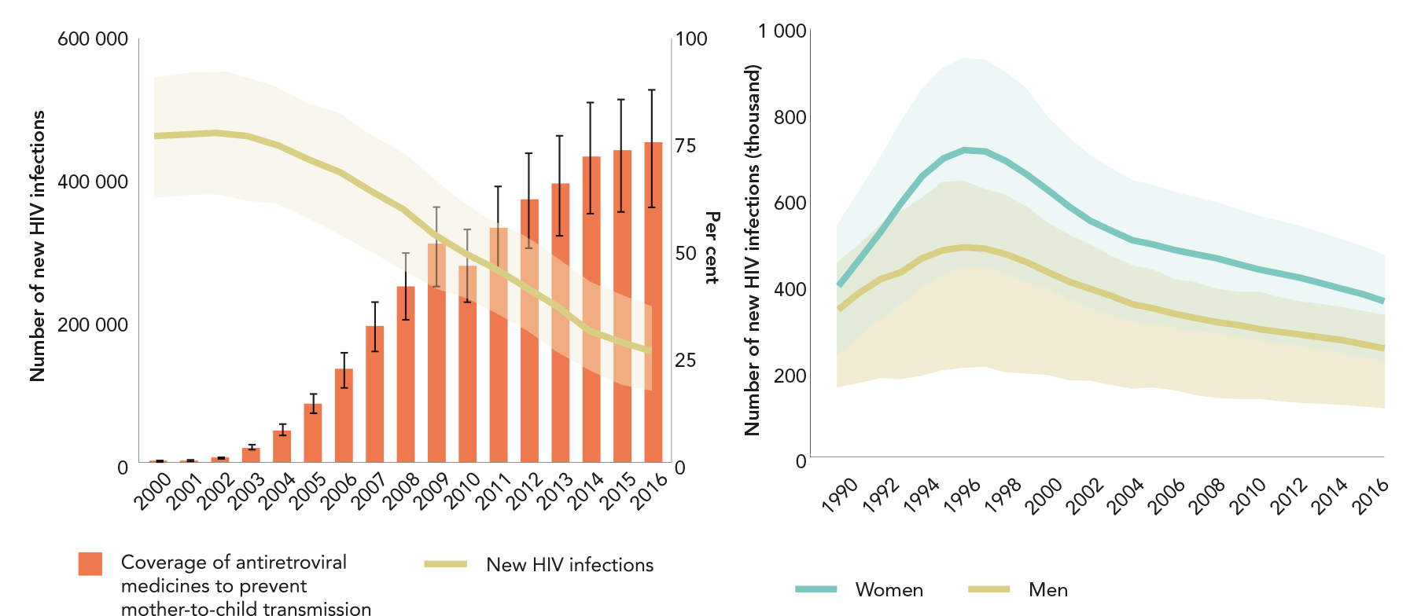
DECLINES IN NEW INFECTIONS VARY BY AGE AND SEX
New HIV infections among children (aged 0–14 years) and coverage of ANTIRETROVIRAL REGIMENS to prevent mother-to-child transmission, global,
2000–2016
Figure 2.6. New HIV infections, young people
(aged 15–24 years), by sex, global, 1990–2016
Source: UNAIDS 2017 estimates
Source: UNAIDS 2017 estimates

Slide 13
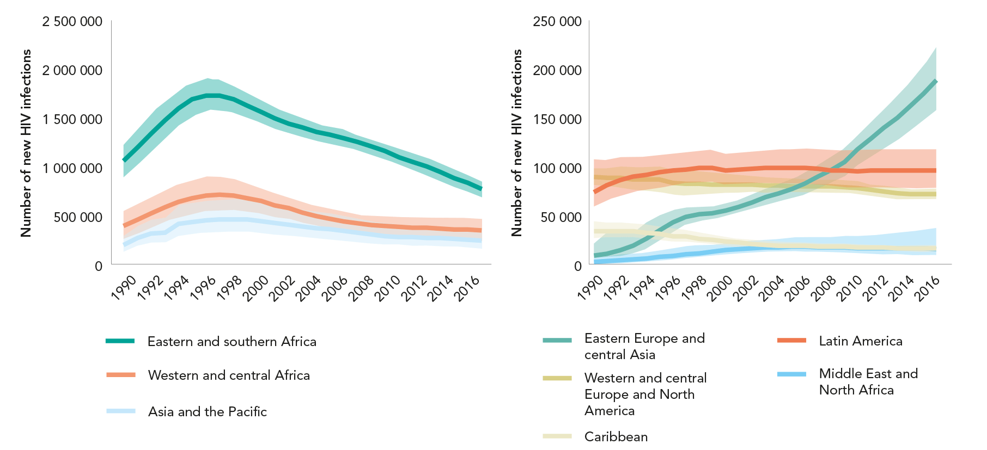
ALARMING RISE IN NEW INFECTIONS IN EASTERN EUROPE
AND CENTRAL ASIA
New HIV infections, all ages, global, 1990–2016 and 2020 target
Source: UNAIDS 2017 estimates.

Slide 14
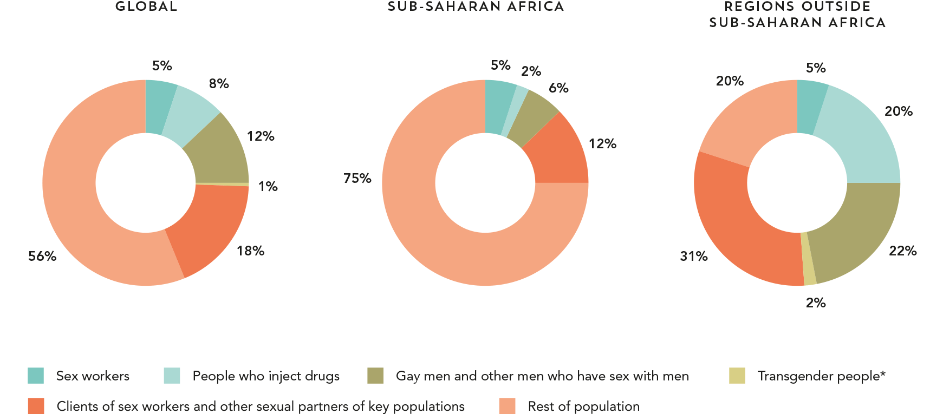
KEY POPULATIONS ARE IMPORTANT IN ALL EPIDEMIC SETTINGS
Distribution of new HIV infections, by population, global, sub-Saharan Africa and countries outside of sub-Saharan Africa, 2015
Source: UNAIDS special analysis, 2017.
*Only reflects Asia and the Pacific, Latin America and Caribbean regions.

Slide 15
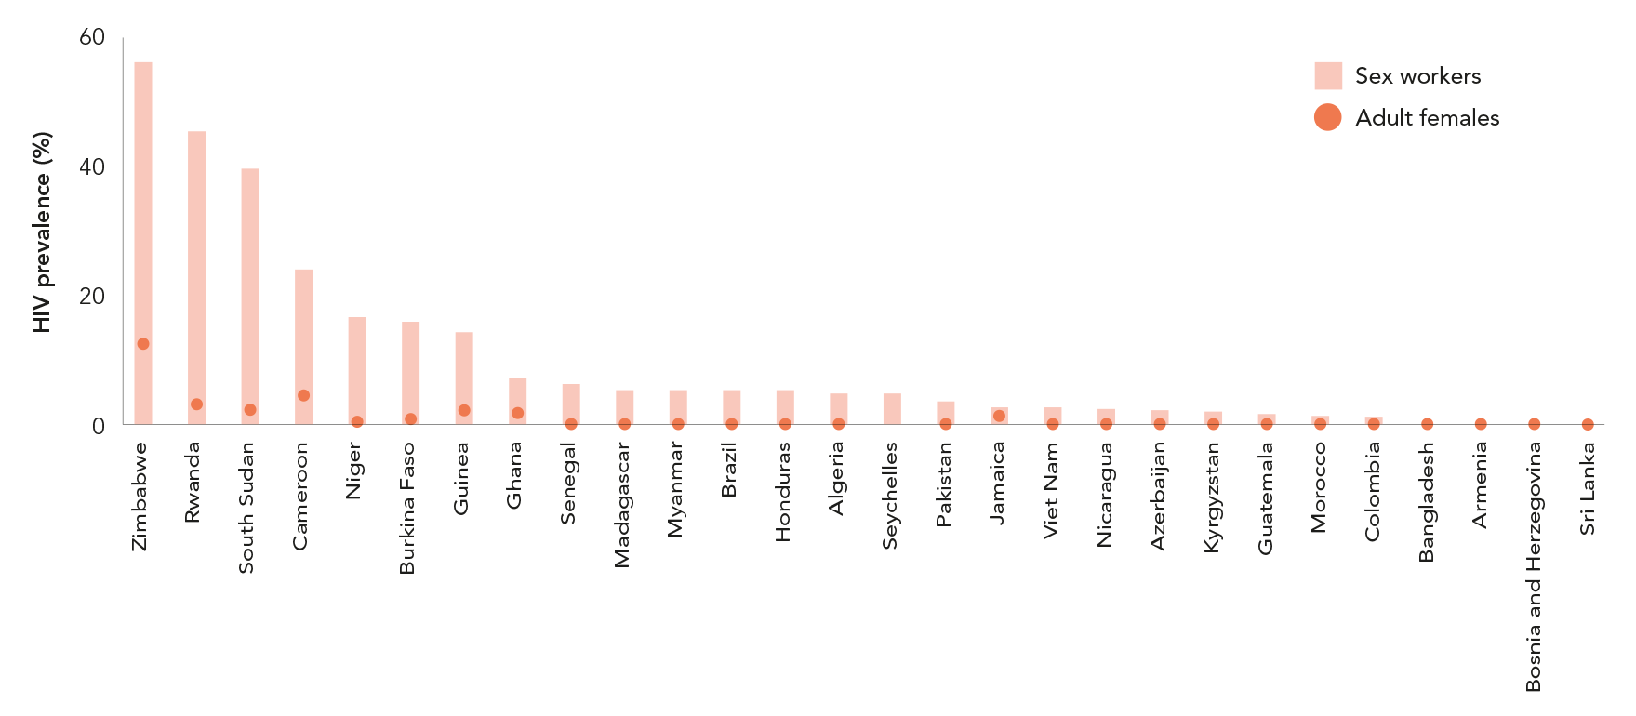
HIGH HIV PREVALENCE AMONG KEY POPULATIONS
Female sex workers and the adult female population
HIV prevalence among key populations and general population, select countries, 2014–2016 (first of 3 slides)
Source: UNAIDS 2017 estimates. Global AIDS Monitoring, 2017.

Slide 16
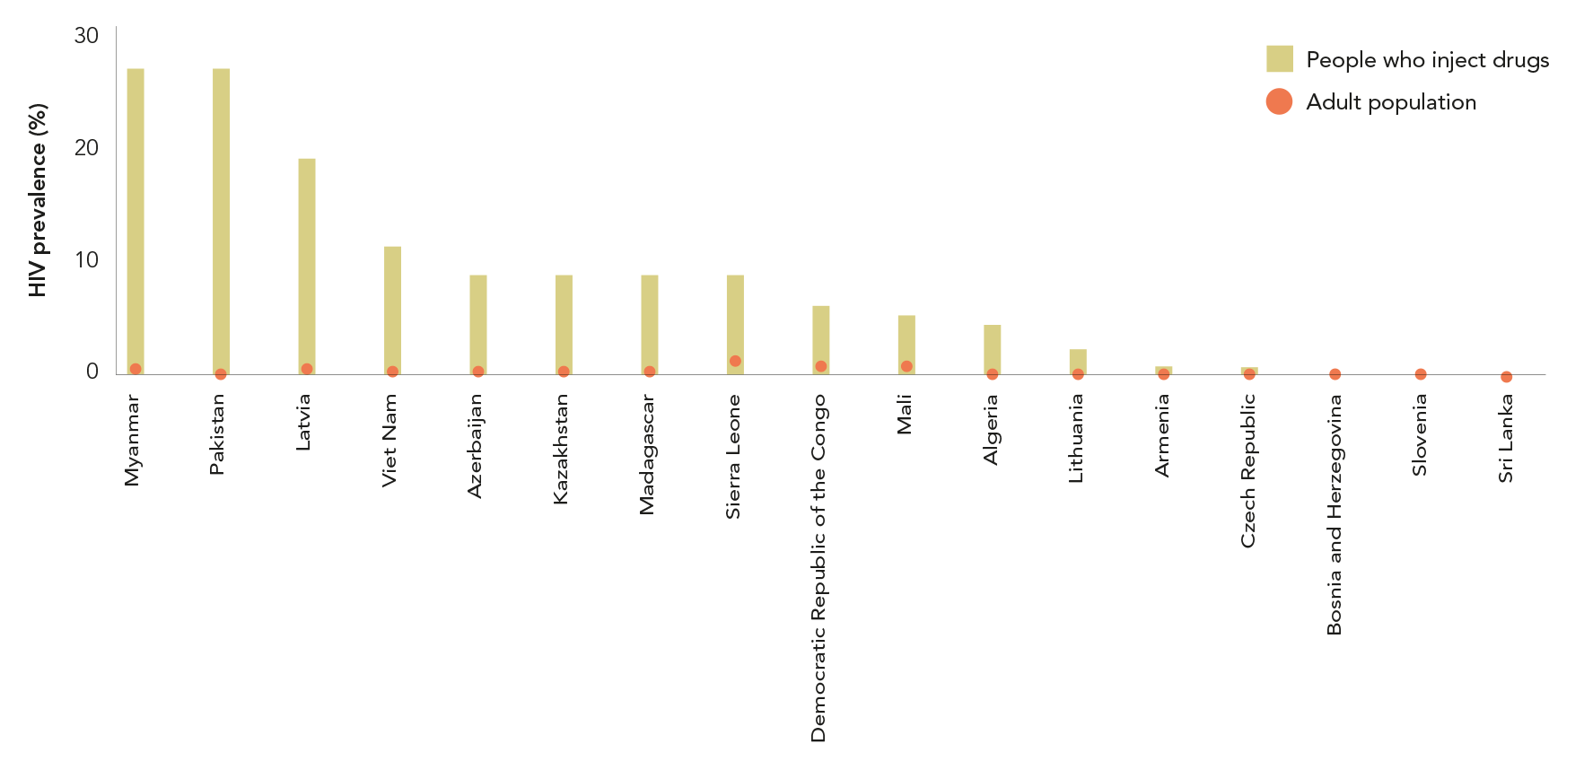
HIGH HIV PREVALENCE AMONG KEY POPULATIONS
People who inject drugs and the adult population
HIV prevalence among key populations and general population, select countries, 2014–2016 (second of 3 slides)
Source: UNAIDS 2017 estimates. Global AIDS Monitoring, 2017.

Slide 17
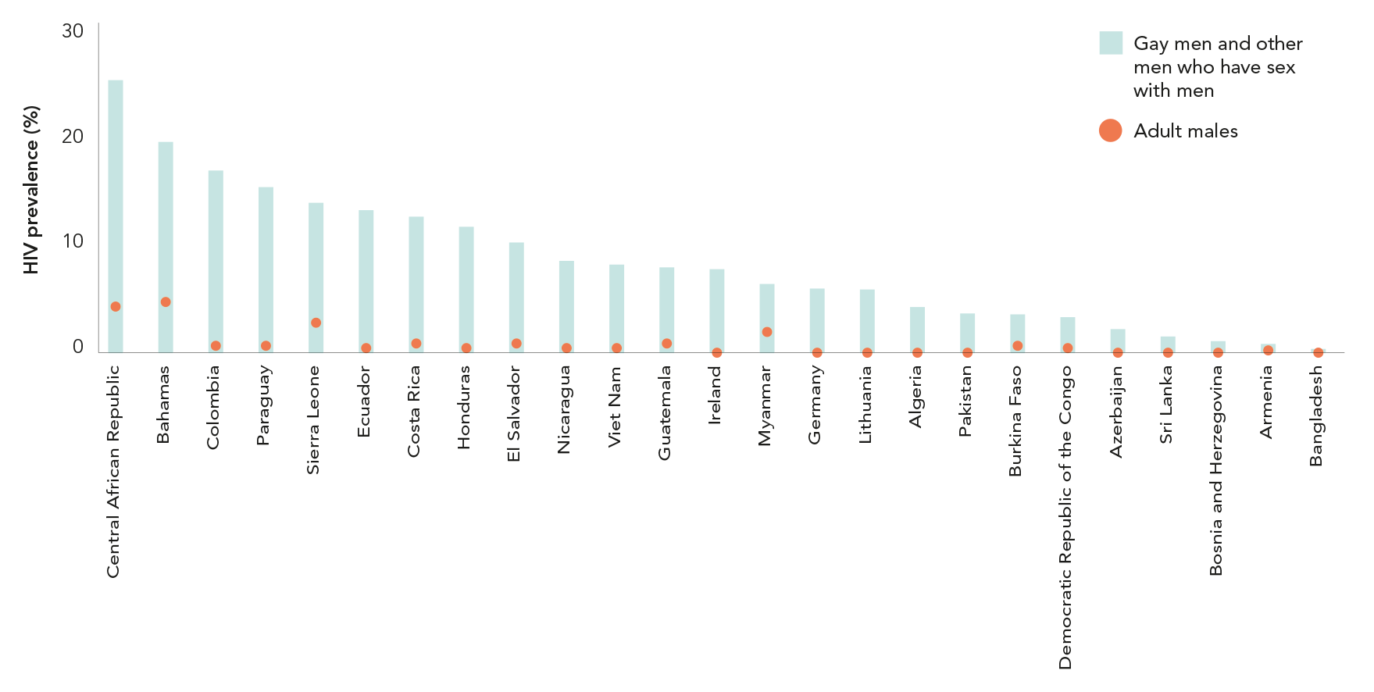
HIGH HIV PREVALENCE AMONG KEY POPULATIONS
Gay men and other men who have sex with men and the adult male population
HIV prevalence among key populations and general population, select countries, 2014–2016 (last of 3 slides)
Source: UNAIDS 2017 estimates. Global AIDS Monitoring, 2017.

Slide 18


Slide 19
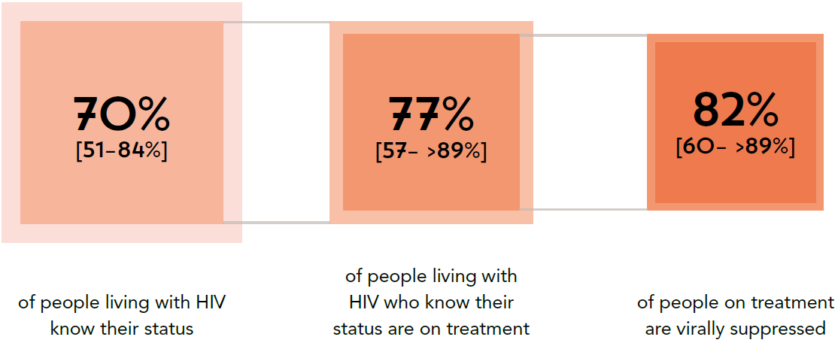
CLOSING IN ON A FAST-TRACK TARGETS
PROGRESS TOWARDS THE 90–90–90 targets, global, 2016
Source: UNAIDS special analysis, 2017; see annex on methods for more details

Slide 20
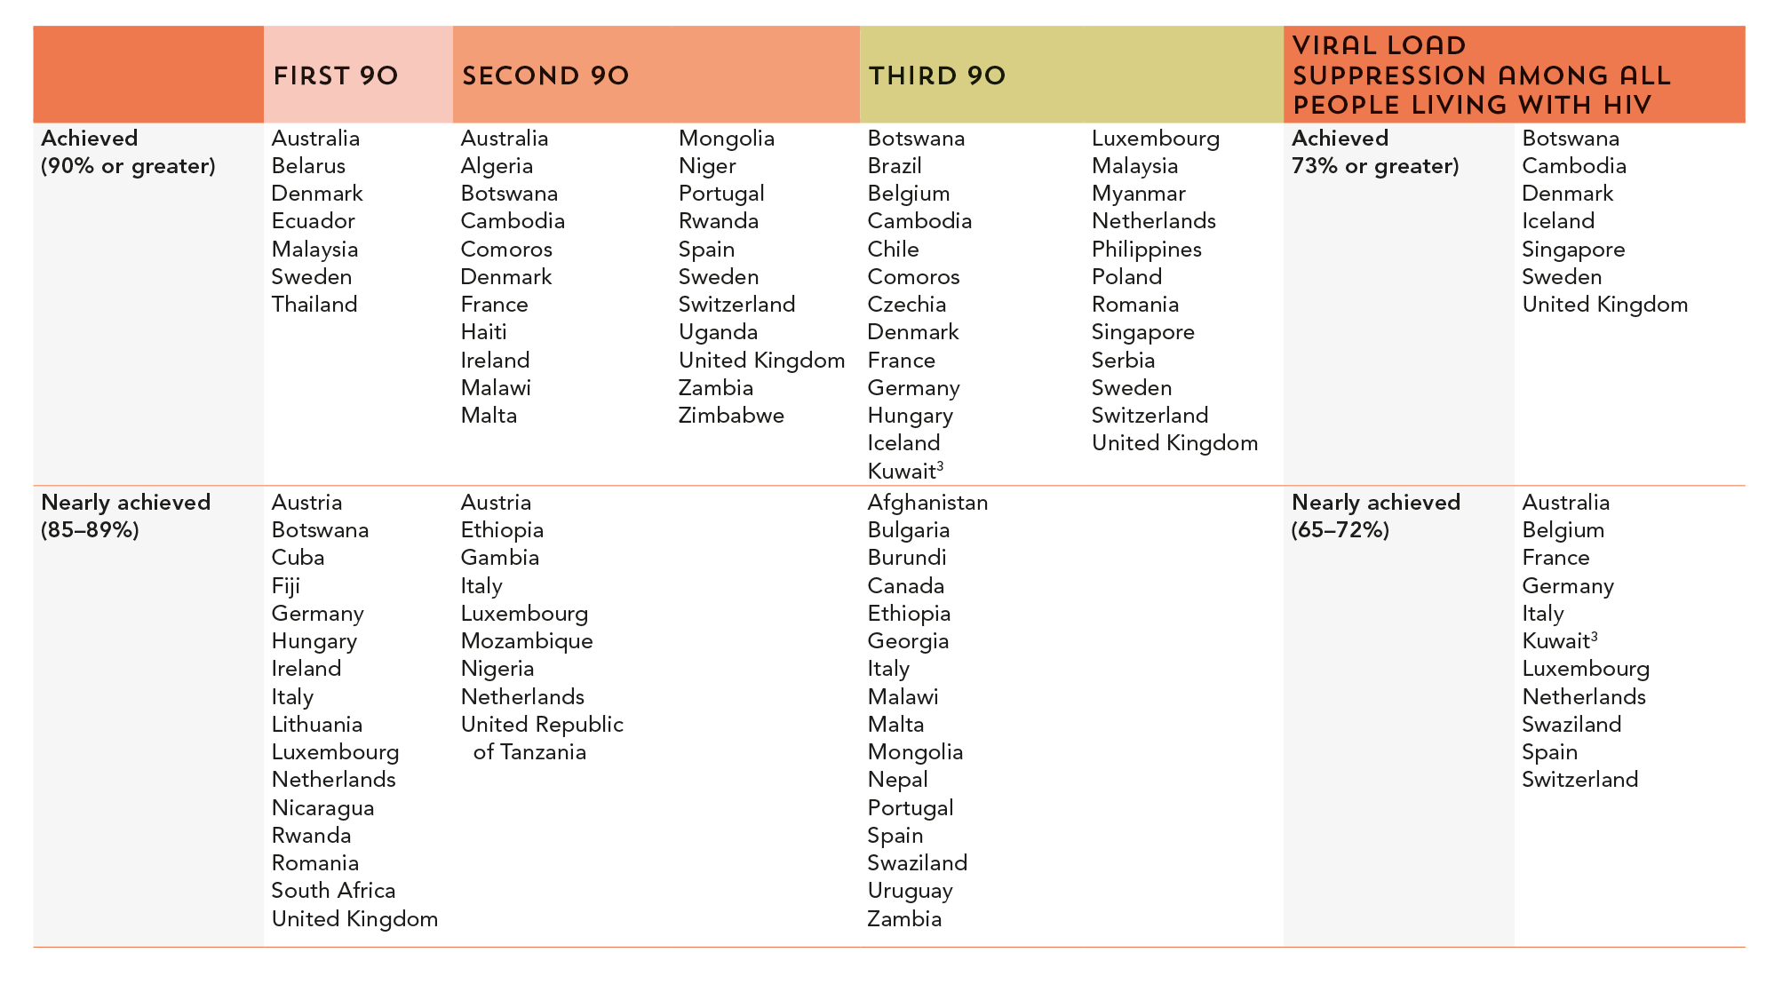
ACHIEVING THE 90–90–90 TARGETS, 2016
Countries that have achieved the 90–90–90 targets or are near to achieving theM,
MOST RECENT COUNTRY DATA^{1,2}
Source: UNAIDS special analysis, 2017; see annex on methods for more details.
¹ Data are for 2016, except as follows: 2015: Bulgaria, Germany, Hungary, Netherlands, Sweden, Switzerland, United Kingdom. 2014: Belgium, Canada, Serbia, Spain. 2013: Austria, France. 2012: Italy.
² Estimates of people living with HIV are supplied by the country and not validated by UNAIDS: Austria, Belgium, Bulgaria, Canada, Denmark, France, Germany, Hungary, Iceland, Italy,
Luxembourg, Malta, Netherlands, Portugal, Singapore, Spain, Switzerland, and the United Kingdom
³ Estimates for citizens of the country only.

Slide 21
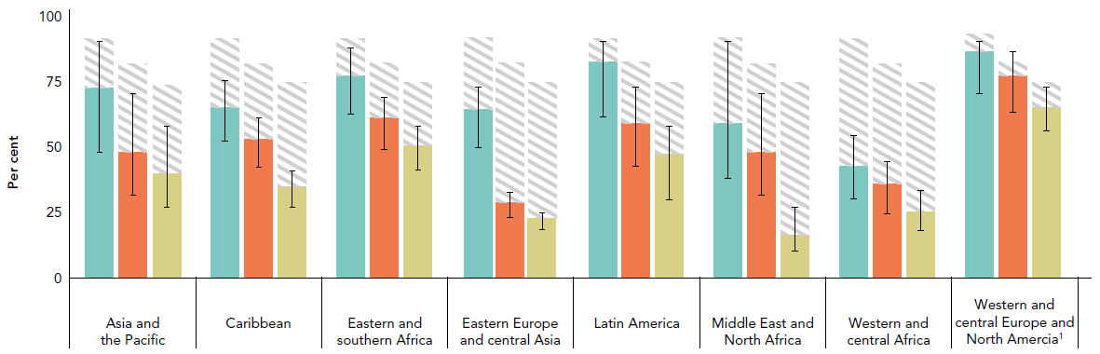
CASCADE PROGRESS VARIES AMONG REGIONS
Knowledge of HIV status, treatment coverage and viral load suppression,
by region, 2016
Comparison of HIV testing and treatment cascades by region reveals different patterns of progress. Western and central Europe and North America
are approaching global targets. Latin America and eastern and southern Africa show high levels of achievement across the cascade. Eastern Europe
and central Asia, the Middle East and North Africa, and western and central Africa are clearly on track.
Source: UNAIDS special analysis, 2017; see annex on methods for more details.
¹ Cascade for the western and central Europe and North America region is for 2015.

Slide 22
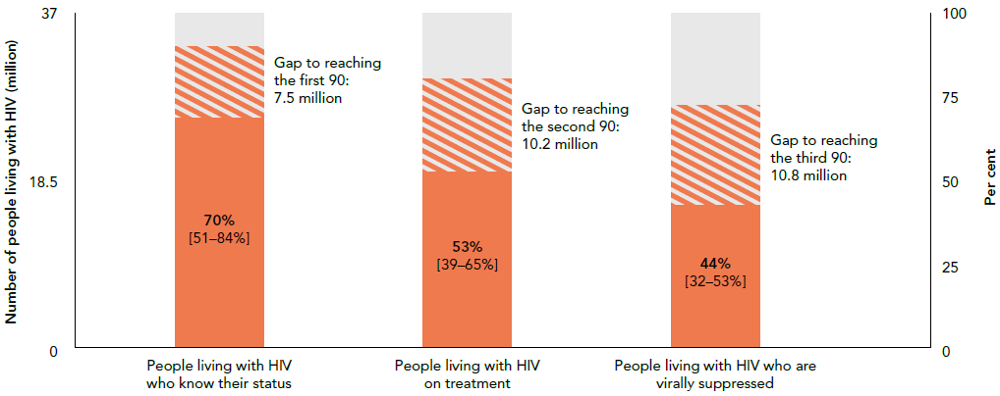
THE HIV TESTING AND TREATMENT CASCADE
Knowledge of HIV status, treatment coverage and viral load
suppression, global, 2016
Source: UNAIDS special analysis, 2017; see annex on methods for more details.

Slide 23
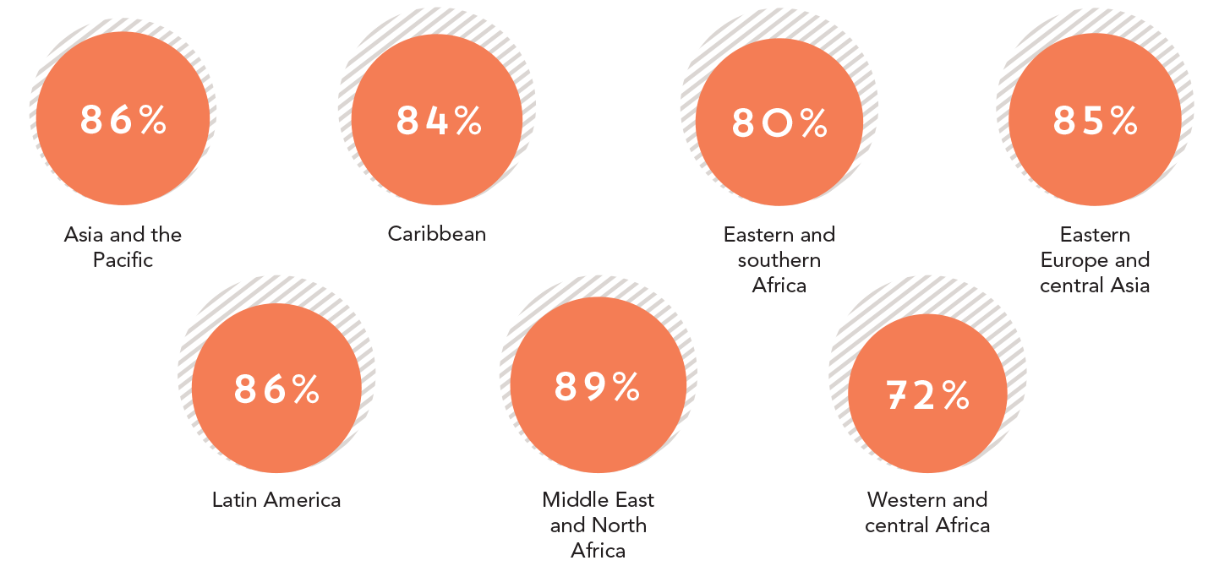
HIGH RETENTION RATES SUPPORT HIGH RATES
OF VIRAL SUPPRESSION
Percentage of people living with HIV retained on treatment 12 months
after initiation, by region, 2016
Source: UNAIDS 2017 estimates. Global AIDS Monitoring, 2017.

Slide 24
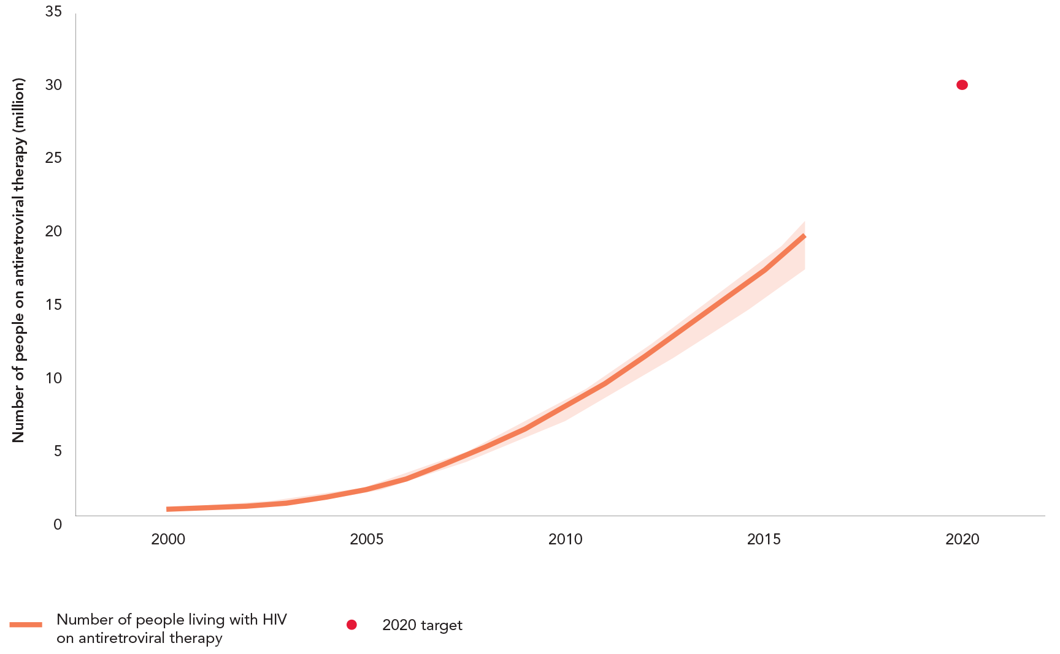
ON TRACK TO 30 MILLION PEOPLE ACCESSING TREATMENT
Number of people living with HIV ON antiretroviral therapy,
global, 2000–2016
Source: UNAIDS 2017 estimates. Global AIDS Monitoring, 2017.

Slide 25
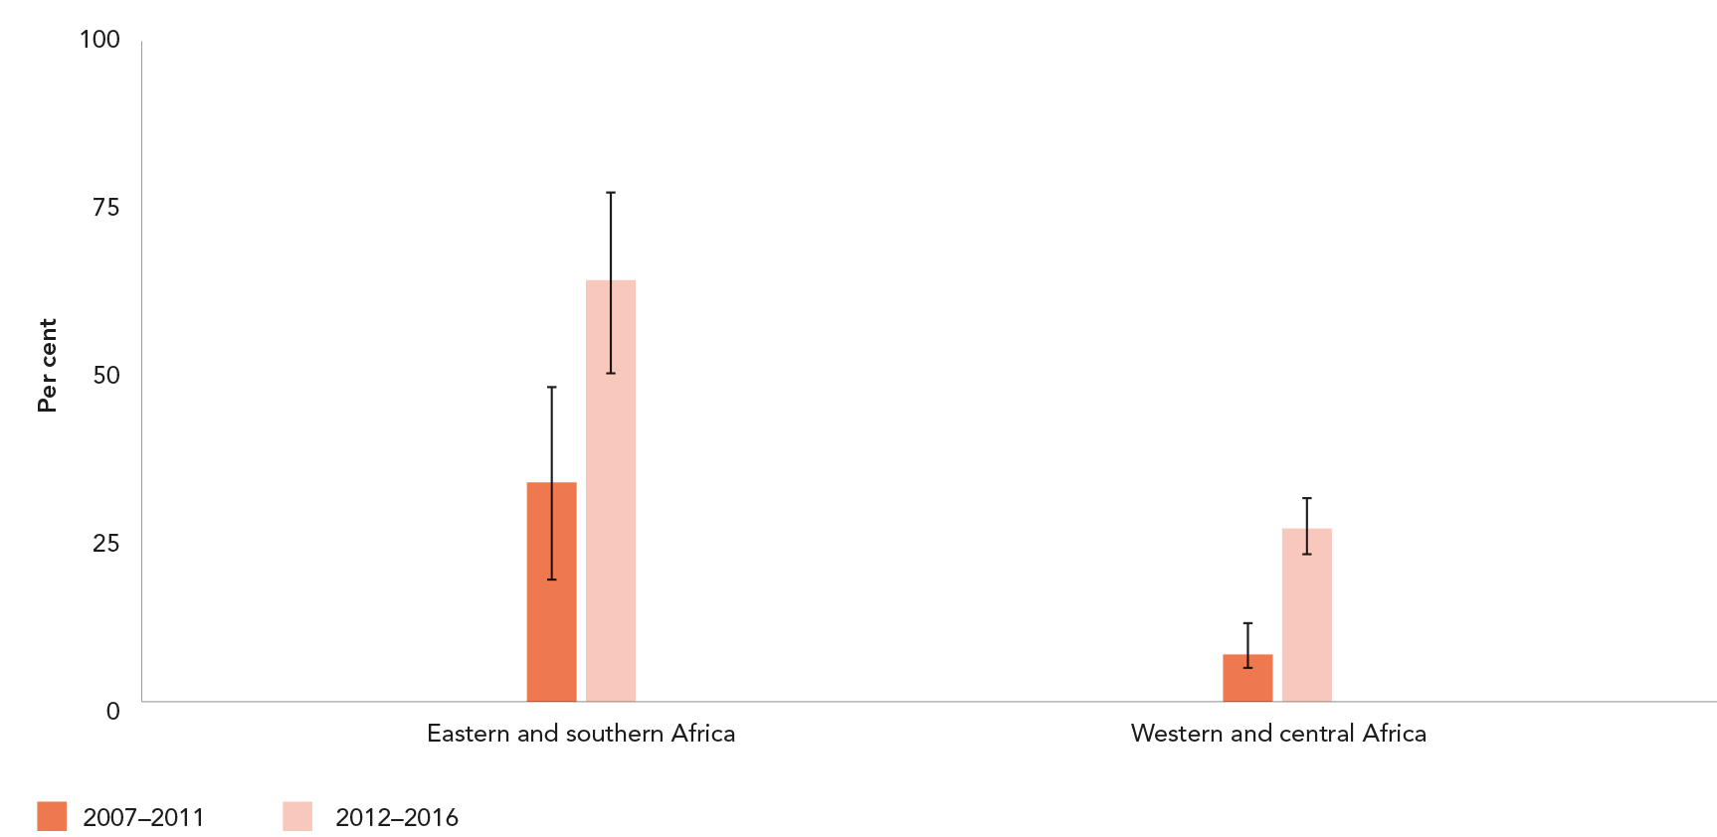
REMARKABLE INCREASE IN KNOWLEDGE OF HIV STATUS
OVER THE PAST DECADE
Knowledge of HIV status among adults aged 15–49 years, eastern and southern Africa
and western and central Africa, 2007–2011, compared to 2012–2016
Source: UNAIDS special analysis, 2017.

Slide 26
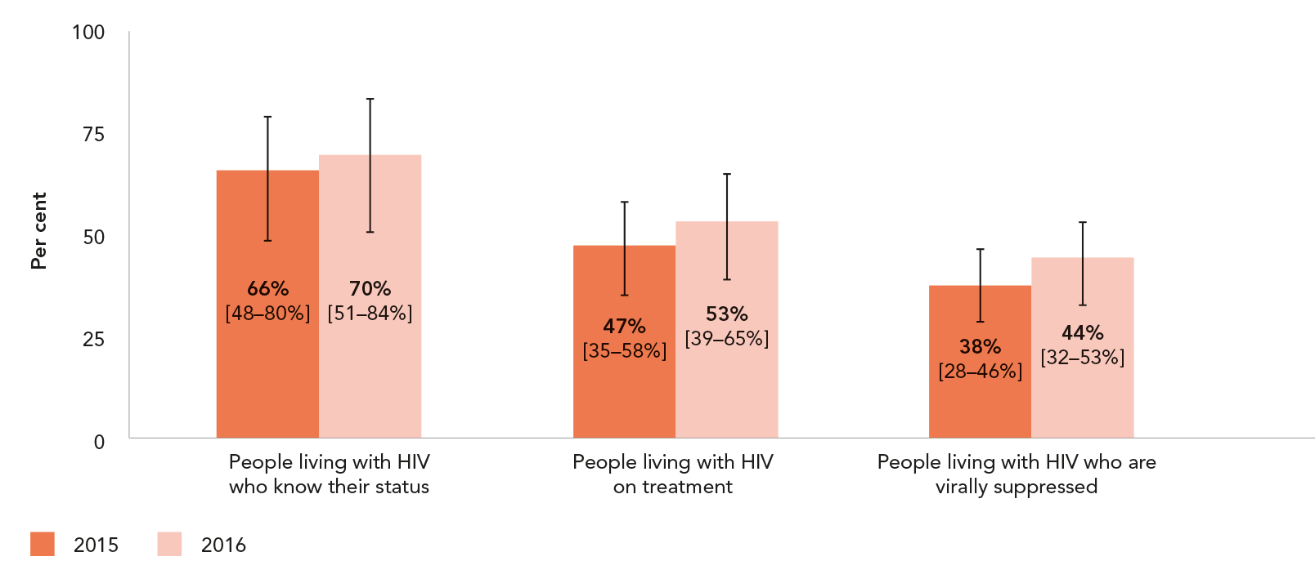
ONE-YEAR GAINS ACROSS THE CASCADE
Knowledge of HIV status, antiretroviral therapy coverage and viral suppression among people living with HIV, global, 2015 and 2016
Source: UNAIDS special analysis, 2017; see annex on methods for more details.

Slide 27
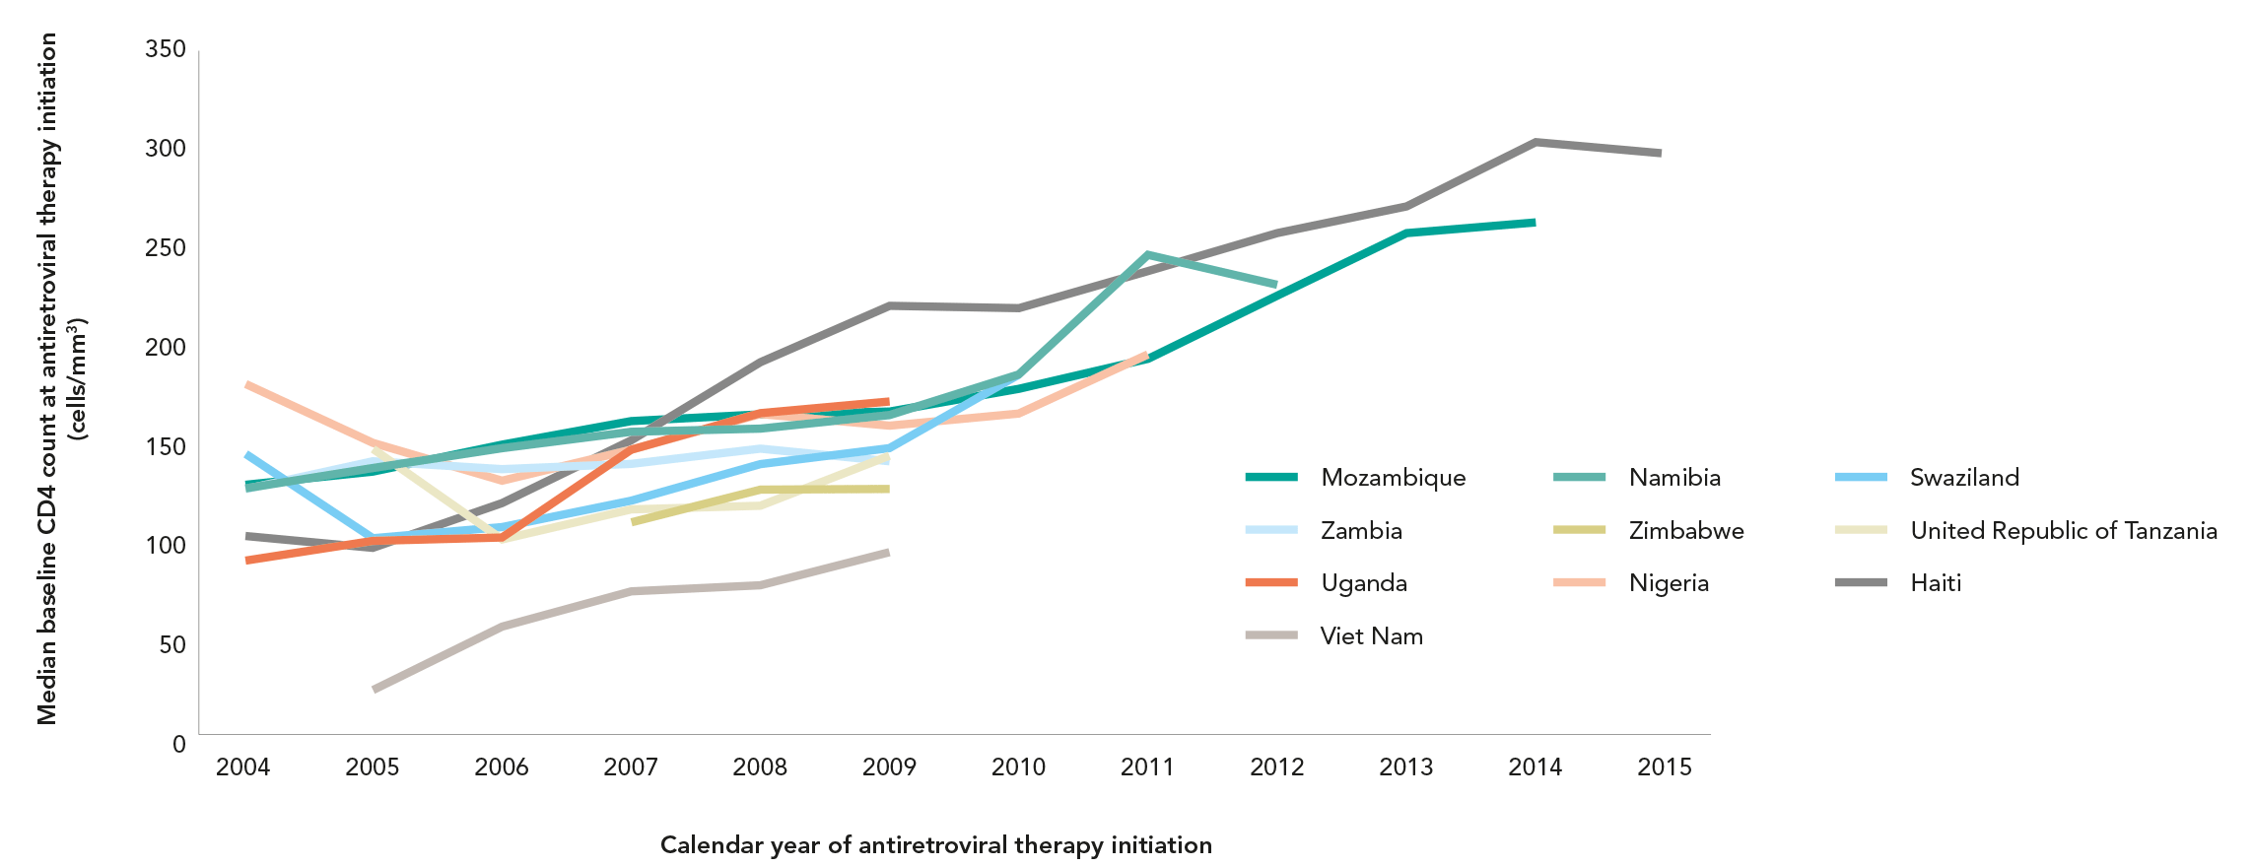
PEOPLE INITIATING TREATMENT EARLIER, BUT MANY STILL START WITH ADVANCED DISEASE
TRENDS IN MEDIAN CD4 T-CELL COUNT AT ANTIRETROVIRAL THERAPY INITIATION,
10 COUNTRIES, 2004–2015
Source: Auld AF, Shiraishi RW, Oboho l et al. Trends in Prevalence of Advanced HIV Disease at Antiretroviral Therapy Enrollment—10 Countries, 2004–2015. MMWR Morb
Mortal Wkly Rep 2017;66:558–563. doi: http://dx.doi.org/10.15585/mmwr.mm6621a3.

Slide 28
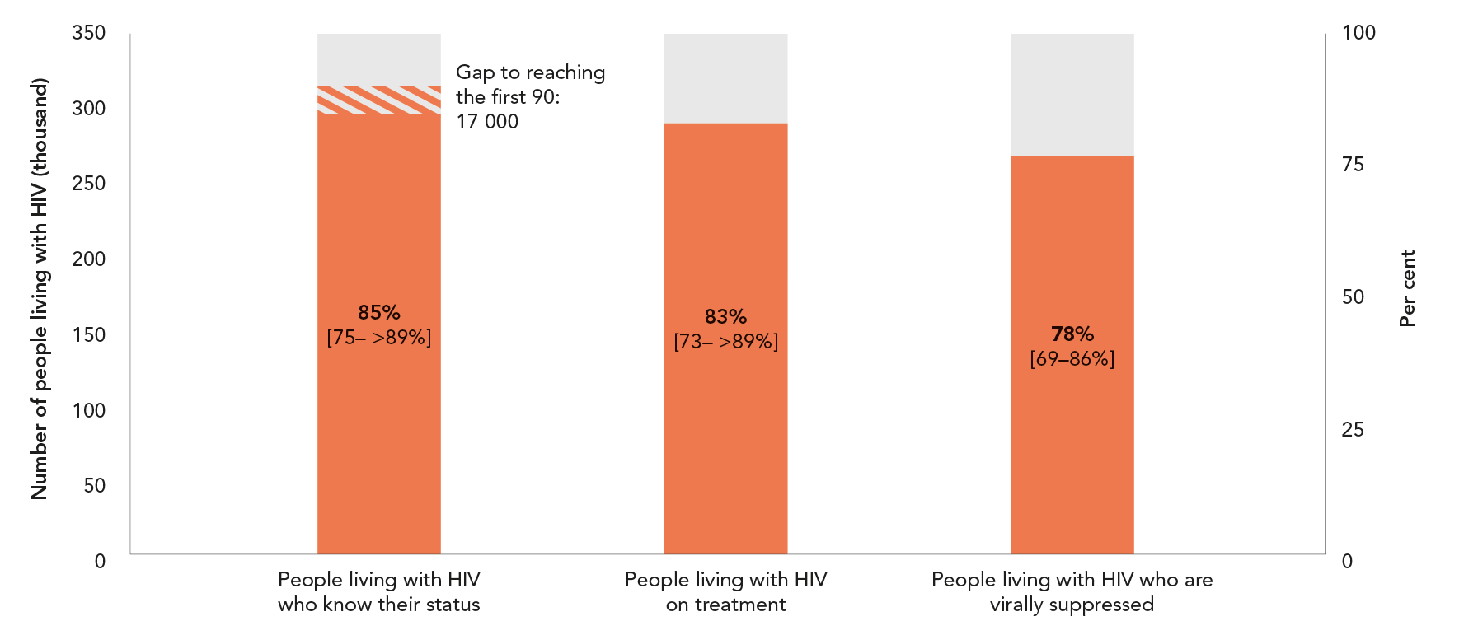
BOTSWANA and THE 90–90–90 TARGETS
Knowledge of HIV status, antiretroviral therapy coverage
and viral suppression among people living with HIV, Botswana, 2016
Source: UNAIDS special analysis, 2017; see annex on methods for more details.

Slide 29
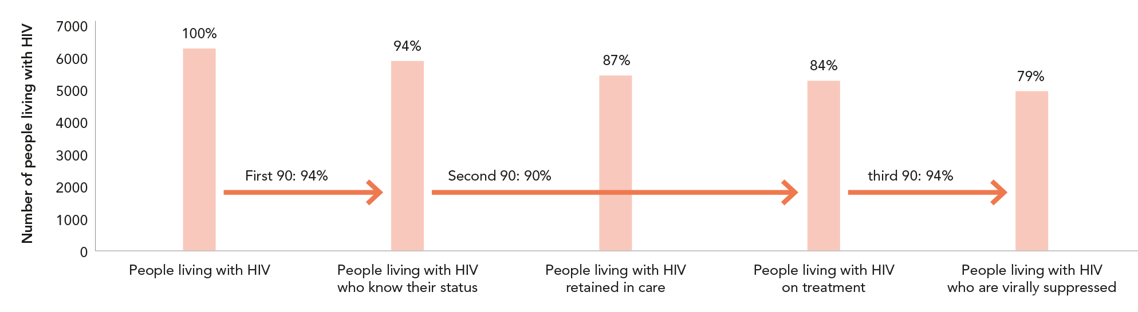
AMSTERDAM
City case study
HIV TESTING AND TREATMENT CASCADE, AMSTERDAM, 2015
Source: Stichting HIV Monitoring, 2017.

Slide 30
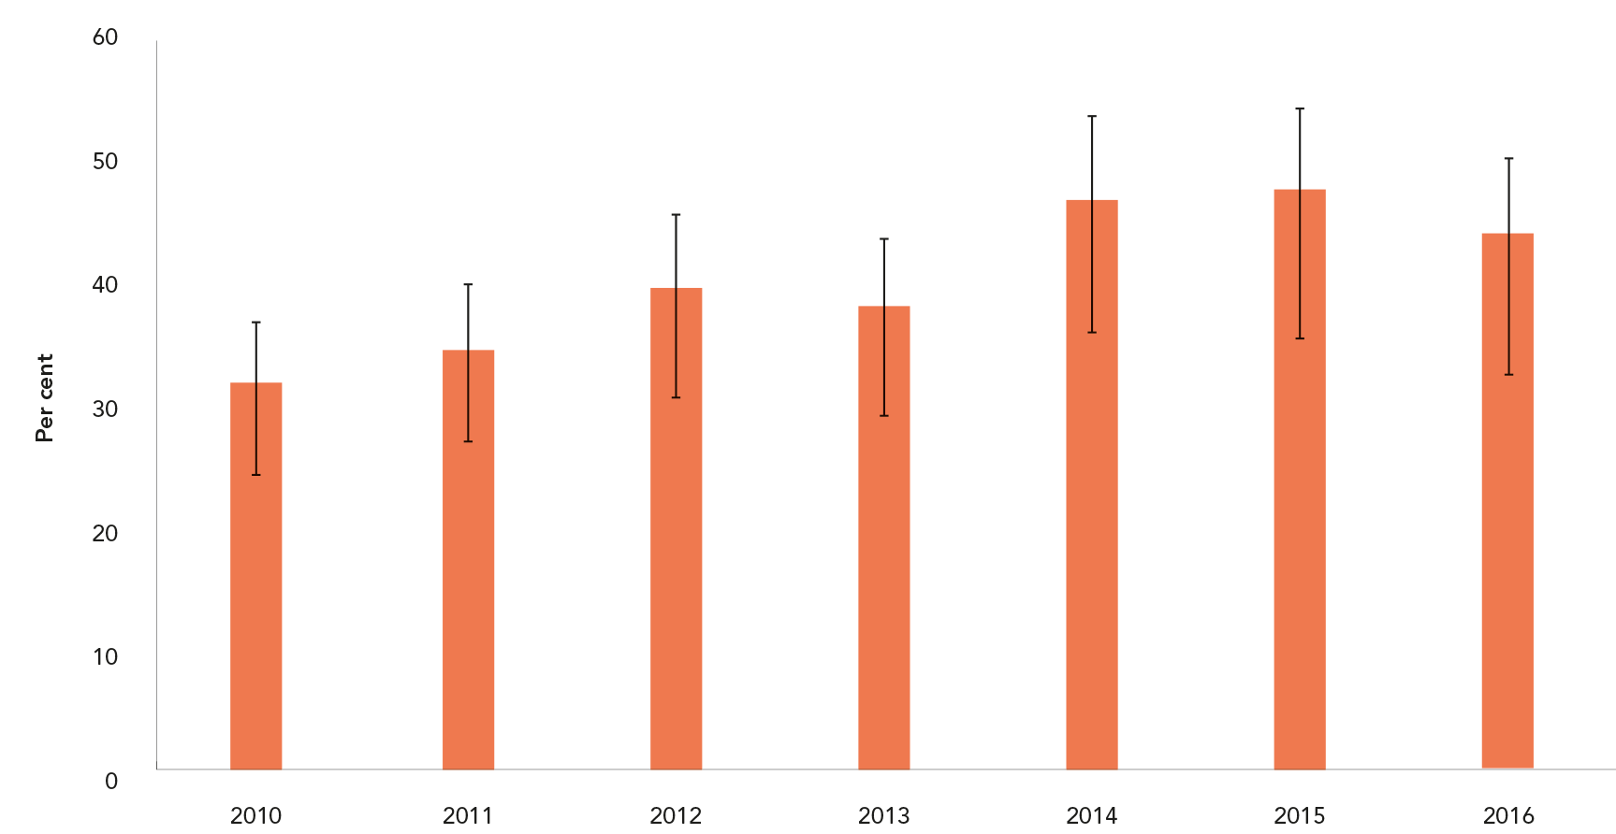
EARLY INFANT DIAGNOSIS
Percentage of HIV-exposed infants who have been diagnosed within
two months of birth, 21 high-burden countries, 2013 and 2016
Source: Global AIDS Monitoring, 2017; UNAIDS 2017 estimates.

Slide 31
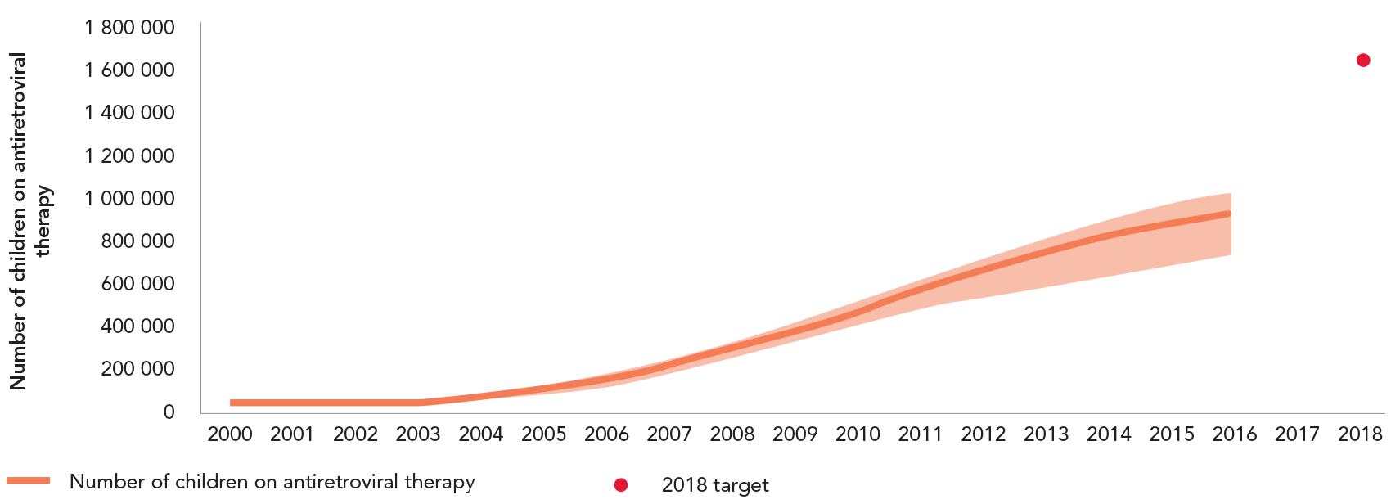
SLOWING SCALE-UP OF PAEDIATRIC TREATMENT
Number of children aged 0–14 years accessing antiretroviral therapy, global, 2000–2016 plus 2018 target
Source: UNAIDS 2017 estimates. Global AIDS Monitoring, 2017.

Slide 32
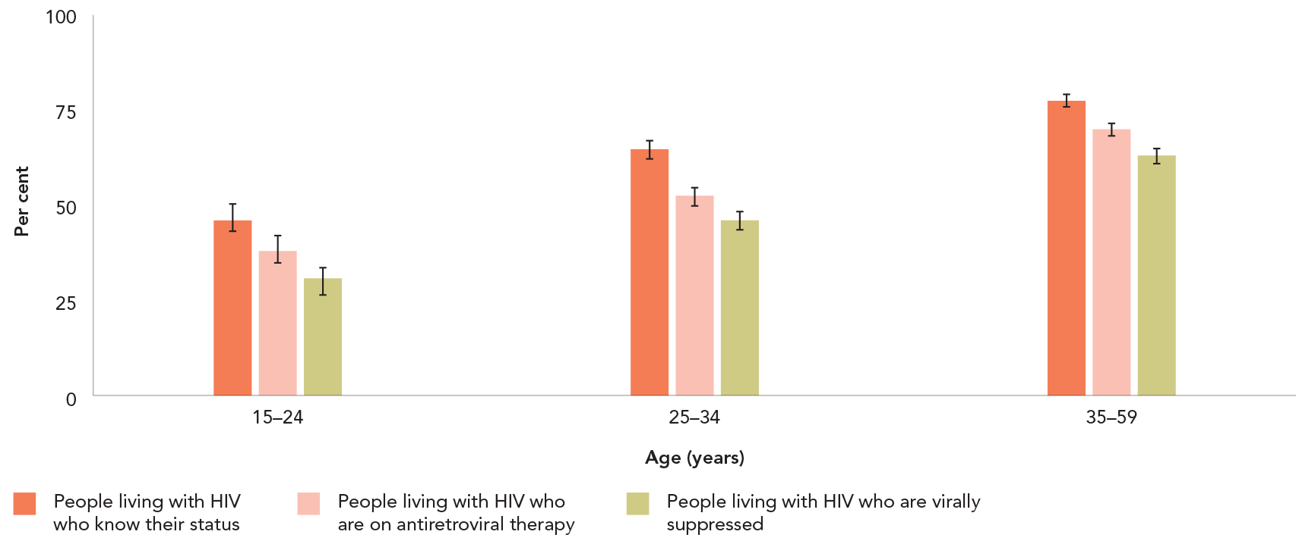
LARGER GAPS FOR YOUNG PEOPLE ACROSS THE CASCADE
Knowledge of HIV status, treatment coverage and viral load suppression, Malawi, Zambia and Zimbabwe, BY AGE, 2015–2016
Source: Malawi population-based HIV impact assessment (MPHIA), 2015–2016. Summary sheet: preliminary findings. New York: PHIA Project; December 2016. Zambia population-based
HIV impact assessment (ZAMPHIA), 2015–2016. Summary sheet: preliminary findings. New York: PHIA Project; December 2016. Zimbabwe population-based HIV impact assessment
(ZIMPHIA), 2015–2016. Summary sheet: preliminary findings. New York: PHIA Project; December 2016.

Slide 33
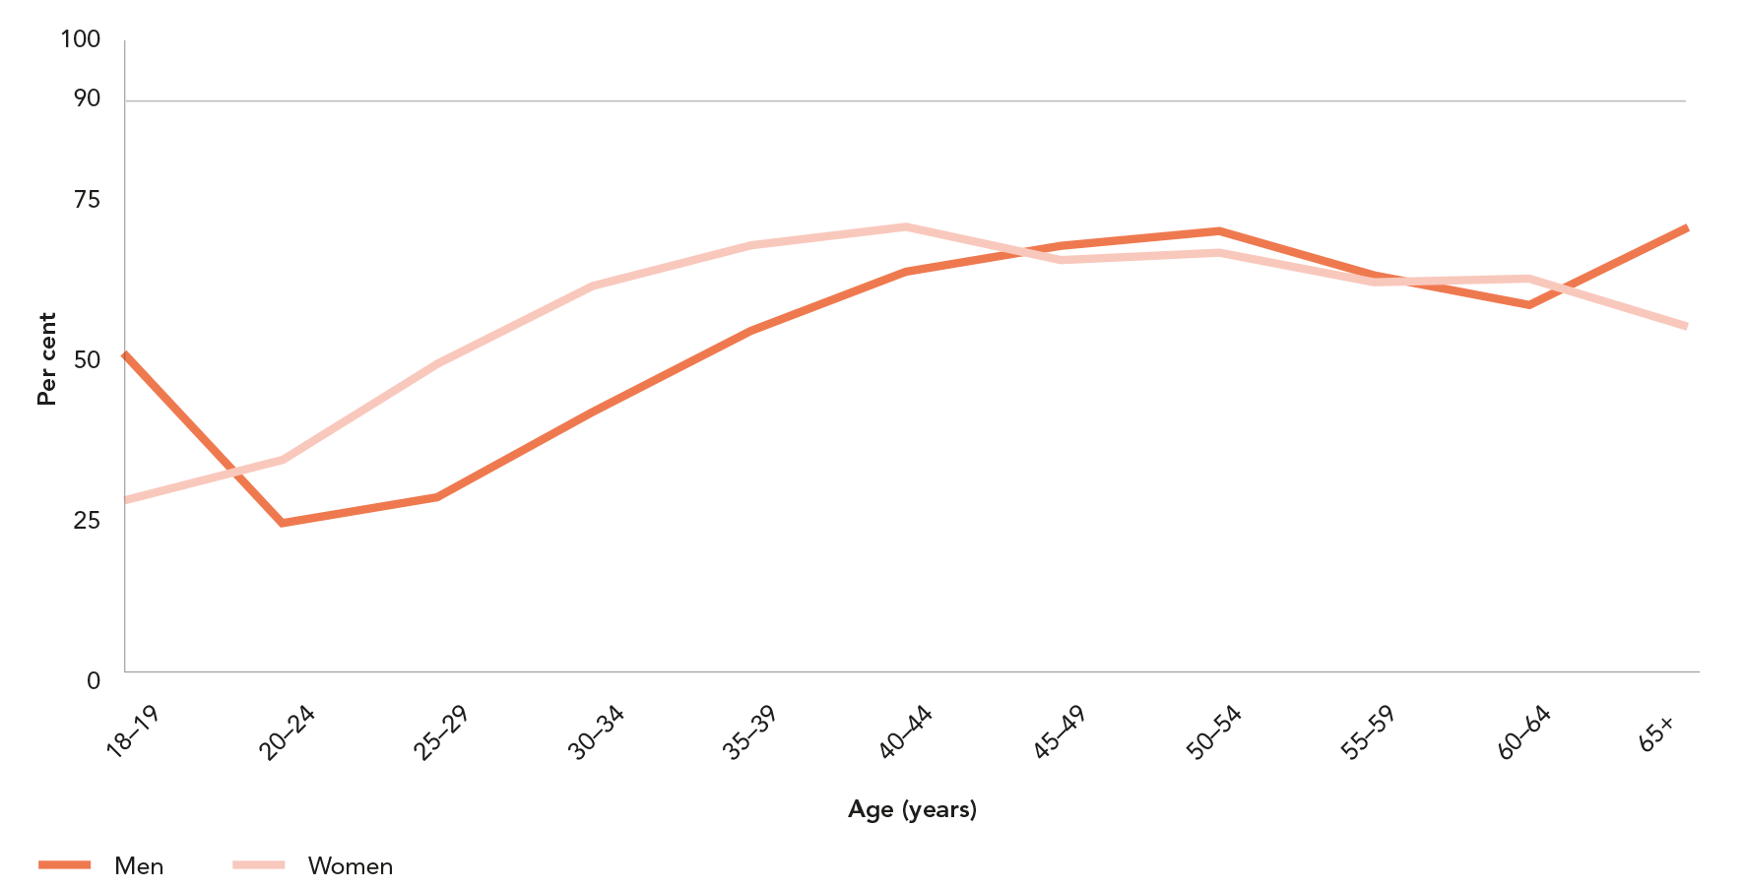
LOWER AWARENESS OF HIV STATUS AMONG YOUNG PEOPLE LIVING WITH HIV (first of 2 slides)
HPTN 071 (PopART) trial: Knowledge of HIV status among men and women living with HIV, by age, before community-based services, Zambia, November 2013 to June 2015
Source: Hayes R, Floyd S, Schapp A, Shanaube K, Bock P, Sabapathy K et al. A universal testing and treatment intervention to improve HIV control: one-year results from intervention
communities in Zambia in the HPTN 071 (PopART) cluster-randomised trial. PLoS Med. 2017;15(5):e1002292.
* Data are extrapolated to the total adult population.

Slide 34
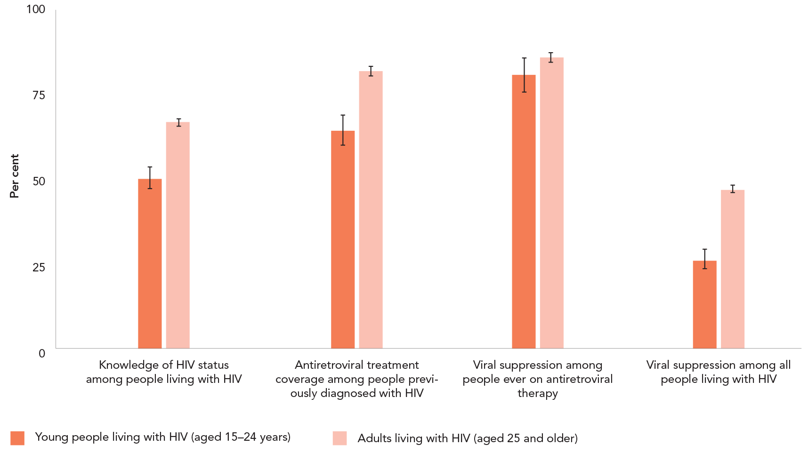
LOWER AWARENESS OF HIV STATUS AMONG YOUNG PEOPLE LIVING WITH HIV (last of 2 slides)
90–90–90 at baseline among people living with HIV aged 15 years and older,
by age, 16 communities in rural Kenya and Uganda, June 2013 to June 2014
Source: Petersen M, Balzer L, Kwarsiima D, Sang N, Chamie G, Ayieko J et al. Association of implementation of a universal testing and treatment intervention with HIV diagnosis,
receipt of antiretroviral therapy, and viral suppression in East Africa. JAMA. 2017;317(21):2196–2206.

Slide 35
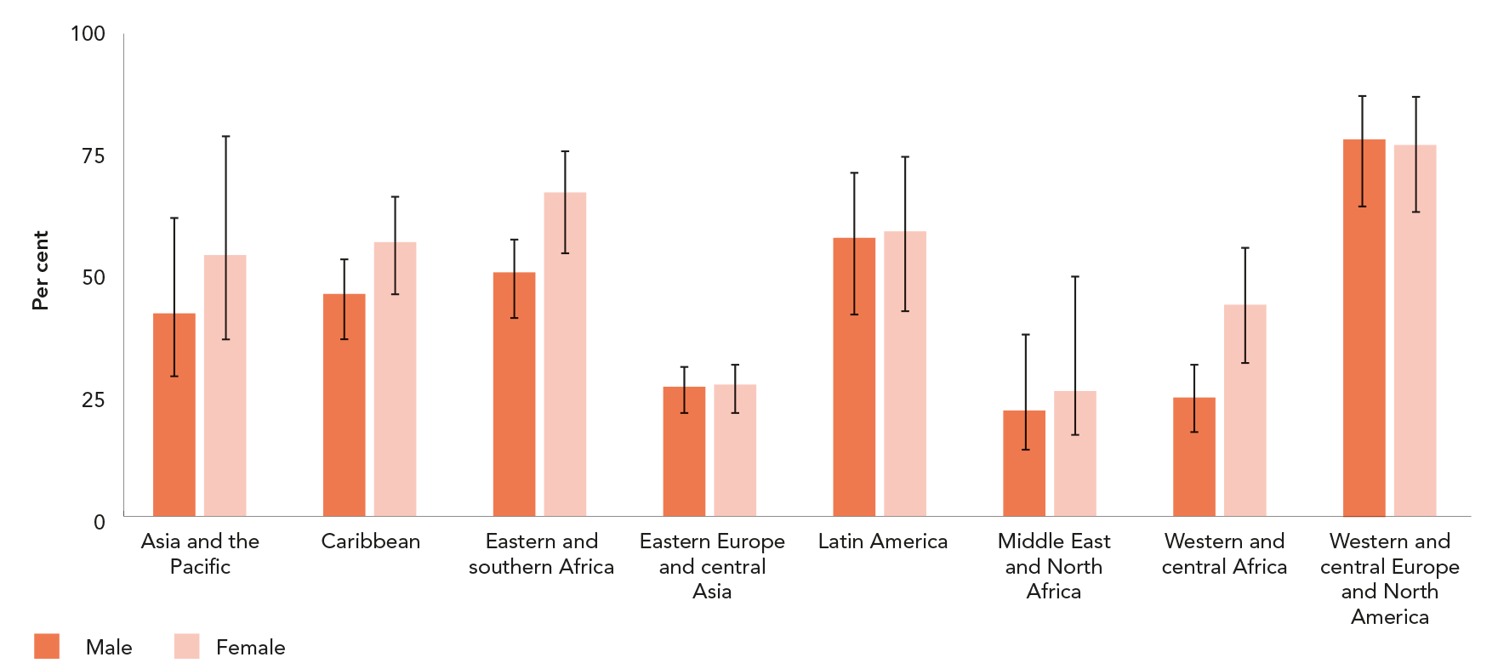
TREATMENT COVERAGE LOWER AMONG MEN
Antiretroviral therapy coverage among adults living with HIV aged 15 years
and older, by sex, by region, 2016
Source: Global AIDS Monitoring, 2017. UNAIDS 2017 estimates.

Slide 36
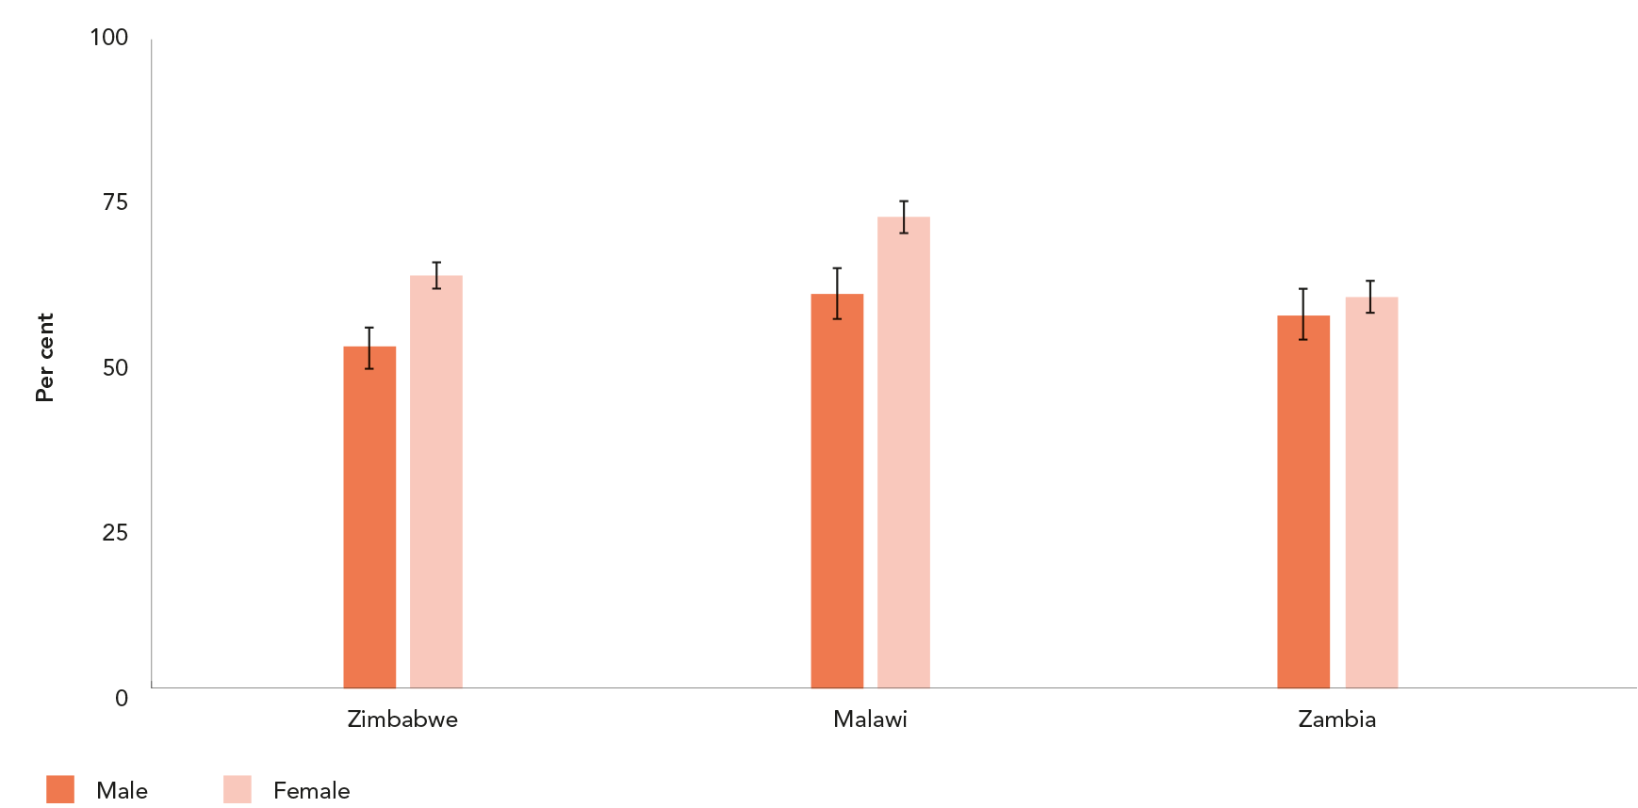
MEN LESS LIKELY THAN WOMEN TO HAVE SUPPRESSED
VIRAL LOADS
Percentage of adults (aged 15–59 years) living with HIV who are virally
suppressed, by sex, Malawi, Zambia and Zimbabwe, 2015–2016
Source: Malawi population-based HIV impact assessment (MPHIA), 2015–2016. Summary sheet: preliminary findings. New York: PHIA Project; December 2016. Zambia population-based
HIV impact assessment (ZAMPHIA), 2015–2016. Summary sheet: preliminary findings. New York: PHIA Project; December 2016. Zimbabwe population-based HIV impact assessment
(ZIMPHIA), 2015–2016. Summary sheet: preliminary findings. New York: PHIA Project; December 2016.

Slide 37
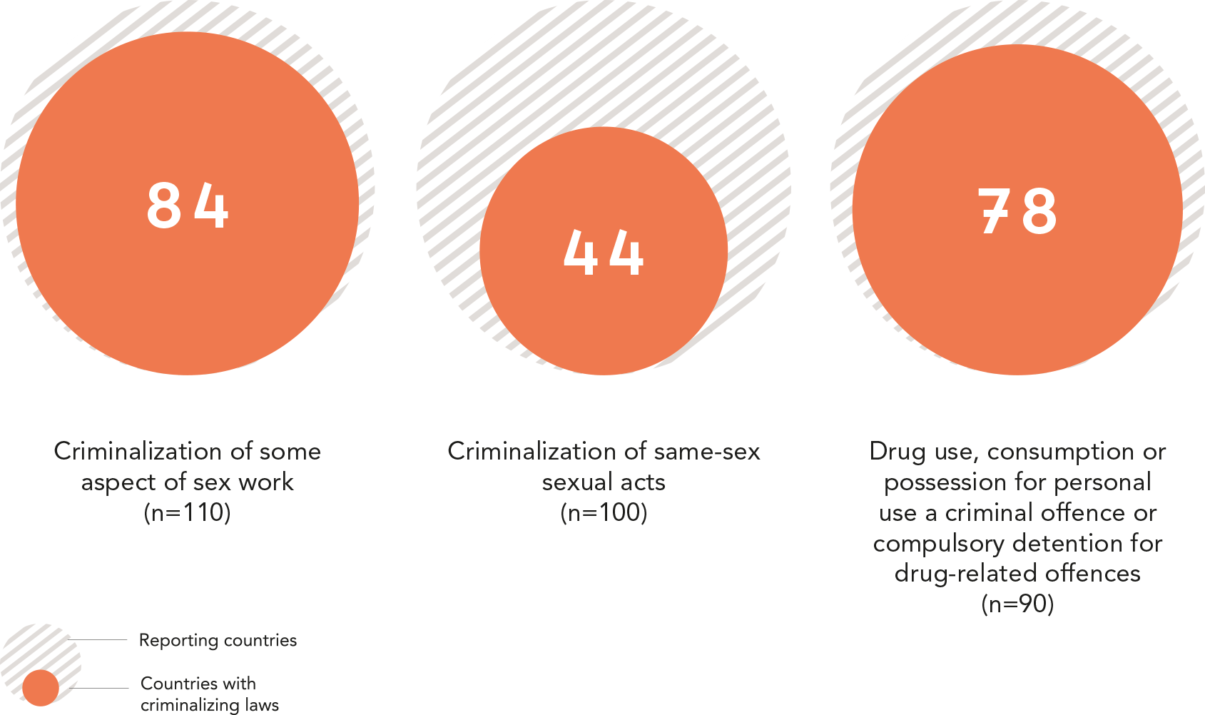
CRIMINALIZATION OF KEY POPULATIONS IS A BARRIER
TO TESTING AND TREATMENT SERVICES
Countries with laws that criminalize some aspects of sex work, same-sex
sexual relations or the possession or use of drugs, 2016
Source: 2017 National Commitments and Policy Instrument.

Slide 38
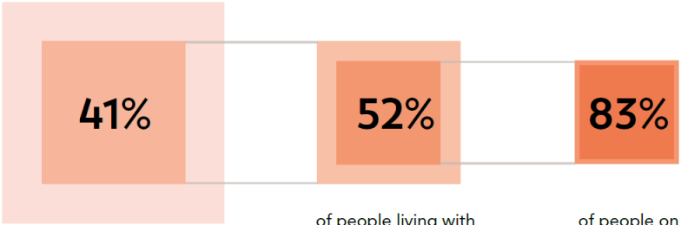
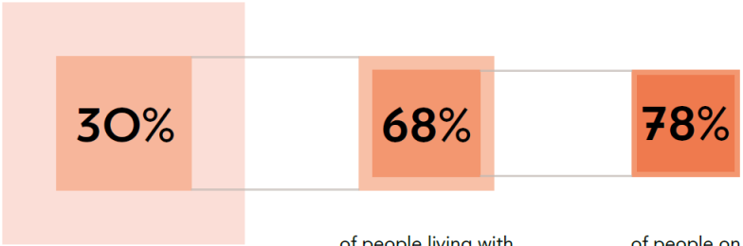
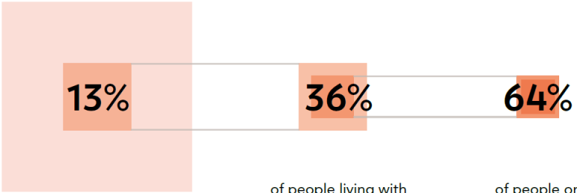
ALARMING GAPS IN THE 90–90–90 CONTINUUM
AMONG KEY POPULATIONS
Of people living
with HIV
know their status
Of people living
with HIV who
know their status
are on treatment
Of people on
treatment are
virally
suppressed
People who inject drugs, India
Gay men and other men who have sex with men, India
Gay men and other men who have sex with men, Moscow
90–90–90 among key populations in India and THE RUSSIAN FEDERATION, 2013.
Source: Mehta SH, Lucas GM, Solomon S, Srikrishnan AK, McFall AM, Dhingra N et al. HIV care continuum among men who have sex with men and persons who inject drugs in India: barriers to successful engagement.
Clin Infect Dis. 2015 Dec 1;61(11):1732–41. Wirtz A, Zelaya C, Latkin C, Peryshkina A, Galai N, Mogilnyi V et al. The HIV care continuum among men who have sex with men in Moscow, Russia: a cross-sectional study of
infection awareness and engagement in care. Sexually Transm Infect. 2016;92(2):161–167. doi:10.1136/sextrans-2015-052076..

Slide 39
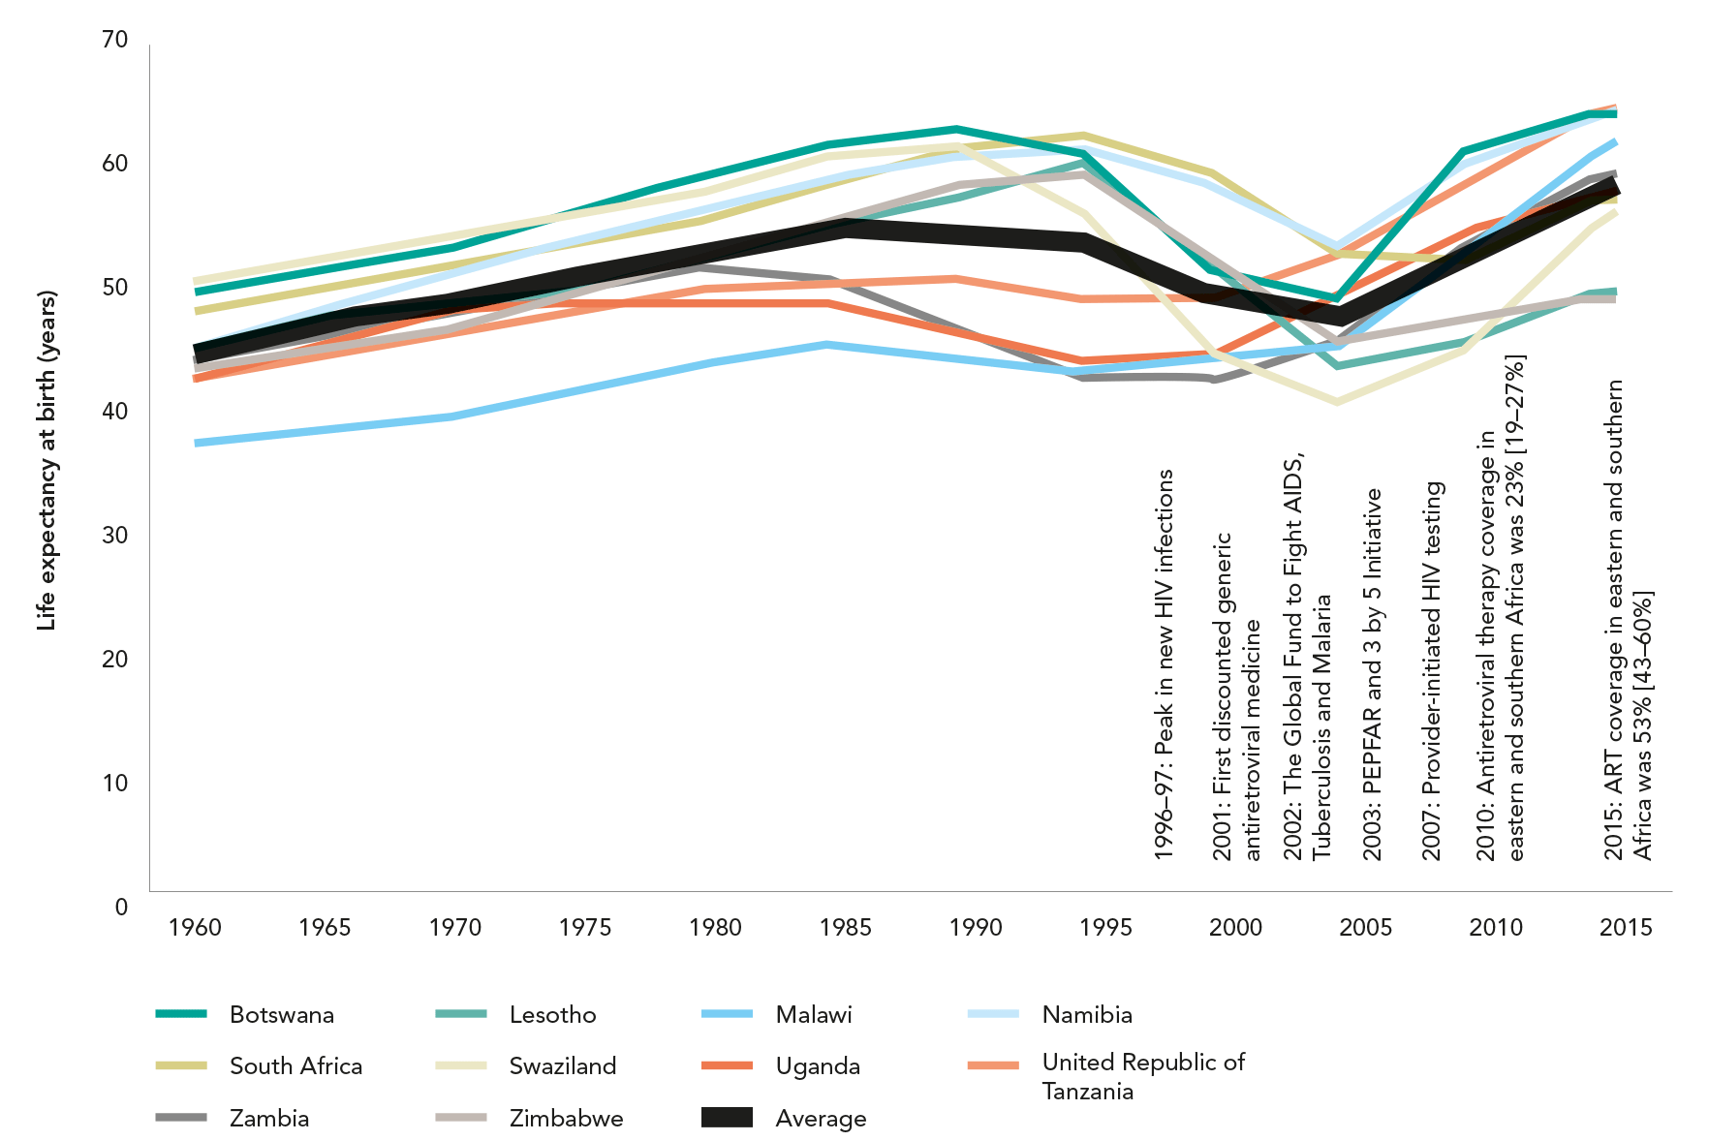
LIFE EXPECTANCY REBOUND FOLLOWING TREATMENT SCALE-UP
Life expectancy for 10 countries in eastern and southern Africa, 1960–2016
Source: UNAIDS analysis of data from United Nations Department of Economic and Social Affairs, Population Division, World Population Prospects: 2015 revision.

Slide 40
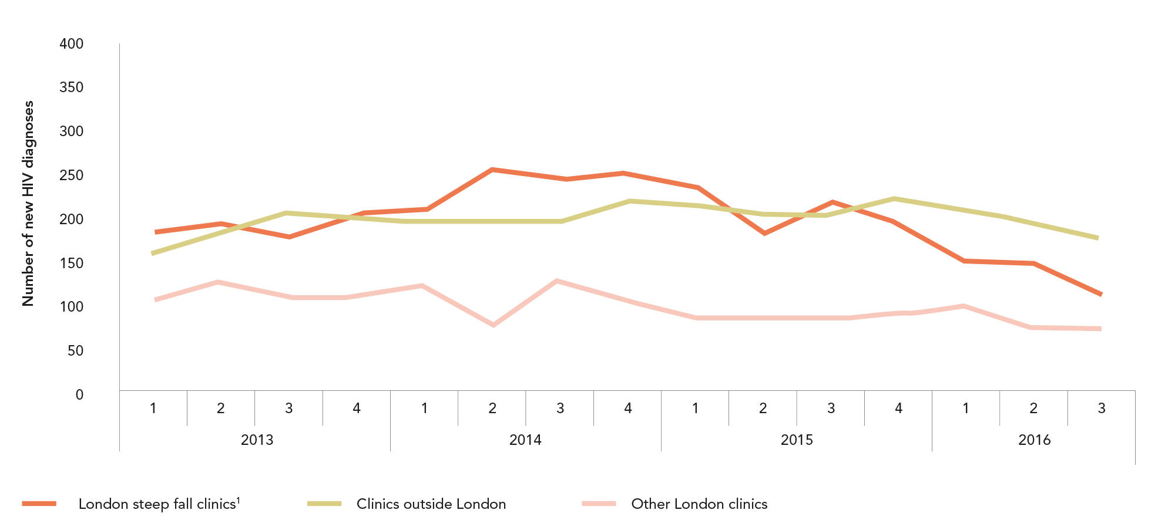
New HIV diagnoses among gay men and other men who have sex with men
attending sexual health clinics, England, United Kingdom, 2013–2016
Source: UNAIDS analysis of data from United Nations Department of Economic and Social Affairs, Population Division, World Population Prospects: 2015 revision.

Slide 41


Slide 42
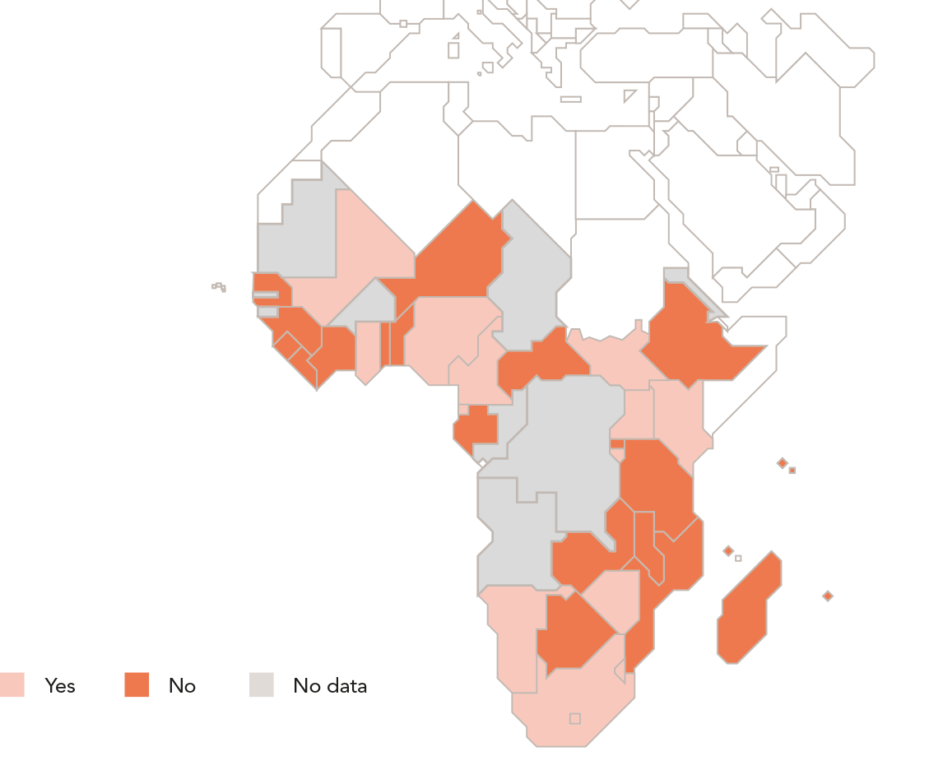
POLICIES FOR COMMUNITY-BASED TREATMENT
Countries with a national policy promoting community delivery of ANTIRETROVIRal THERAPY, SUB-SAHARAN AFRICA, 2016
A key characteristic of most differentiated care approaches is the expansion of care beyond secondary and tertiary health centres into community settings. In 2016,
25 of 118 reporting countries had a national policy promoting community delivery of antiretroviral therapy, including 40% of reporting countries in eastern and southern Africa..
Source: National Commitments and Policy Instrument.

Slide 43
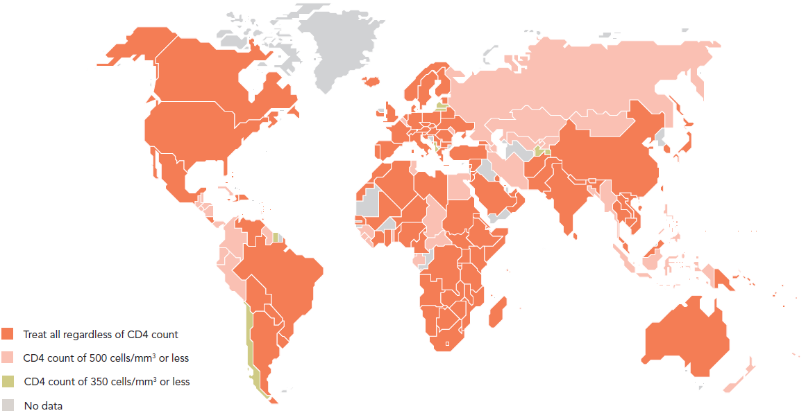
COUNTRIES ADOPTING THE TREAT ALL GLOBAL STANDARD
Recommended antiretroviral therapy initiation threshold among people living
with HIV per Ministry of Health guidelines, by country, global, MID-2017
Drawing on the rapidly growing body of data demonstrating the clear preventive and therapeutic effects of early antiretroviral therapy, the
World Health Organization (WHO) recommended in 2015 that antiretroviral therapy should be initiated in every person living with HIV at any CD4
cell count. Among the 194 countries that reported information to WHO and UNAIDS, 123 of them—including 29 of 35 Fast-Track countries—had
adopted this treat all approach within their national HIV treatment guidelines. Among the remaining reporting countries, eight continue to limit
treatment to people living with HIV who have a CD4 count of 350 cells/mm3 or lower.
Source: World Health Organization, 2017.

Slide 44
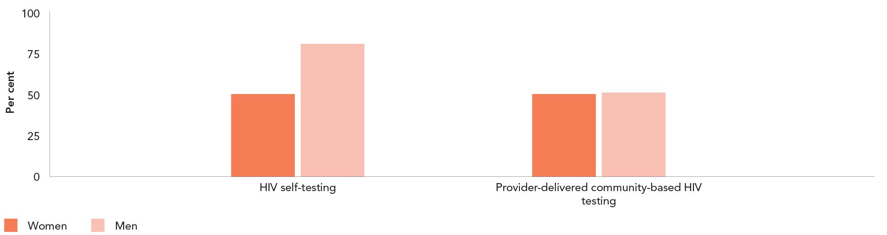
LINKING SELF-TESTERS TO TREATMENT
Proportion of HIV self-testers who initiated treatment following a reactive
self-test, Zimbabwe, 2016–2017*
HIV self-testing, which enables users to learn their HIV status by themselves in private, could play a pivotal role in reaching the first 90.
The result of a self-test is not a diagnosis, however, and an important challenge is linking an individual with a reactive self-test to a
confirmatory diagnosis and HIV treatment initiation. The UNITAID-supported Self-Testing Africa (STAR) project, led by Population Services
International (PSI) in partnership with the World Health Organization (WHO), is addressing this problem. During the first year of the project,
80% of reactive male self-testers in Zimbabwe initiated HIV treatment, compared to 51% among men who received reactive tests through
provider-delivered, community-based testing. Among women, the proportion of reactive testers initiating HIV treatment was equivalent
between the two testing options.
Source: STAR project, 2017.
* Proportion linked to care following HIV self-testing is based on the total number of reactive HIV self-test results over the total number of self-testers with a reactive test result, who were linked
to a health facility for both confirmative testing and treatment from March 2016 to May 2017. Comparative data is based on PSI Zimbabwe programmatic data from January to October 2016.

Slide 45
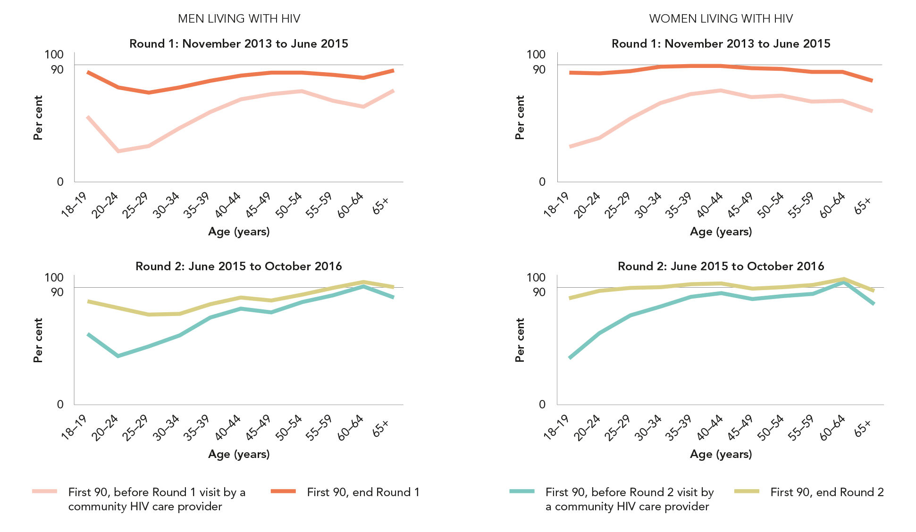
HPTN 071 (POPART) TRIAL: REACHING THE FIRST 90
KNOWLEDGE OF HIV STATUS BEFORE AND AFTER COMMUNITY-BASED SERVICES
Knowledge of HIV status and antiretroviral therapy coverage, by age and sex, HPTN 071 (PopART) trial communities before and after two rounds of service delivery, Zambia, 2013-2016. (first of 2 slides)
Source: Hayes R, Floyd S, Schaap A, Shanaube K, Bock P, Sabapathy K et al. A universal testing and treatment intervention to improve HIV control: one-year results from intervention communities in Zambia in the HPTN 071 (PopART) cluster-randomised trial. PLoS Med.
2017;15(5):e1002292. Hayes R, Floyd S, Schaap A, Shanaube K, Bock P, Griffith S et al. Reaching 90–90–90? Findings after two years of HPTN 071 (PopART ) intervention in Zambia. Conference on Retroviruses and Opportunistic Infections (CROI), 13–16 February 2017,
Seattle. Poster Number 1011.

Slide 46
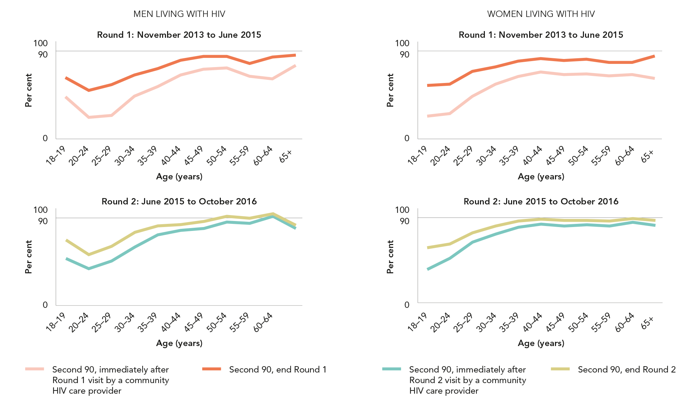
HPTN 071 (POPART) TRIAL: REACHING THE SECOND 90
ANTIRETROVIRAL THERAPY COVERAGE BEFORE AND AFTER COMMUNITY-BASED SERVICES
Knowledge of HIV status and antiretroviral therapy coverage, by age and sex, HPTN 071 (PopART) trial communities before and after two rounds of service delivery, Zambia, 2013-2016 (last of 2 slides)
Source: Hayes R, Floyd S, Schaap A, Shanaube K, Bock P, Sabapathy K et al. A universal testing and treatment intervention to improve HIV control: one-year results from intervention communities in Zambia in the HPTN 071 (PopART) cluster-randomised trial. PLoS Med.
2017;15(5):e1002292. Hayes R, Floyd S, Schaap A, Shanaube K, Bock P, Griffith S et al. Reaching 90–90–90? Findings after two years of HPTN 071 (PopART ) intervention in Zambia. Conference on Retroviruses and Opportunistic Infections (CROI), 13–16 February 2017,
Seattle. Poster Number 1011.

Slide 47
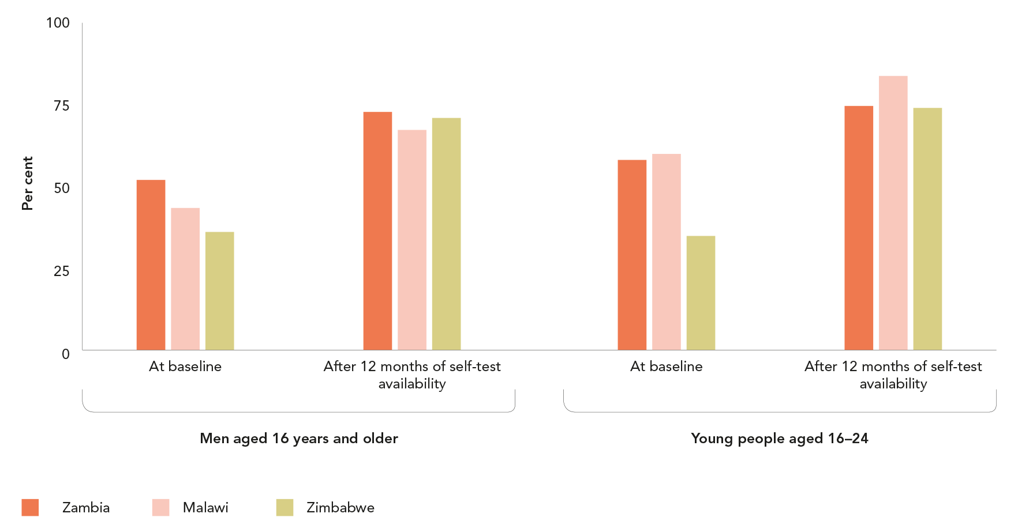
SELF-TESTING REACHING YOUNG PEOPLE AND MEN
Testing coverage, men (aged 16–65 years) and young people (aged 16–24 YEARS), baseline and after
12 months of self-test availability, STAR self-testing project, Malawi, Zambia and Zimbabwe, 2016–2017
Source: STAR project, 2017.

Slide 48
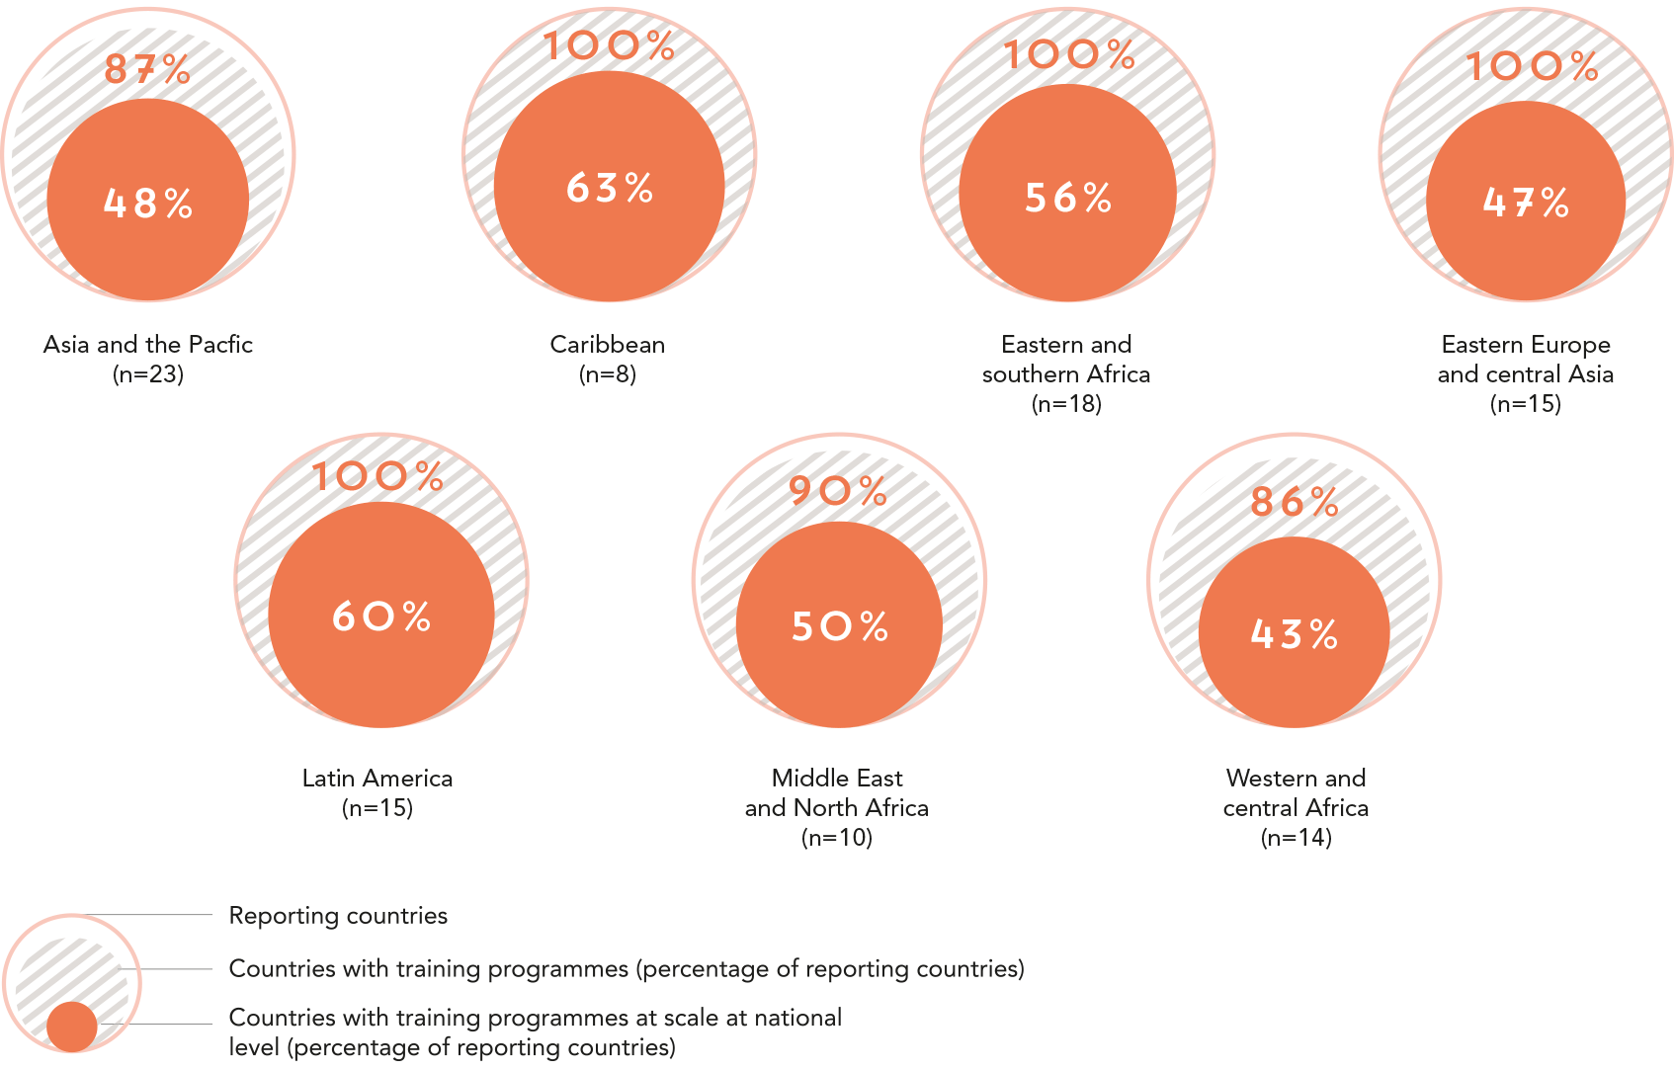
TRAINING FOR STIGMA AND DISCRIMINATION REDUCTION (first of 2 slides)
Percentage of countries with training programmes for health-care workers on human rights and non-discrimination legal frameworks as applicable to HIV, by region, 2016
Source: 2017 National Commitments and Policy Instrument.

Slide 49
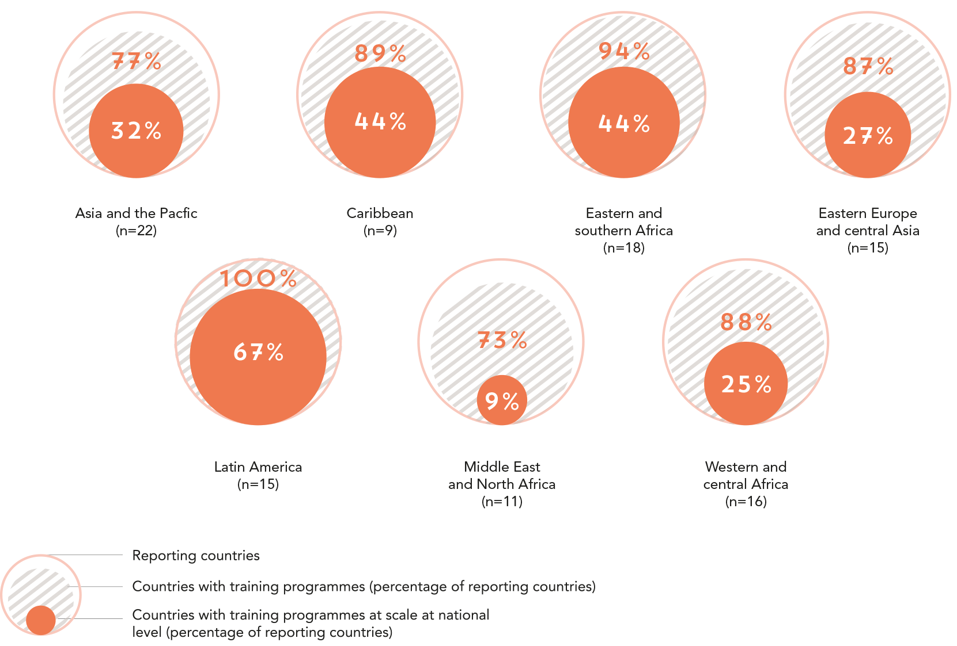
TRAINING FOR STIGMA AND DISCRIMINATION REDUCTION (last of 2 slides)
Percentage of countries that have HAD training and/or capacity-building on HIV-related rights for people living with HIV and key populationS IN THE PAST TWO YEARS, by region, 2016
Source: 2017 National Commitments and Policy Instrument.

Slide 50


Slide 51
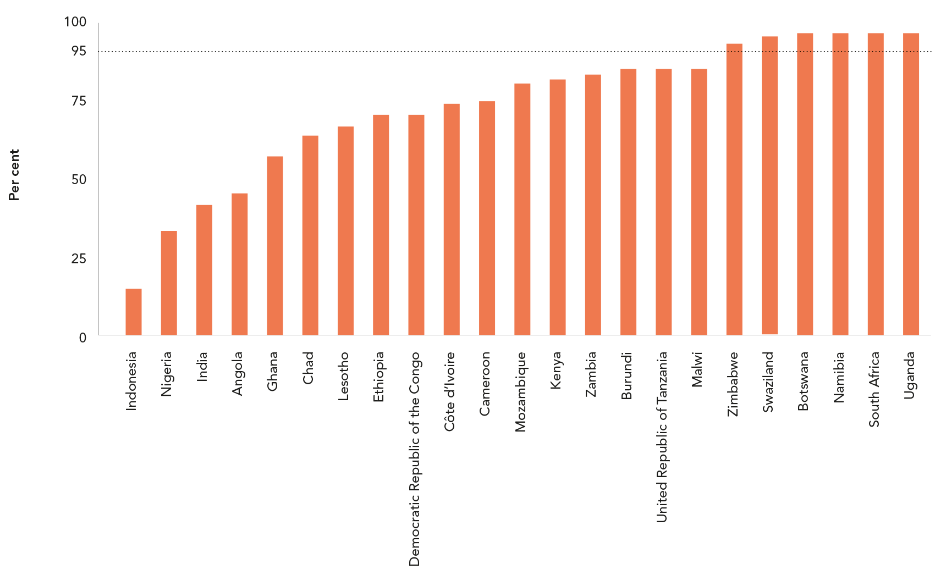
REACHING A MILESTONE TOWARDS ELIMINATION OF MOTHER-TO-CHILD TRANSMISSION
Percentage of pregnant women living with HIV receiving antiretroviral medicineS*
to prevent mother-to-child transmission, 23 priority countrieS**, 2016
Source: UNAIDS 2017 estimates.
* Either prophylaxis or lifelong therapy.
** Start Free Stay Free AIDS Free priority countries.

Slide 52
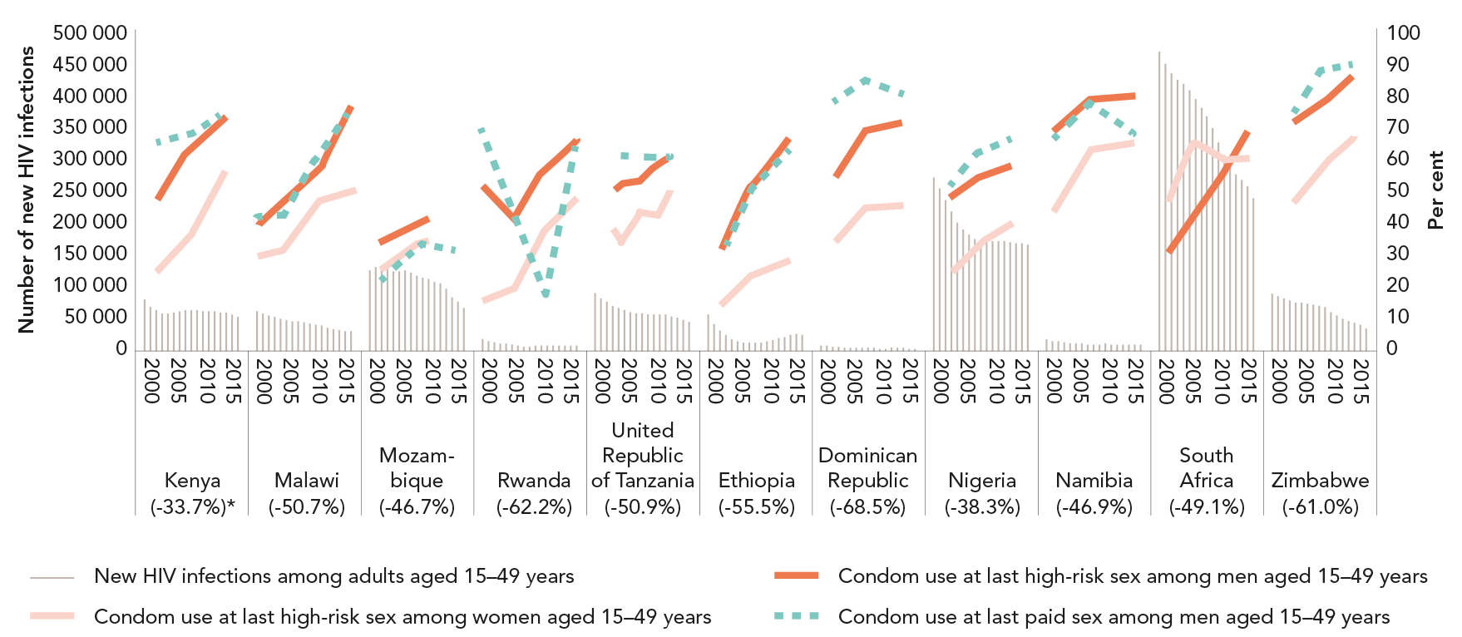
INCREASES IN CONDOM USE COINCIDE WITH DECLINES
IN NEW HIV INFECTIONS
Condom use at last high-risk sex and new HIV infections, adults (aged 15–49 years),
11 countries, 2000–2016
Source: UNAIDS 2017 estimates. Population-based surveys, 2000–2016.
* Percent decrease in new infections between 2000 and 2016.

Slide 53
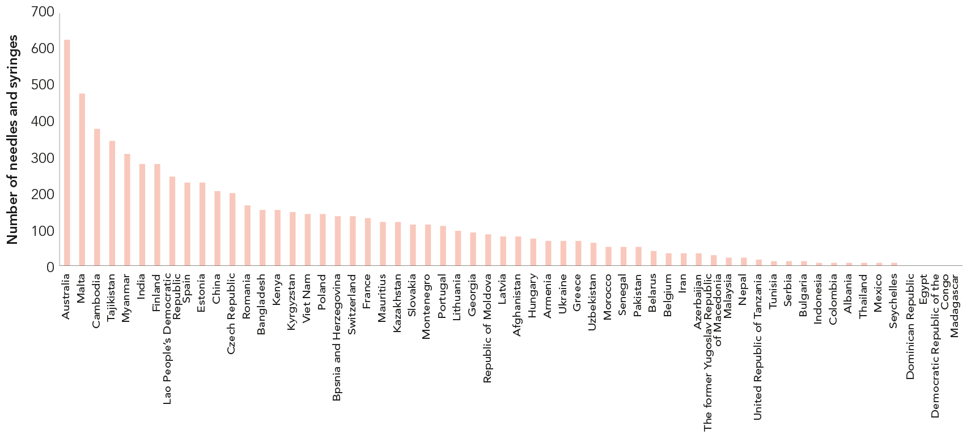
INSUFFICIENT DISTRIBUTION OF A CRITICAL AND COST-EFFECTIVE PREVENTION TOOL
Number of sterile needles and syringes distributed per person who injects drugs, by country, 2014–2016.
Source: Global AIDS Monitoring, 2015–2017.
*Most recently available data from 2014 to 2016.

Slide 54

AVAILABILITY OF PREP STILL LIMITED
Availability of pre-exposure prophylaxis, by country, 2017
Source: 2017 National Commitments and Policy Instrument.
* See text for further explanation.
** A framework for PrEP scale-up includes clinical guidelines; service provider training; access-oriented PrEP services; use of generic PrEP, price subsidy or reimbursement;
effective demand creation.

Slide 55

VOLUNTARY MEDICAL MALE CIRCUMCISION NEEDS A BOOST
IN KEY COUNTRIES
Prevalence of male circumcision (AGED 15–49), 14 priority countries, 2005–2015
Source: Population-based surveys, 2005–2015.

Slide 56

ENSURING YOUNG PEOPLE HAVE THE KNOWLEDGE THEY NEED
Countries with education policies that provide for life skills-based
HIV and sexuality education in schools and teacher training, 2016
Source: 2017 National Commitments and Policy Instrument.

Slide 57

LAWS ON DOMESTIC VIOLENCE
Percentage of countries with domestic violence legislation reporting that different forms
of violence are integrated in legislation, REPORTING COUNTRIES, 2016
Source: 2017 National Commitments and Policy Instrument.

Slide 58

KEEPING GIRLS IN SCHOOL
Countries where cash transfer programmes for young women
(aged 15–24 years) are being implemented, by region, 2016
Source: 2017 National Commitments and Policy Instrument.

Slide 59

GAINS IN THE GLOBAL RESPONSE TO TUBERCULOSIS AND HIV
Tuberculosis cases AND tuberculosis-related deaths among people living
with HIV, number of notified tuberculosis patients who were known to be living
with HIV, and number of tuberculosis patients living with HIV ON antiretroviral
therapy, global, 2005–2015
Source: Global tuberculosis report, 2016. Geneva: World Health Organization; 2016.

